Slide 1
American Revolution
End of War and Outcomes

Slide 2
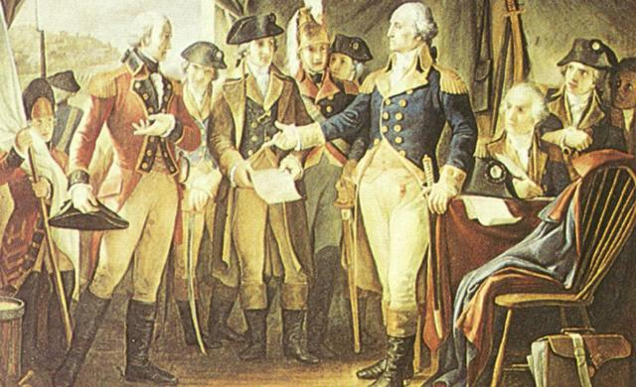
After the surrender at Yorktown, Cornwallis met with Washington.
Notes:
Picture by Richard Stein

Slide 3
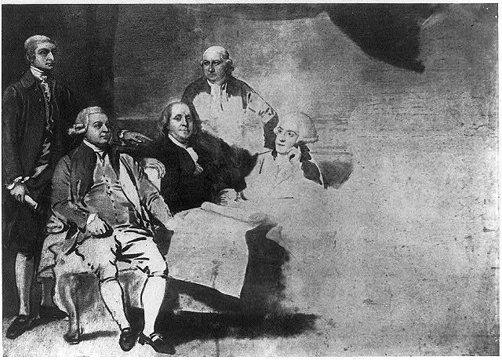
Signing of the Treaty of Paris (1783) American and British representatives met in Paris to sign the treaty that would officially recognize America as its own nation.

Slide 4
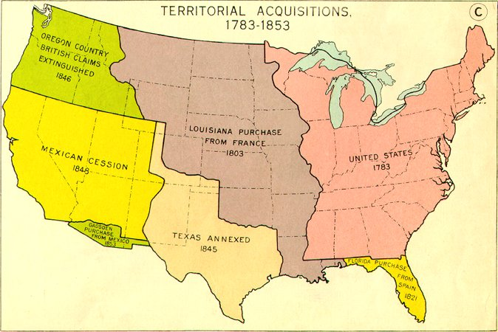
America after the Treaty of Paris in 1783

Slide 5
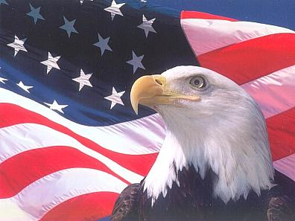
The United States of America was now its own nation and free from Britain.

Slide 6
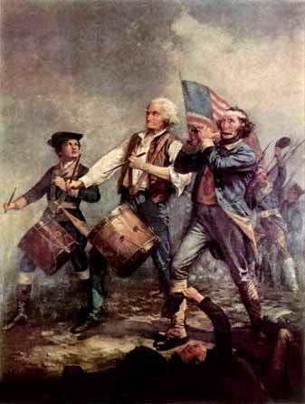
The Americans took the risks for freedom, faced many challenges, and achieved many successes on their way to becoming a free nation.
Notes:
Picture by Richard Stein

Slide 7
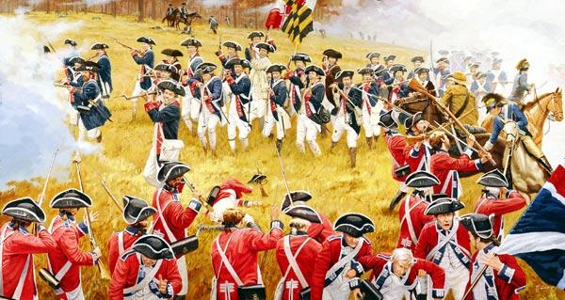
It seemed like the war would be a huge mismatch.
Continental Army
Lack of supplies, money, and weapons
Lack of trained soldiers
Lack of experience
Only 4 boats – no real Navy
Army not well organized
British Army
Plenty of money, weapons and supplies
Highly trained soldiers
Lots of experience
More than 250 naval ships
World’s most powerful army
VS
Notes:
The Granger Collection, New York

Slide 8
1) The colonists were defending their own land, principles and beliefs
Notes:
The Granger Collection, New York

Slide 9
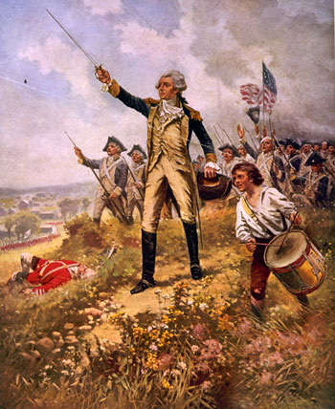
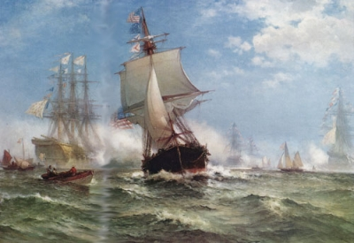
2) The colonists got Support from France and Spain
Notes:
SwampFoxFrancisMarion –French / Amon Carter Museum; Fort Worth, Texas

Slide 10
3) The Colonial Army had Strong Leadership
Notes:
Metropolitan Museum of Art

Slide 11
4) The Colonists were fighting on their own land, and were more familiar with it than the British troops were.
Notes:
Metropolitan Museum of Art

