Slide 1
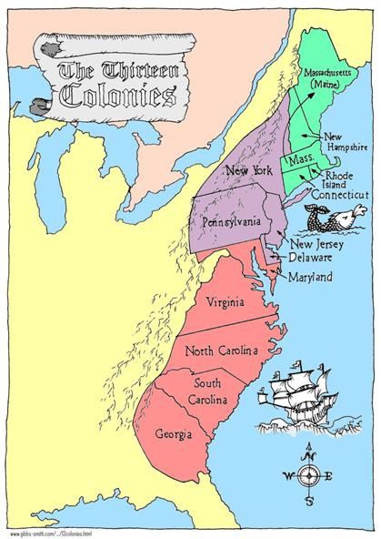
The Colonial Regions

Slide 2
New England Colonies
The New England Colonies were:
Massachusetts
Rhode Island
Connecticut
New Hampshire

Slide 3
New England Colonies
Settlers came primarily from England – many Puritans with very strict religious laws and strong work ethic.
Small towns grew up around larger port cities that were ideal for shipping goods and products in and out of the colonies.

Slide 4
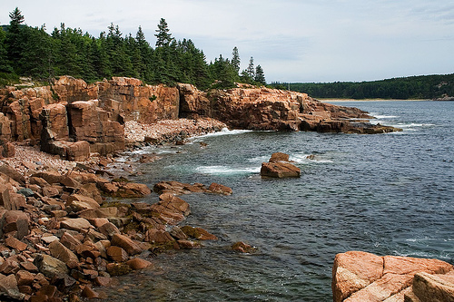
New England Colonies
Climate
Cold
Short growing season
Terrain
Rocky, hilly land, suitable only for small farms and family crops
Economy
Because farming was not ideal, settlers relied on fishing, whaling, and shipbuilding to provide for their families.

Slide 5
Middle Colonies
The Middle Colonies were:
New York
New Jersey
Delaware
Pennsylvania

Slide 6
Middle Colonies
Settlers of the Middle colonies were primarily English, but there was also a strong presence of Dutch, German, and Scots-Irish.
The colony was a combination of rural farm areas, small towns, and cities.

Slide 7
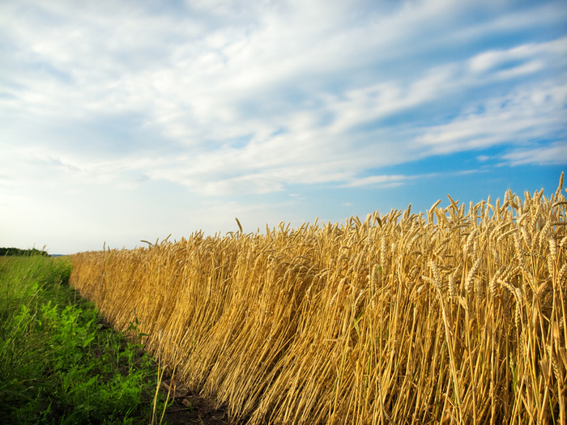
Middle Colonies
Climate
Temperate
Long growing seasons
Terrain
Rich soil and huge wheat fields
gave the middle colonies the nickname
“America’s breadbasket”
Economy
Farming, manufacturing, mining, and textiles

Slide 8
Southern Colonies
The Southern Colonies were:
Maryland
Virginia
North Carolina
South Carolina
Georgia

Slide 9
Southern Colonies
The Southern colonies were inhabited mostly by English, African, and Scots-Irish.
Few towns. Large plantations were common. Settlers grew tobacco, rice, cotton, sugar, and indigo.
Plantation owners purchased slaves to harvest crops. As the plantation system grew, slavery spread throughout the region.

Slide 10
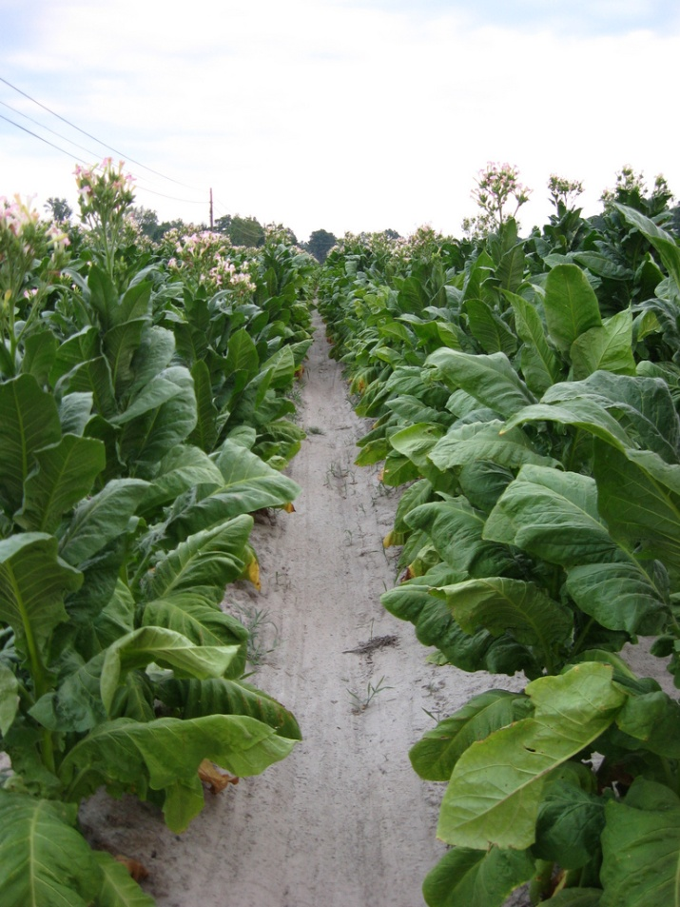
Southern Colonies
Climate
Hot and humid
Longer growing season
Terrain
Tidewater Region
Vast Coastal Plain areas
Economy
Farming, large plantations
Forest products (naval stores)

