Slide 1
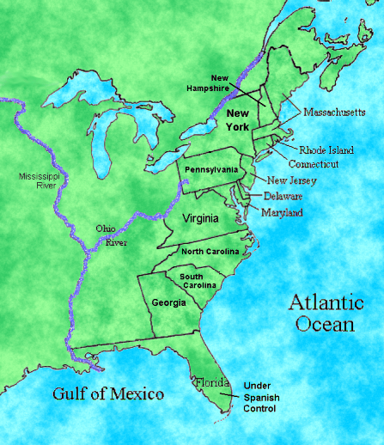
Where is
Roanoke Island?

Slide 2
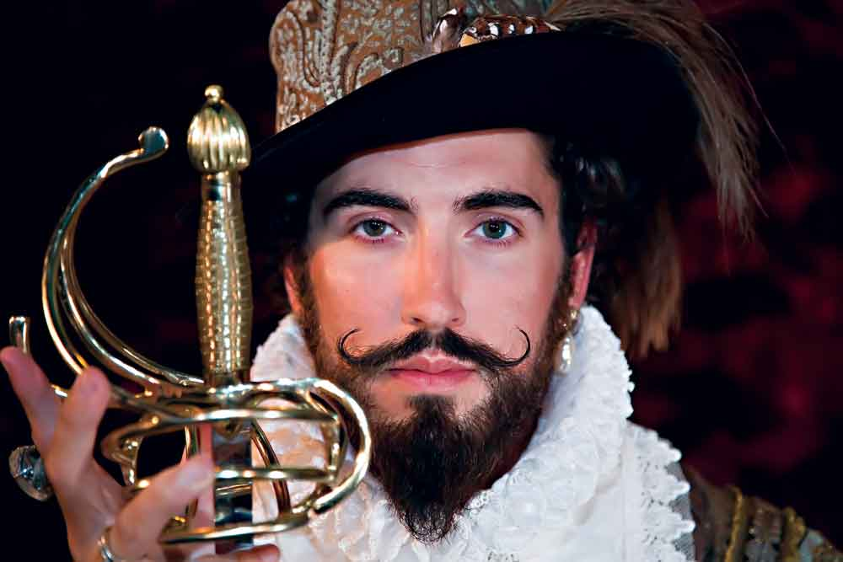
You are about to read the story of The Lost Colony. As you read our story, think about what lessons you can learn from our successes and our failures.

Slide 3
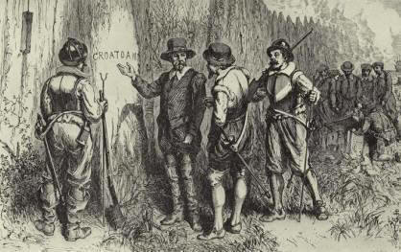
Story Time!! Read the article and complete the Reading Guide

Slide 4
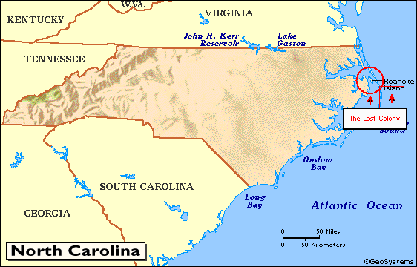

Slide 5
Group Discussion Questions
1) Pretend you are a detective – there are many theories as to what happened to the settlers at The Lost Colony on Roanoke Island. What do you think happened?

Slide 6
Group Discussion Questions
2) Now that you have heard the Roanoke Island story, what successes and failures did they experience that will help you if you were to start your own colony?

Slide 7
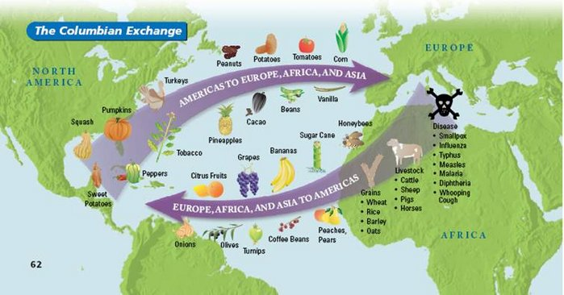
Columbian Exchange - Exchange of goods and ideas
Notes:
Albert Lorenz

