Slide 1
Washington, DC Memorials

Slide 2
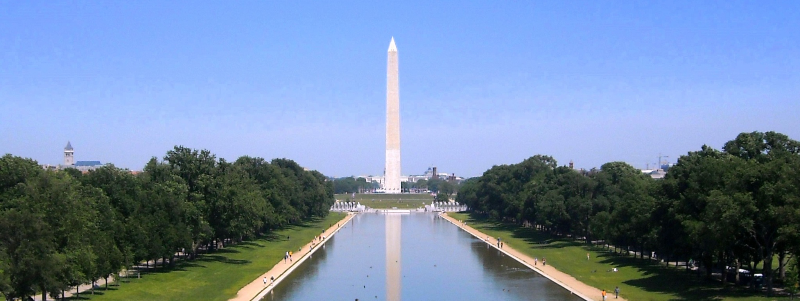
Washington Monument

Slide 3
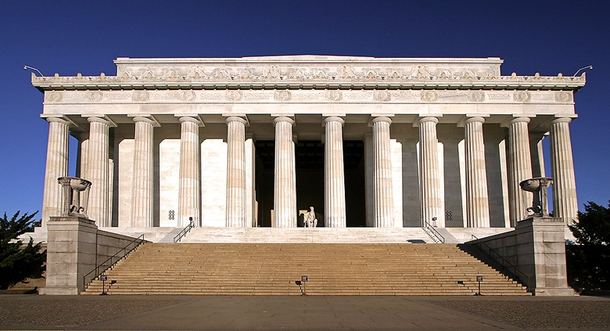
Lincoln Memorial

Slide 4
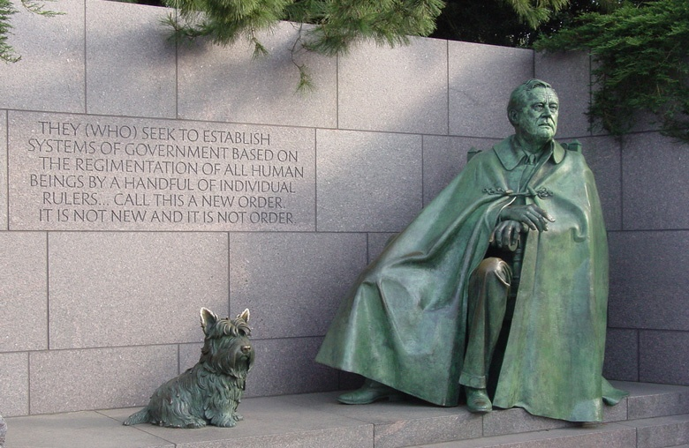
Roosevelt Memorial

Slide 5
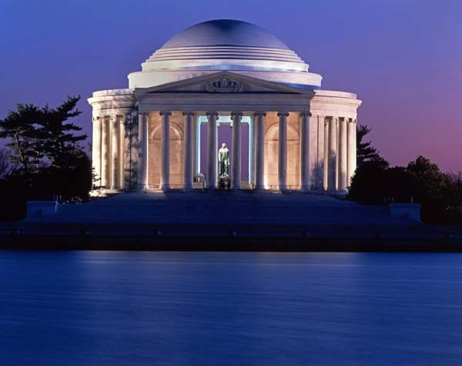
Jefferson Memorial

Slide 6
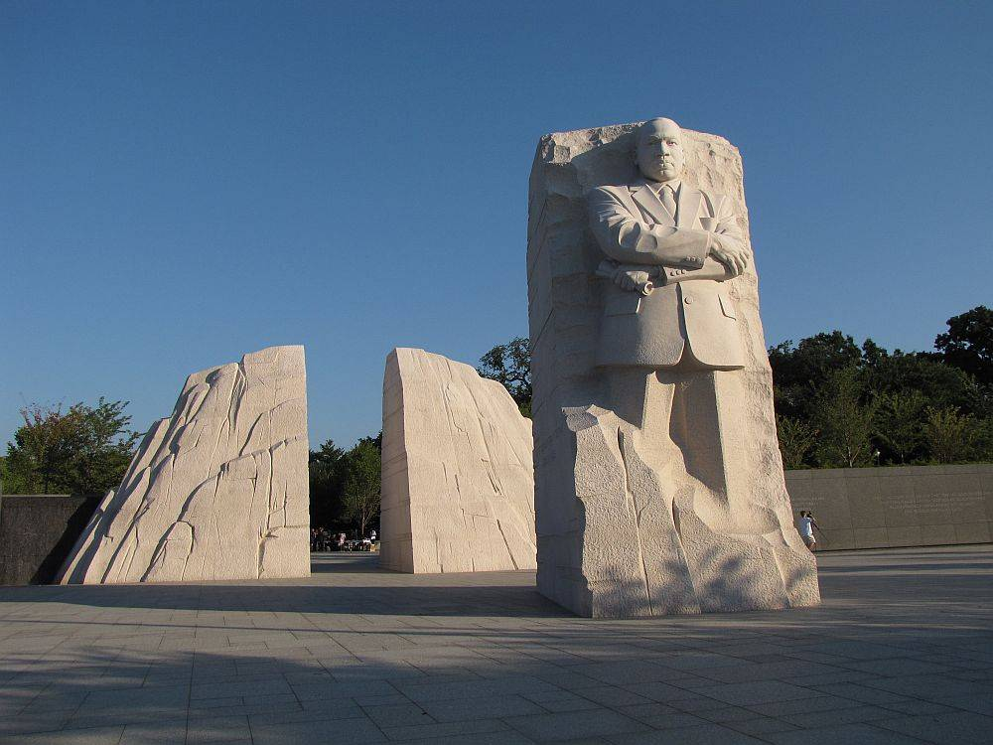
MLK, Jr Memorial

Slide 7
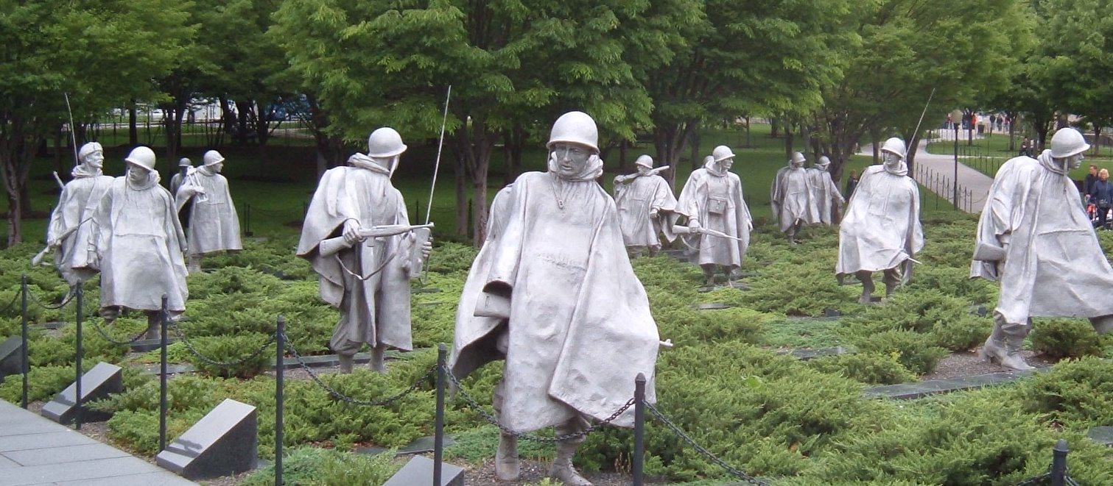
Korean War Memorial

Slide 8
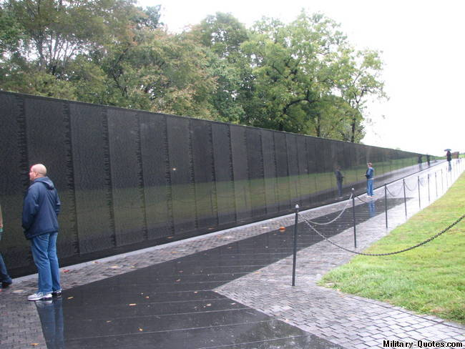
Vietnam War Memorial

Slide 9
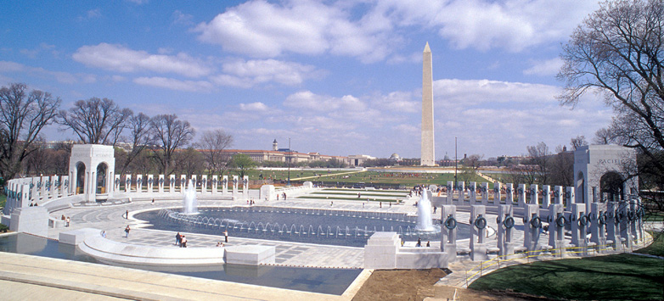
World War II Memorial

Slide 10
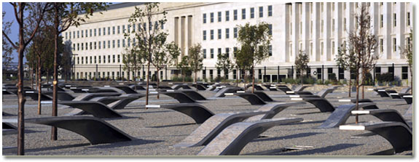
Pentagon 9/11 Memorial

