Slide 1
The American Civil War
The End of the War, Outcomes, and Reconstruction

Slide 2
Civil War Prisons
North and South routinely exchanged prisoners at start of war
Grant stopped exchanging when he heard the South killed several black military prisoners
War prisons on both sides quickly began overflowing; neither side had planned or prepared for how to care for prisoners

Slide 3
Civil War Prisons (con’t.)
Andersonville was particularly bad; 13,000 Union prisoners died in the 15 months that the prison operated
Andersonville is a national cemetery today
http://www.google.com/url?q=http://www.youtube.com/watch%3Fv%3D1edqOerpiC8&sa=U&ei=FuMST7uUJYXXtwegh-X-AQ&ved=0CCIQtwIwAA&usg=AFQjCNHzKMXnVzsiqXfwadThKlPFQCpeKQ

Slide 4
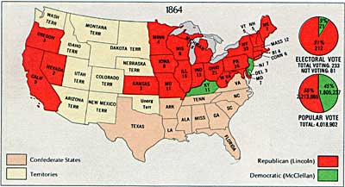
Election of 1864
1864: President Lincoln was re-elected
This destroyed any hope the South had that the North would give in and negotiate peace

Slide 5
The Fall of the Confederacy
Transportation problems and successful blockades caused severe shortages of food and supplies in the South
Starving soldiers began to desert Lee’s forces
Although President Jefferson Davis approved the arming of slaves as a means of augmenting the shrinking army, the measure was never put into effect.

Slide 6
Final Battles of the Civil War
Jan. 13, 1865: North captured final blockade-running port, Fort Fisher in NC
March 2: Lee’s men surrounded, hungry, in rags, and nearly out of supplies; Lee asked to meet with Grant
Jefferson Davis knew war was ending and fled Richmond to Danville, VA
April 9, 1865: Lee surrendered to Grant at Appomattox Courthouse, VA

Slide 7
Surrender!
Video:
http://www.civilwar.org/video/appomattox-the-surrender.html

Slide 8
The Assassination of Lincoln
April 14, 1865: John Wilkes Booth shot Lincoln at Ford’s Theatre; Lincoln died the next morning
Booth was cornered and shot two weeks later
John Wilkes Booth – an actor and a Confederacy supporter was a part of a larger plot to also kill Vice President Johnson and the Secretary of the State.
Booth probably did more harm to the South because Lincoln was going to “forgive and forget”
http://www.youtube.com/watch?v=6qAeFjCscRY&feature=related

Slide 9
A Look at the South After War
The South had sustained immense damage after the Civil War
Entire cities lay in ruins.
Many plantations and fields had been burned and homes had been gutted.
Train tracks were blown up and many bridges were destroyed.
Rivers were not navigable and needed to be dredged due to boats that had sunk in them.
What lands were left unburned hadn’t been cultivated for four years and were thus in shambles.
Thousands of people lacked the means to provide food, clothing, or shelter for themselves or their dependents

Slide 10
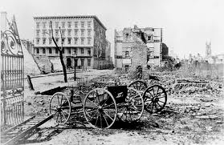
Destruction in the South

Slide 11
The Freedmen
Freedmen faced great hardships
Homeless, uneducated, had little more than the clothes on their backs
Many looking for food, shelter, and work
Others searching for family members or friends
Many were afraid they’d be re-enslaved
Most whites had difficulty accepting slaves as free persons or as equals

Slide 12
A Look at the North After War
Since the war had been fought almost entirely in the South, the North did not have the great task of rebuilding itself
Yet, the economy was struggling in the North as well
While the North’s economy had boomed during the war, bringing economic growth to both the factories and the farms, the war had been costly for the North

Slide 13
Now What?
Tensions between the North and South naturally lingered and there was no script for Reconstruction
In many ways, winning the war, by comparison, was easier than figuring out what to do about Reconstruction.
Reconstruction presented a massive logistical, political, Constitutional, and economical challenge that the country had never faced.

Slide 14
Reconstruction (1865-1877)
Reconstruction – period when the federal government struggled with how to return the South to the Union.
3 Issues of Reconstruction:
1. How will Southern states rejoin the Union?
2. How will the Southern economy be built?
3. What rights will African Americans have?

Slide 15
Presidential Reconstruction
Lincoln’s Plan:
Reunify the Union
Amnesty (a group pardon) to all Southerners except Confederate government leaders and top military officers.
Ten Percent Plan – as soon as 10% of the state’s prewar voters took an oath of loyalty to the Union, the state could then set up a new government
Once slavery was abolished and education for African Americans was offered, states could regain representation in Congress.
**Not everyone was very happy with Lincoln’s Plan…

Slide 16
Radical Republicans
Radical Republicans felt the South led the North into war and committed terrible crimes against African Americans.
Confederates MUST be punished for what they did!
Wade – Davis Bill (1864):
Rejected the 10% plan
MAJORITY of prewar voters had to swear loyalty before restoration
There also must be guarantees of African American equality
Notes:
Congressional Reconstruction!
In some cases, Radical Republicans wanted to confiscate land and give it to Freedmen.
Pocket vetoed – did not sign the bill; past the 10 day deadline of Congressional Session

Slide 17
Freedman’s Bureau
Provided food, healthcare and education for White AND Black refugees in the South
Helped to reunite families
Eventually established schools to teach freedmen to read and write
Continued until 1872

Slide 18
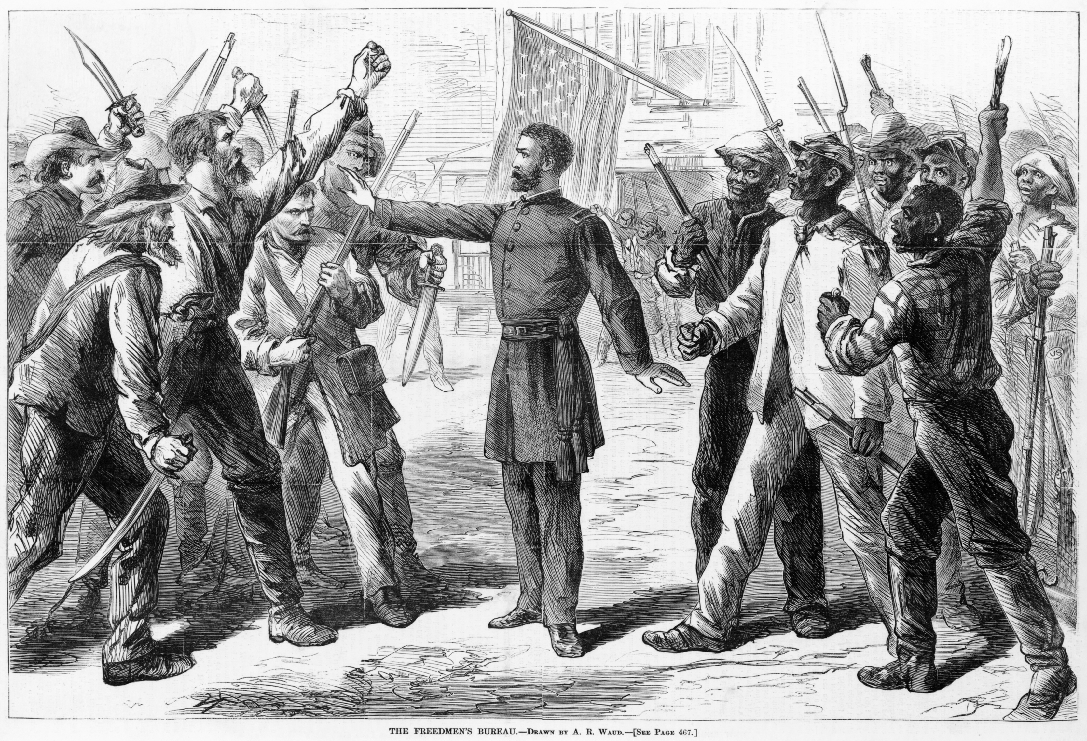
Freedman’s Bureau

Slide 19
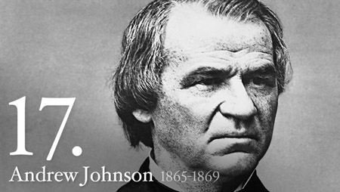
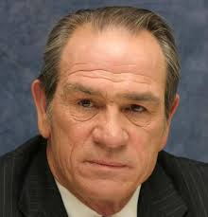
Andrew Johnson Becomes 17th President
Andrew Johnson, only a few months after taking office as Vice President, was thrust into Presidency after the assassination of Abe Lincoln.
Just as Lincoln had, Johnson wanted to reunify and restore the Union as quickly as possible.
BUT, that’s where the similarities end…
Notes:
Honorable and honest, but one of the most unfortunate presidents.
He was no match for the sometimes ruthless Radical Republicans in Congress.

Slide 20
Presidential Reconstruction
Johnson’s Plan:
Offered pardons to most, BUT, did not like wealthy planters and Confederate leaders, so he made them write to him personally for a pardon.
Required the ratification of the 13th amendment to be restored into the Union
Did NOT want African Americans to vote – little sympathy for their plight
Notes:
Now, you can imagine this led to VERY UNHAPPY Radical Republicans who were staunch supporters of equality for African Americans

Slide 21
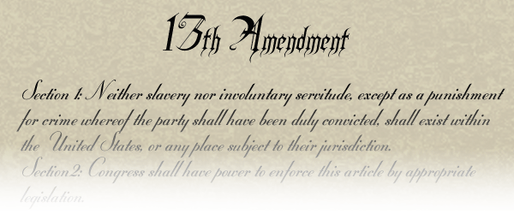
13th Amendment
“Neither slavery nor involuntary servitude, except as a punishment for crime whereof the party shall have been duly convicted, shall exist within the United States, or any place subject to their jurisdiction.”
This amendment, passed on January 31st, 1865 and ratified by the states in December 1865, formally abolished slavery in the United States.

Slide 22
Black Codes
With Johnson in office, Southern leaders were beginning to rebuild their prewar world
Instituted the Black Codes:
Limited the rights of African Americans
Kept them landless
Workers in occupations such as servants or farm laborers
**SLAVERY WITHOUT THE CHAINS**
Notes:
The introduction of “Black Codes” further infuriated the Radical Republicans

Slide 23
Congressional Reconstruction
Radical Republicans & Congress fight back – they do not see progress in the way African Americans are being treated (Black Codes)
Passed a bill to continue the work of the Freedman’s Bureau – Johnson vetoes!
Civil Rights Act of 1866: guarantees the civil rights of African Americans and superseded state laws that limited them.
Johnson vetoes this as well – defying Congress!
Congress passes this act over Johnson’s veto because of the increased violence in the South
Notes:
Radical Republicans fought back – ushered in this idea of Congressional Reconstruction

Slide 24
Military Reconstruction
Military Reconstruction Act of 1867:
Divided the Southern states into 5 military districts governed by former Union Generals
Each state was required to ratify the 14th amendment and develop a new government & constitution to receive Congressional recognition.
Notes:
Radical Reconstruction Era

Slide 26
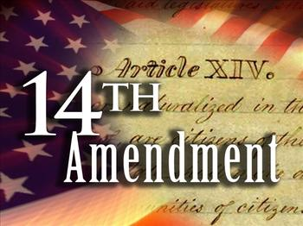
14th amendment
Ratified on July 9th, 1868
Granted citizenship to “all persons born or naturalized in the United States” and it forbade states from denying any person “life, liberty or property, without due process of law.”

Slide 27
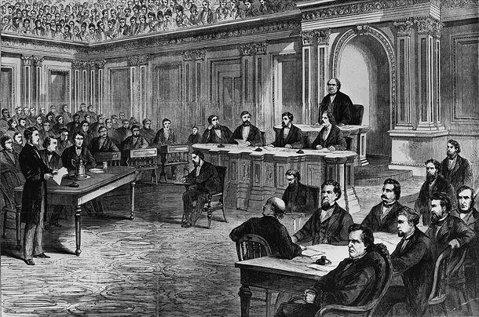
IMPEACH!
House = IMPEACH JOHNSON!
Radical Republicans failed to remove Johnson from office by ONE vote!
Notes:
Wanted to remove Stanton because he was one of the last remaining radical republicans in his cabinet!

Slide 28
Scalawags & CarpetBaggers
These individuals began to take part of Southern politics
Scalawags – White men who had been locked out of pre-Civil War politics by their wealthier neighbors. The new Republican party had invited them in to join their party.
Friends or allies of Scalawags were known as Carpetbaggers.
Carpetbaggers – White or Black men who relocated to the South that were seeking to improve their economic or political situations and/or to help make life better for freedmen.
Notes:
Called carpetbaggers because they were named after their inexpensive carpet cloth suitcases

Slide 29
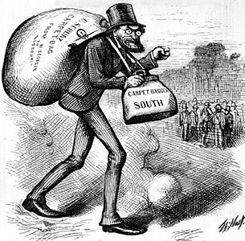
Notes:
We’re now seeing new people with new opportunities, well now we need to make some changes to the economy…

Slide 30
Building up the economy
Sharecroppers – individuals get a place to live in which the landowner dictates the crops & provides the tools to tend to the crops. **The sharecropper is in debt to the owner and can never progress/get ahead**
Tenant Farmers – tenant paid rent to the landowner and had a great deal of freedom
Notes:
We had many poor white and black individuals that needed to work. In addition, Southern land owners were not able to afford their land anymore and had trouble maintaining their land.

Slide 31
15th amendment
“[the] right of citizens of the United States to vote shall not be denied or abridged by the United States or by any state on account of race, color, or previous condition of servitude.”
Ratified on February 3rd, 1870 (although not fully recognized until 1965!)
Gave African American men the right to vote

Slide 32
End of Reconstruction
Northern support for Reconstruction started to wane
Supreme Court decisions were impeding the fight for African American equality
Southern whites were starting to gain power
Subtle strategies for suppressing blacks were starting to develop
Union troops were removed from the South and the last southern state (Georgia) was readmitted to the Union in 1870.
Southern state and former slaves were left to “figure it out” on their own.
Notes:
The end of Reconstruction is official by the Election of 1876 with the election of Hayes

