Slide 1
The End of WWI and the Treaty of Versailles

Slide 2
WWI Ends
World War I (1914-1918) was finally over!
This first global conflict had claimed from 9 million to 13 million lives and caused unprecedented damage.
Germany had formally surrendered on November 11, 1918
All nations agreed to stop fighting while the terms of peace were negotiated.
The cease-fire began on the 11th hour of the 11th day of the 11th month. To recognize the end of the war, we used to celebrate Armistice Day on Nov. 11. Today we call it…?

Slide 3
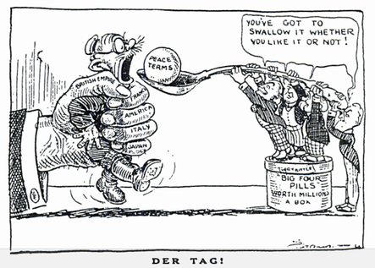
Treaty of Versailles

Slide 4
Treaty of Versailles
The details of the Versailles Treaty had been debated and finalized at the Paris Peace Conference, which opened on January 18, 1919 - just over two months after the fighting on the Western Front ended.
Although many diplomats from the Allied Powers participated, Germany was not invited to the conference.

Slide 5
Treaty of Versailles
The "big three" who were the most influential in the debates were:
President Woodrow Wilson of the United States.
Prime Minister Georges Clemenceau of France
Prime Minister David Lloyd George of Great Britain

Slide 6
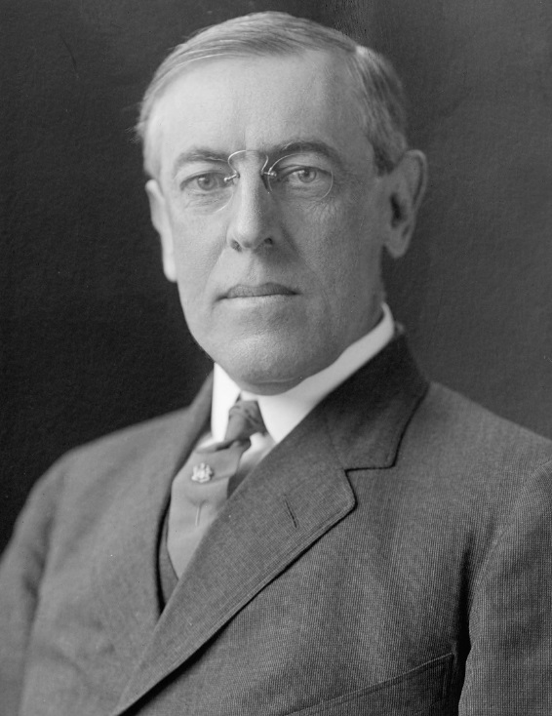
United States & Woodrow Wilson
Goal: Prevent future European conflicts
Created “14 Points” plan outlining goals for world peace
establish League of Nations
German disarmament and loss of conquered land

Slide 7
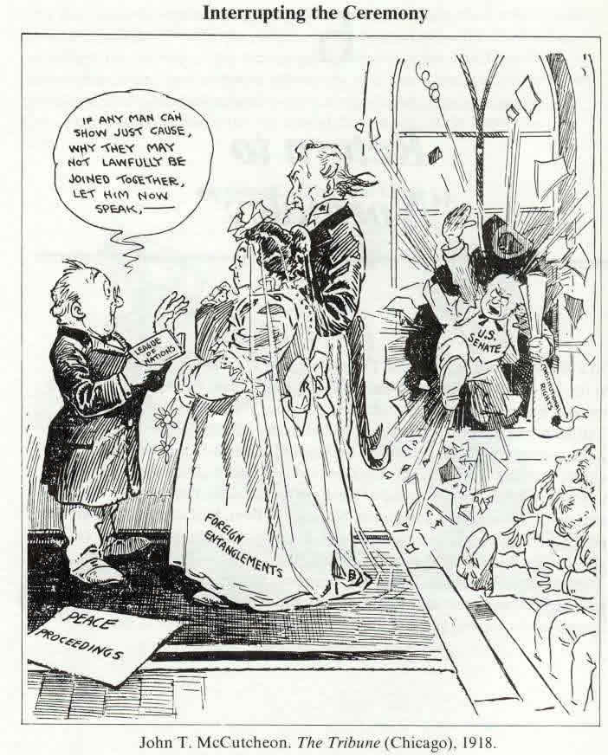
US Senate rejects Treaty of Versailles
7 votes short of 2/3 approval required
Opposed to League of Nations – didn’t want to be a part of “entangling alliances”
US signs separate peace treaty with Germany

Slide 8
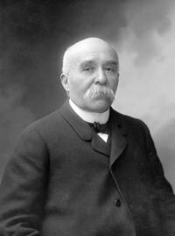
France – Georges Clemenceau
Goal: Revenge
Weaken Germany
so it can no longer
threaten France

Slide 9
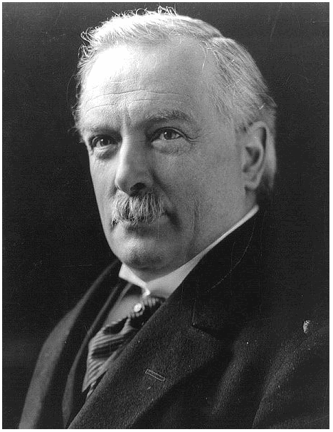
Great Britain – David Lloyd George
Goal: Moderation
Punish Germany but not too much to avoid extremism
Divide German colonies among Great Britain and France

Slide 10
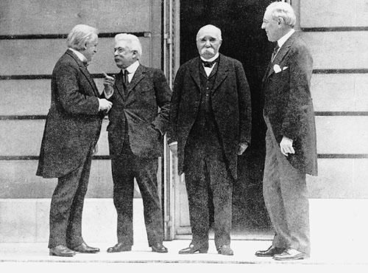

Slide 11
The Treaty of Versailles
On May 7, 1919, the Versailles Treaty was handed over to Germany with the instructions that they had only three weeks to accept the Treaty.
Considering that in many ways the Versailles Treaty was meant to punish Germany, Germany of course found much fault with the Treaty.
Although Germany sent back a list of complaints over the Treaty, the Allied Powers ignored most of them.

Slide 12
The Treaty of Versailles
The Versailles Treaty itself is a very long and extensive document, made up of 440 Articles (plus Annexes) which have been divided into 15 parts.
The first part of the Versailles Treaty established the League of Nations.
Other parts included the terms of military limitations, prisoners of war, finances, access to ports and waterways, and reparations.

Slide 13
Treaty of Versailles
The most controversial aspects of the Versailles Treaty were:
that Germany was to take full responsibility for the damage caused during World War I (known as the "war guilt" clause, Article 231)
the major land concessions forced upon Germany (including the loss of all her colonies)
the limitation of the German army to 100,000 men
the extremely large sum in reparations Germany was to pay to the Allied Powers.

Slide 14
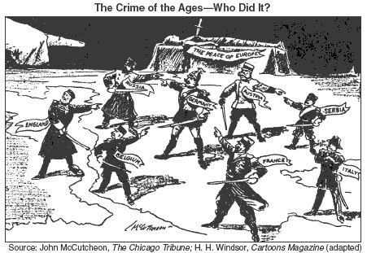
Blame: Germany “war guilt clause”

Slide 15
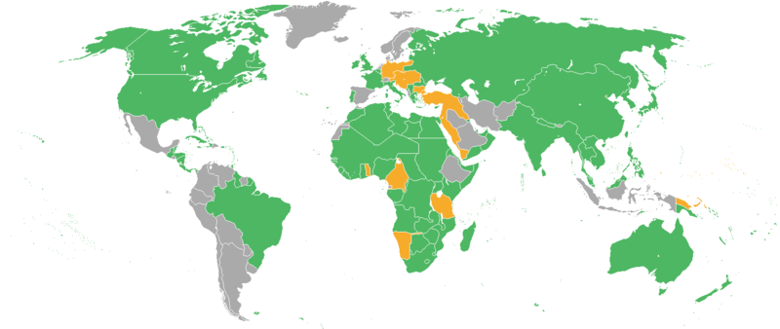
Colonies
Allies (France and Britain received most)
split German colonies and Ottoman territory (in Africa and Middle East)

Slide 16
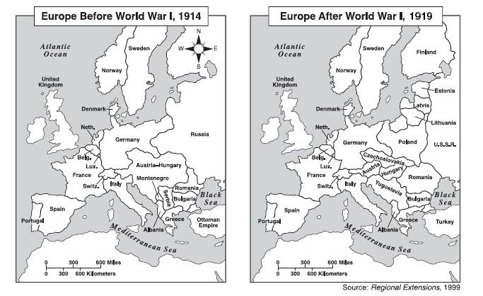

Slide 17
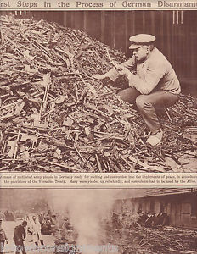
German military
Reduced to:
100,000 men
36 ships
No draft, tanks, submarines, or aircraft
Disarmament of most weapons

Slide 18
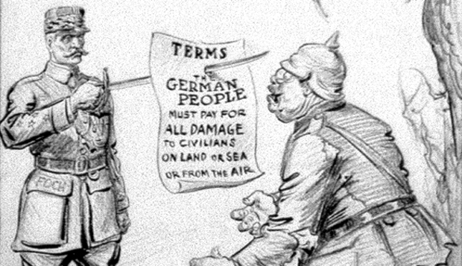
Cost of the war
Germany pays 6.6 million pounds in reparations
(about $400 billion today!)

Slide 19
Germany’s Reaction to the Treaty
In Germany, the treaty provoked universal outrage, particularly Article 231.
Germans took to the streets in protest.
Unwilling to sign it, the nation's first democratically-elected chancellor, Philipp Scheidemann, resigned on June 20
Lacking any other options, the treaty was signed on June 28, 1919.

Slide 20
The Stab-in-the-Back
As the postwar Germany moved forward, resentment over the end of the war and the Treaty of Versailles continued to fester.
Thus began the "stab-in-the back" legend
stated that Germany's defeat was not the fault of the military
but rather due to a lack of support at home from anti-war politicians and the sabotaging of the war effort by Jews, Socialists, and Bolsheviks.
As such, these parties were seen to have stabbed the military in the back as it fought the Allies.

Slide 21
WWI Leads to WWII?
Resonating among conservatives, nationalists, and former-military, the stab-in-the-back concept became a powerful motivating force and was embraced by the emerging National Socialist Party (Nazis).
This resentment, coupled with the economic collapse of Germany facilitated the rise of the Nazis to power under Adolf Hitler.
As such, the Treaty of Versailles may be seen as leading to many of the causes of World War II in Europe.
http://www.history.com/topics/world-war-i/treaty-of-versailles

