Slide 1
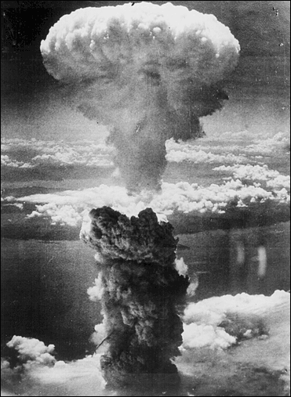
The End of WWII

Slide 2
Winning WWII
The Allies, made up of 26 nations including America, decided to crush Germany, then Italy and Japan.
On June 6, 1944, the Allies launched a massive invasion on Nazi occupied Europe, known as D-Day.
US General Eisenhower landed on the beach of Normandy, France with over 130,000 allied soldiers.
From there, allies pushed on to Paris and then set their sights on Berlin to the east.

Slide 3
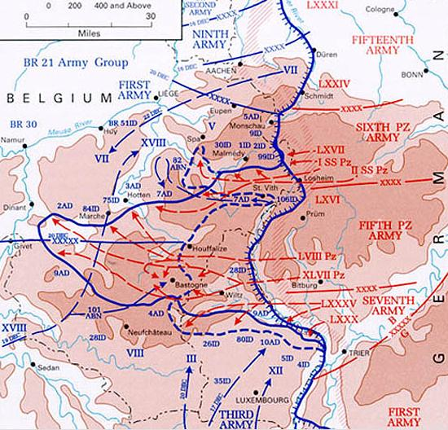
The Battle of the Bulge
Dec 1944 - Jan 1945
As the allies moved toward Germany, they were halted in Belgium and the Nazis created a dent in the allied lines.
However, the allies recovered and continued on toward Hitler.
This was the last major offensive by the Germans.
Battle of the Bulge

Slide 4
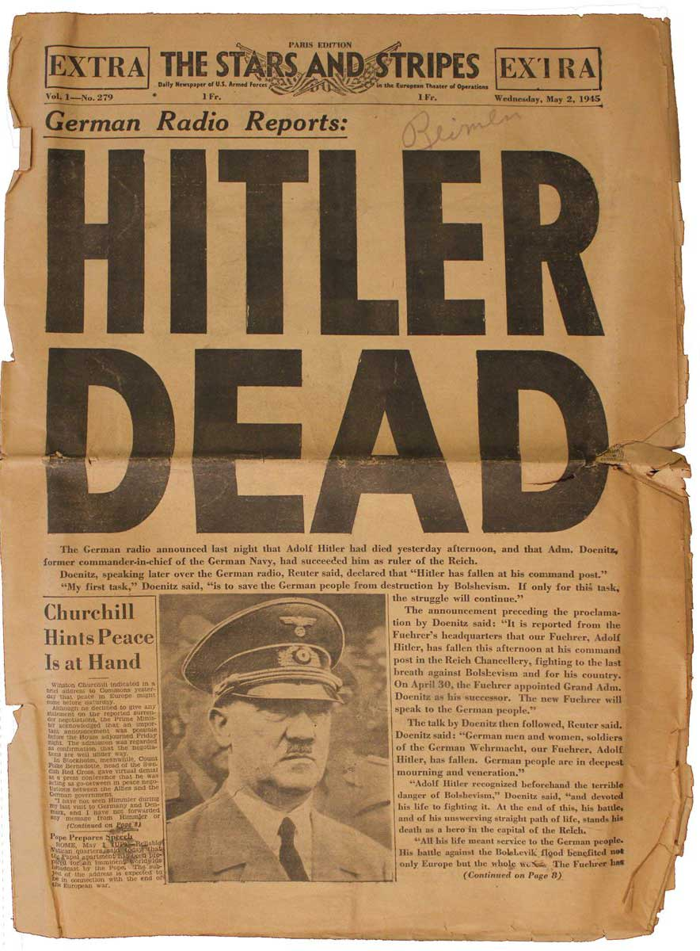
With allies closing in from both the east (Soviets) and west (British/ Americans), Hitler committed suicide on April 30, 1945 in his underground bunker.

Slide 5
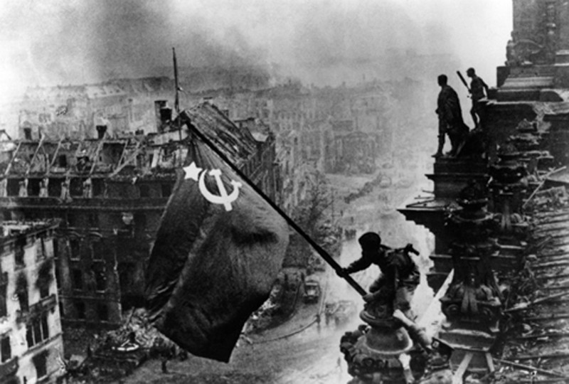
Soviets Take Berlin
The Soviets were the first to reach Berlin and flew their flag from the top of the Reichstag.
Notes:
Reichstag = Parliament

Slide 6
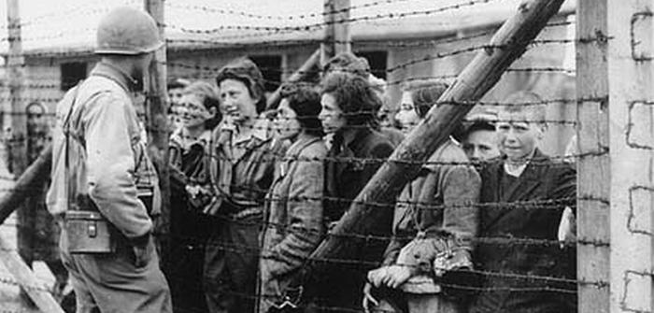
Concentration Camps
Allied soldiers discovered evidence of the Holocaust and liberated concentration camps.

Slide 7
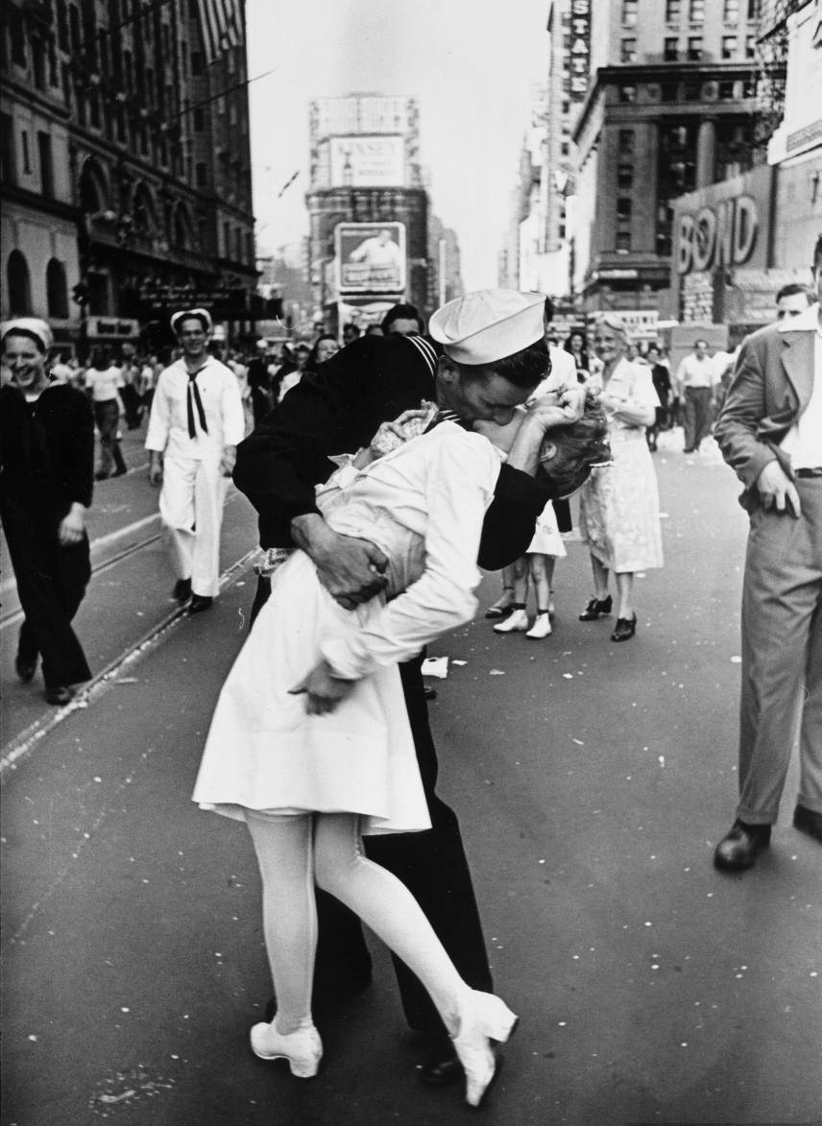
V-E Day (May 8, 1945)
The Allies celebrate the end of the war in Europe.

Slide 8
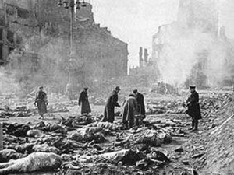
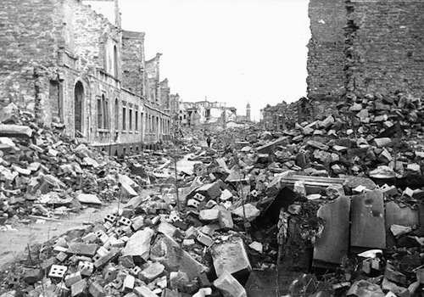
Summer 1945
Although the war against Germany was won, most of Europe was in ruins. Thus, it was up to the United States to defeat Japan, who refused to surrender.

Slide 9
President Harry Truman (who took over when Roosevelt died on April 12th1945) faced a difficult decision…
Should the United States fight on with Japan in the Pacific? OR Should Truman order the atomic bomb to be dropped on Japan?

Slide 10
A Decision is Made
On August 6, 1945, the United States used its massive, secret weapon against Hiroshima, Japan.
This atomic bomb, equivalent to 20,000 tons of TNT, flattened the city, killing tens of thousands of civilians.

Slide 11
August 6th, 1945
Colonel Paul W. Tibbets, Jr., pilot of the
ENOLA GAY,
the plane that dropped the atomic bomb on Hiroshima, waves from his cockpit before the takeoff.

Slide 12
Hiroshima, Japan
"The mushroom cloud itself was a spectacular sight, a bubbling mass of purple-gray smoke and you could see it had a red core in it and everything was burning inside. . . . [I]t looked like lava or molasses covering a whole city. . . ." The cloud is estimated to have reached a height of 40,000 feet.
- Staff Sergeant George Caron, tail gunner

Slide 13
Hiroshima, Japan
Captain Robert Lewis, the co-pilot, stated,
"Where we had seen a clear city two minutes before, we could no longer see the city. We could see smoke and fires creeping up the sides of the mountains.“
Two-thirds of Hiroshima was destroyed.
Within three miles of the explosion, 60,000 of the 90,000 buildings were demolished.
Clay roof tiles had melted together. Shadows had imprinted on buildings and other hard surfaces. Metal and stone had melted.

Slide 14
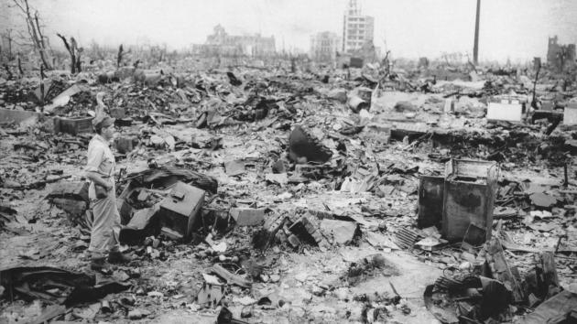
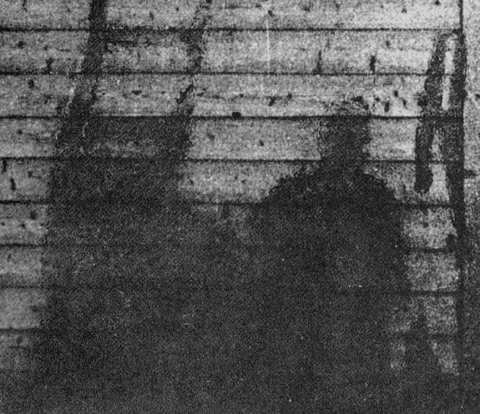

Slide 15
Hiroshima, Japan
The atomic bomb that exploded over Hiroshima killed civilian women and children in addition to soldiers.
Hiroshima's population has been estimated at 350,000; approximately 70,000 died immediately from the explosion and another 70,000 died from radiation within five years.
“The appearance of people was . . . well, they all had skin blackened by burns. . . . They had no hair because their hair was burned, and at a glance you couldn't tell whether you were looking at them from in front or in back. . .their skin - not only on their hands, but on their faces and bodies too - hung down. . . . If there had been only one or two such people . . . perhaps I would not have had such a strong impression. But wherever I walked I met these people. . . . Many of them died along the road - I can still picture them in my mind - like walking ghosts.”

Slide 16
Nagasaki
While Japan was still trying to comprehend this devastation, three days later, the United States struck again, this time, on Nagasaki.
A dense column of smoke rises more than 60,000 feet into the air over the Japanese port of Nagasaki, the result of an atomic bomb, the second ever used in warfare, dropped on the industrial center August 9, 1945, from a U.S. B-29 Superfortress.
With a population of 270,000, approximately 70,000 people died by the end of the year.

Slide 17
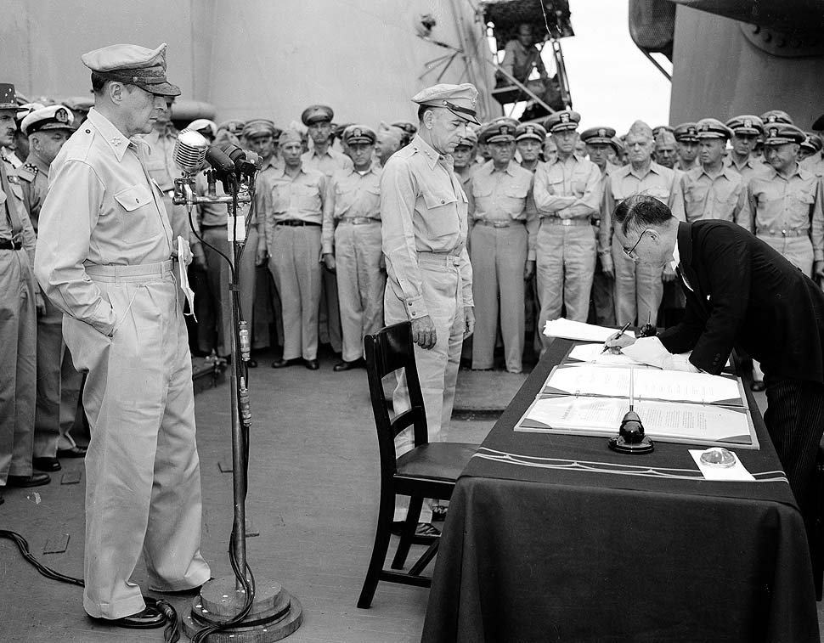
A Final Surrender
On August 14, 1945, Japan finally agreed to surrender. This brought an end to 6 years of fighting and devastation across the globe.
http://www.history.com/topics/world-war-ii/world-war-ii-history/videos/atomic-bomb-ends-wwII (Atomic bombs ends WWII)

Slide 18
Remembering History:
Each year on August 6th the City of Hiroshima holds the Peace Memorial Ceremony. People from across the world gather at the memorial and pray for the repose of the A-bomb fallen victims while calling out to the entire world for peace.
What lessons can we learn from this history?

Slide 19
“If we do not die together in war, we must live together in peace.” ~President Truman

Slide 20
Sources
http://www.city.hiroshima.jp/shimin/shimin/shikiten/shikiten-e.html
http://history1900s.about.com/od/worldwarii/a/hiroshima.htm
http://en.wikipedia.org
http://www.mbe.doe.gov/me70/manhattan/hiroshima.htm

