Slide 1
England’s First Successful Colonies

Slide 2
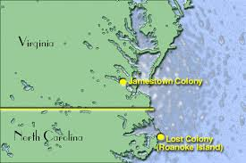
Jamestown
Date/Location: 1607 at the James River in Virginia
Established/Founded By: Virginia Company of London (a Joint-Stock Company)
Reasons for Settlement: Money & Opportunity

Slide 3
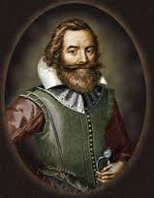
Jamestown
Leaders/Key People:
John Smith
Pocahontas
Powhatan
Obstacles to Settlement:
Starvation
Leadership
Disease
Laziness
Conflict (with Natives & each other)
Type of Government Established:
House of Burgesses – elected officials, first legislature in America

Slide 4
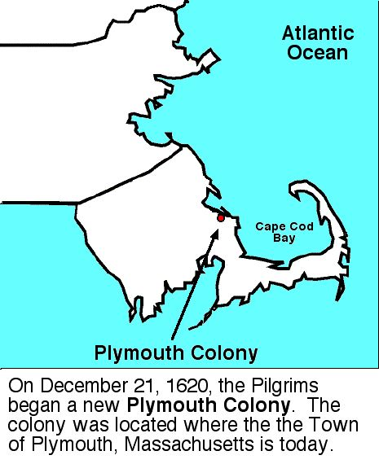
Plymouth
Date/Location: 1620; Cape Cod, Massachusetts
Established/Founded By: Separatists from England (Pilgrims)
Reasons for Settlement: Religion

Slide 5
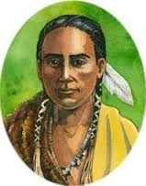
Plymouth
Leaders/Key People:
William Bradford
Squanto
Obstacles to Settlement:
Starvation
Disease
Weather
Type of Government Established:
Mayflower Compact – colonists claimed the right to govern themselves

Slide 6
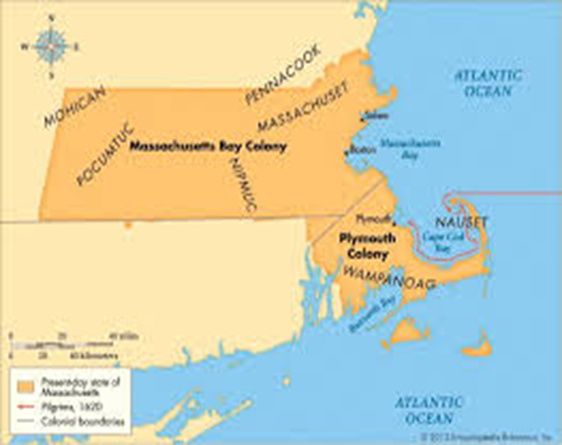
Massachusetts Bay
Date/Location: 1630 in Boston Massachusetts
Established/Founded By: Very wealthy Puritans from England (Massachusetts Bay Company)
Reasons for Settlement: Religion

Slide 7
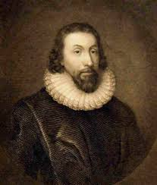
Massachusetts Bay
Leaders/Key People:
John Winthrop
Obstacles to Settlement:
Disease
Lack of clean water
Puritans were NOT tolerant of other religions
Type of Government Established:
General Court = elected assembly from each town

