Slide 1
THE GREAT DEPRESSION
CAUSES OF
THE GREAT DEPRESSION

Slide 2
Overproduction
created
lower prices
High tariffs
discouraged
trade
Too much
debt/buying
on the margin
The Great
Depression
Little governmental
intervention

Slide 3
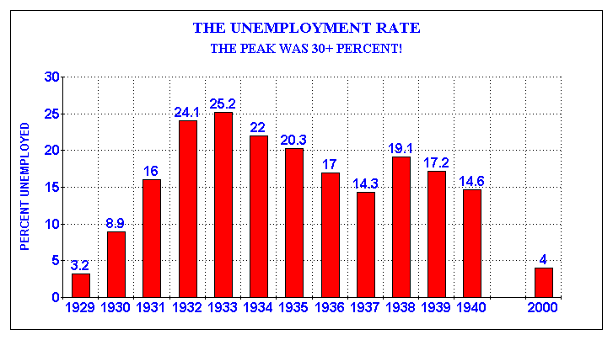

Slide 4
OVERPRODUCTION OF GOODS
Farmers and manufacturers overproduced goods which increased the supply.
Increased supply, drove prices down.
When prices were down, profits went down.
When profits went down, farmers & manufacturers started to fire workers.
Many farms/businesses went bankrupt.

Slide 5
In 1925, corn had sold at $1.07 per bushel.
By the end of 1932, corn was selling for only 13-cents per bushel.
Most homes were heated, and food cooked, by coal. But by 1932, corn was actually cheaper than coal. So, farmers began burning their harvest rather than selling it.

Slide 6
Farmers &
manufacturers
overproduce
goods
Overproduction
increases
supply
An increase in
supply,
decreases
price
Decreasing
prices,
decreases
profit
Decreasing
profit,
requires
increasing
unemployment

Slide 7
STOCKS WERE OVERVALUED
Speculation is investing in risky deals and often borrowing money to do it.
“Rags to riches” stories encouraged many Americans to speculate and try their luck at the stock market.
Since so many were investing, demand for stocks went up. So did the price of stocks (Often as demand goes up, so does the price).
Eventually, just before October, 1929, most stocks were selling for much more than they were worth.

Slide 8
Too much debt and “buying on the margin”
Many farmers were in debt and could not pay it off during the 1920’s.
Many Americans went into debt to buy cars, stoves, sewing machines, etc.
Many investors went into debt and bought stocks “on the margin,” putting 10% down, and promising to pay the 90% later.

Slide 9
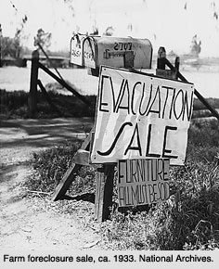
When hard times hit, debts could not be paid off.

Slide 10
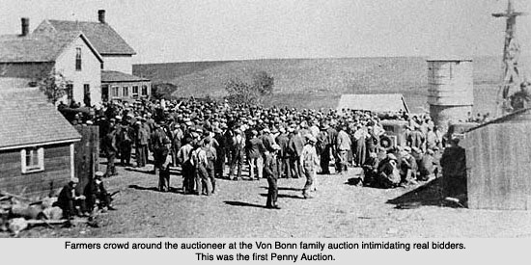

Slide 11
$.10 FARM SALE
When a farmer could no longer pay his bills, the bank seized the assets (house, barns, tractors, cows, horses, etc.) and sold them at auction
Neighboring farmers and the auctioneer, joined together against the bank, in defense of the indebted farmer
At the auction, farmers would gather and bid $.10 for items and no more. The auctioneer would yell, “SOLD!” and the buyer would pay $.10
At the end of the auction, the buyers would give the items, back to the farmer. This way he kept his farm.

Slide 12
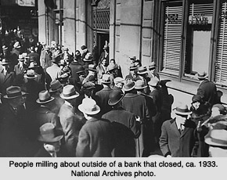
When debts weren’t paid, creditors (banks, brokers, stores) also suffered.

Slide 13
Little/no governmental regulation of banks
Banks loaned out too much money
Borrowers could not repay loans
“Runs on the bank,” where everyone panicked and rushed to get their money out.
Banks had to close

Slide 14
HIGH TARIFFS (TAXES) DISCOURAGED TRADE
US government increased tariffs on foreign imports, hoping to increase the sales of domestic goods (Smoot-Hawley Act).
When the US increased tariffs on foreign goods, foreign countries increased their tariffs on American goods.
Overall result? Trade decreased. This was not good for American or European business.

Slide 15
THE DUST BOWL
Great Plains states suffered through years of drought, which turned farmland into desert.
Many farmers lost their homes and moved to California, in search of jobs.
Became known by the derogatory term of “Okies” and “Arkies”
http://www.history.com/topics/dust-bowl

Slide 16
Plains states suffered through years of drought, which turned farmland . . .

Slide 17
into desert.

Slide 19
More than just crops were affected

Slide 21
PRESIDENT HERBERT HOOVER (1929 – 1933)
Practiced the economic theory of “laissez-faire” = “hands off”; gov’t should not be involved in economic affairs
He did try to introduce some public works, where the gov’t hired people for jobs (building roads, schools, dams, bridges, etc.), but it was “too little, too late.”
Many Americans blamed Hoover for not doing anything. Having Hoovervilles, Hoover flags, Hoover blankets named after him was NOT a compliment.

Slide 23
BONUS ARMY 1932
20,000 World War I veterans marched on Washington DC
Demanded a “bonus” promised to them in 1924 by the gov’t for their service in WWI, but not payable until 1945
Senate and Hoover denied their request for early payment

Slide 26
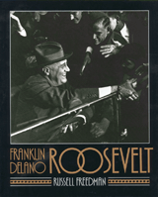
PRESIDENT FRANKLIN DELANO ROOSEVELT
Elected in 1932, defeating incumbent President Herbert Hoover
Elected 4 times, the most of any American President (obviously before the 22nd Amendment, ratified in 1951)
Handicapped with polio
Led America through the Great Depression and most of World War II
http://www.history.com/topics/great-depression/videos

Slide 27
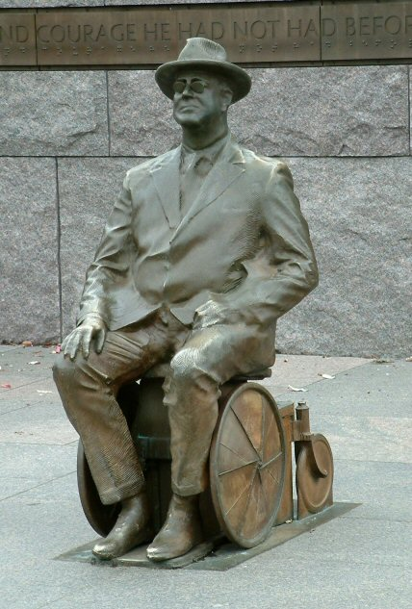

Slide 30
“Fireside Chats” on the radio

Slide 31
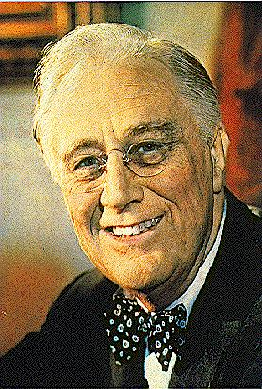
In 1932, in his acceptance speech for the Democratic Presidential nomination Franklin Delano Roosevelt said:
"I pledge you, I pledge
myself, to a new deal
for the American people . . .
it is a call to arms.
Give me your help,
not to win votes alone,
but to win in this crusade
to restore America to its own people."

Slide 32
President Franklin Delano Roosevelt
100 Days
Radio
Fireside Chats
New Deal
“Bank holiday”
Americans believed
FDR “felt their pain.”
“Relief, Recovery, Reform”
Closed, then opened
banks, with regulations
Government paid Americans
to work
IT WORKED, but it introduced
America to “deficit spending”

Slide 33
FDR’s New Deal
FERA
TVA
WPA
CCC
REA
AAA
FDR’S
NEW DEAL
FHA
NRA
SEC
PWA
SSA
FDIC

Slide 34
NEW DEAL PROGRAMS STILL WITH US TODAY
FHA (Federal Housing Administration) – gov’t housing loans, at a reduced interest rate
SEC (Securities and Exchange Commission)– regulates the stock market
SSA (Social Security Administration) – provides money for the elderly, unemployed, disabled
FDIC (Federal Deposit Insurance Corporation) – guarantees that your money in the bank is safe

Slide 35
LASTING RESULTS OF THE NEW DEAL
Americans still benefit from some New Deal programs
It extended the power of the President
It introduced “deficit spending,” where the government is in debt to fund its programs. It spends more than it collects in taxes.
Continued the Progressive Era idea that the government should take care of its citizens.

Slide 36
FUN FACTS ABOUT THE 1930’S
Not everyone loved FDR. An assassin’s bullet missed him and hit the mayor of Chicago instead (1933)
Movies cost $.25 and provided an escape from the Depression
Cigarette smoking increased with no awareness of cancer.
Sweatshops employed 15 year olds for $2.78/week
There was no Novocain, no penicillin, no antibiotics. OUCH!
Divorce decreased. It was too expensive to break up.

