Slide 1
Indian Removal

Slide 2
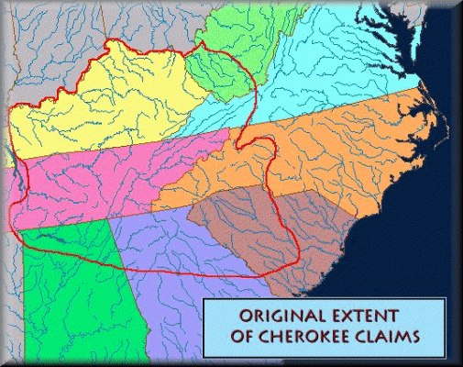

Slide 4
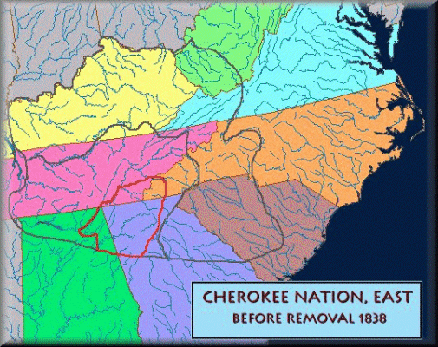

Slide 5
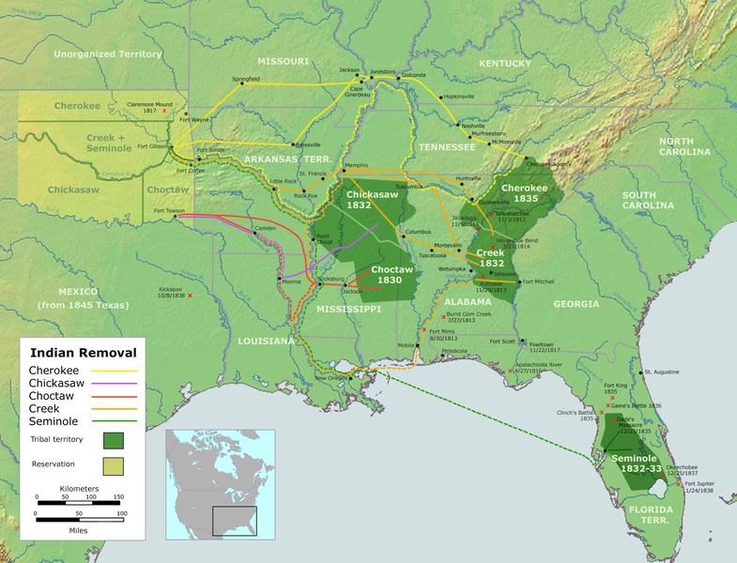

Slide 6
Timeline
1785 First treaty between Cherokee and United States, established peaceful
relations.
1796 George Washington initiated “civilization” program among Cherokees.
1802 Georgia ceded some of its western land to the United States; the U.S.
government, in exchange, promised to purchase for Georgia all of the
Indian lands remaining within the state. However, the Federal Government could only buy land through treaty.

Slide 7
Timeline
1808-1810-First major Cherokee migration to land west of the Mississippi.
1820s Cherokees became the most “civilized” of the five “Civilized Tribes”
(Creeks, Chikasaw, Seminole, Choctaw and Cherokee).
The Cherokee had a newspaper and many had converted to Christianity; they adopted a Constitution; they had farms and owned
slaves.

Slide 8
Timeline
1828 Andrew Jackson elected President and declares his support for removal.
1828 Georgia extended its state power over Cherokee Nation and nullified
(makes illegal) Cherokee law.
1832 Cherokee won their case in Worcester v. Georgia. U.S. Supreme Court
upheld Cherokee sovereignty in Georgia.
Andrew Jackson ignored the ruling.

Slide 9
Timeline
1836 Treaty of New Echota signed; provided for removal of Cherokees to land west of the Mississippi.
Chief John Ross led 15,000 in protesting the treaty.
Only 2,000 Cherokee agreed to migrate voluntarily.

Slide 10
Timeline
1838 U.S. government sent in 7,000 troops, who forced the Cherokees out at
bayonet point. 4,000 Cherokee people died of cold, hunger, and disease on their way to the western lands.
1839 Execution of Major Ridge, John Ridge, and Elias Boudinot for their role
in the Treaty of New Echota.

