Slide 1
Unit 7 The Turn of the Century
Part 1: Industrialization

Slide 2
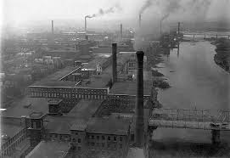
Industrial Revolution
a time of great and rapid changes, when people switched from making goods by hand to manufacturing goods with power-driven machines

Slide 3
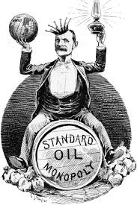
monopoly
the complete control of an industry by one person or company

Slide 4
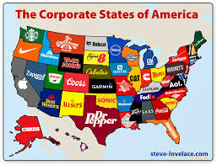
corporation
a business owned by many people

Slide 5
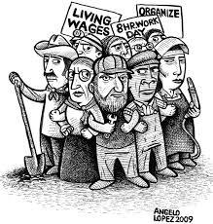
labor union
an organization of workers that tries to help its members receive higher wages and have better working conditions

Slide 6
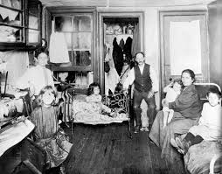
tenement
an apartment house in which living conditions are poor

Slide 7
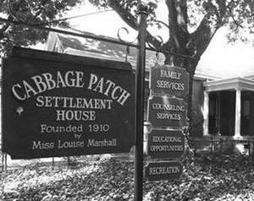
settlement house
a community center established to help immigrants

Slide 8
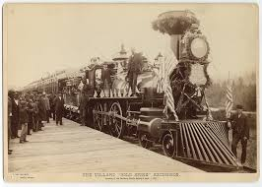
Transcontinental Railroad
a railroad that connects the Atlantic and Pacific coasts of the country

Slide 9
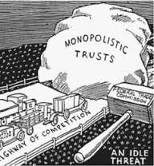
Sherman Anti-Trust Act
a law prohibiting businesses from trying to limit or destroy competition (no monopolies)

Slide 10
assembly line
an arrangement of workers, machines, and equipment in which the product passes from operation to operation until completed
I Love Lucy Assembly Line

Slide 11
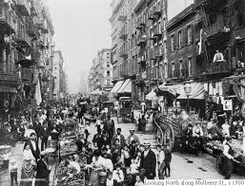
urbanization
the rapid growth of cities

Slide 12
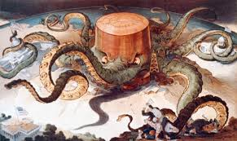
trust
a corporation that owns other businesses, often in an attempt to create a monopoly.

Slide 13
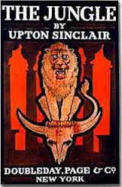
muckraker
crusading journalist

Slide 14
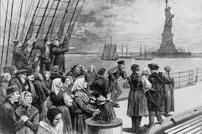
immigration
people moving into a country

Slide 15
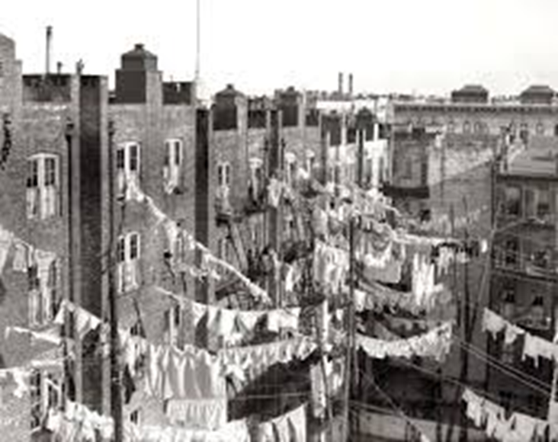
ghettos
part of a city in which members of a minority group live, especially because of social, legal, or economic pressure

