Slide 1
Industrialization:
Key People

Slide 2
Orville and Wilbur Wright
The Wright brothers invented and built the world’s first successful airplane.
Their first flight was on the beach at Kill Devil Hills, NC, on Dec. 17, 1903.
Their longest flight that day lasted about 59 seconds, and they traveled a distance of about 852 feet.
http://www.history.com/topics/inventions/wright-brothers/videos/wright-brothers-test-flight-1909

Slide 3
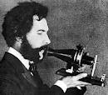
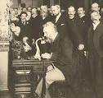
Alexander Graham Bell
With the help of his business partner, Thomas Watson, Alexander Graham Bell invented the telephone in 1876.
The Bell Telephone Company was founded in 1877, and by 1886, telephones were in more than 150,000 American homes.
Bell held a total of 18 patents in his name alone and 12 that were shared with collaborators.

Slide 4
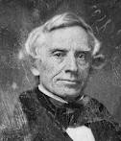
Samuel F. B. Morse
American inventor credited with the development of the telegraph and Morse code in 1844.
Interested in gadgetry and electromagnetism, Morse took out a patent for the telegraph.
In 1836, Morse had a working model, which he made improvements to after he learned about similar work done by American physicist, Joseph Henry.

Slide 5
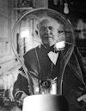
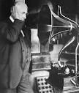
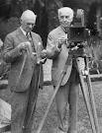
Thomas Edison
Inventor of many things including the phonograph , motion picture camera, electric light bulb, and electric power plant (became General Electric Corporation)
http://www.history.com/shows/modern-marvels/videos/light-bulb-turns-night-into-day#light-bulb-turns-night-into-day

Slide 6
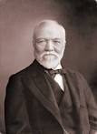
Andrew Carnegie
Founded Carnegie Steel Company which revolutionized steel production in the US with technology and methods that made manufacturing steel easier, faster, and more productive.
Became known as one of America’s “builders,” - his business helped fuel the economy and shape the nation into what it is today.
Carnegie sold his business in 1901 and became a philanthropist.
http://www.history.com/shows/america-the-story-of-us/videos/andrew-carnegie#andrew-carnegie

Slide 7
John D. Rockefeller
Founded the Standard Oil Company in 1870, and had a near-monopoly of the oil business by 1882 – making him the world’s richest man.
His business practices led to the passing of anti-monopoly laws including the Sherman Antitrust Act.
He retired from Standard Oil in 1895, and turned toward philanthropy – donating more than $530 million to various causes
http://www.history.com/topics/john-d-rockefeller/videos/rockefellers-standard-oil

Slide 8
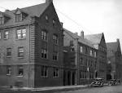
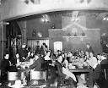
Jane Addams
Founder of Hull House, a settlement house in Chicago that served immigrants and poor.
Services at Hull House included child care, educational courses, an art gallery, a public kitchen, and several other social programs.
http://www.youtube.com/watch?v=5R6GajHiJyk

Slide 9
Samuel Gompers
Founded the American Federation of Labor
The most significant person in the history of the American labor movement (the effort of working people to improve their lives by forming organizations called unions).
The first national union leader to recognize and encourage the strike as labor’s most effective weapon.

Slide 10
Theodore Roosevelt
President during much of the Industrialization Era
Roosevelt coined the term muckrakers describing journalists who raked up muck – uncovering the dark side of society.
Roosevelt is known for his “Square Deal” program that supported reform of the American workplace, government regulation of industry, and consumer protection.
The Pure Food and Drug Administration (FDA) was formed during his presidency.

Slide 11
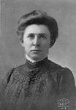
Ida Tarbell
An investigative reporter (muckraker) who examined the Rockefeller family’s oil monopoly and uncovered unfair business practices of the Standard Oil Company.
Her work contributed to the U.S. Supreme Court’s decision to break up the Standard Oil monopoly in 1911.

Slide 12
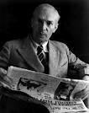
Upton Sinclair
A muckraker who wrote The Jungle and brought attention to the appalling working conditions in the meat packing industry
Led to the creation of new federal food safety laws and organizations.
The Meat Inspection Act
The Pure Food and Drug Act
The Food and Drug Administration (FDA)
http://www.youtube.com/watch?v=M1aZbqjBF7A

Slide 13
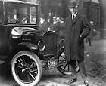
Henry Ford
Founder of the Ford Motor Company. Revolutionized manufacturing worldwide with his creation of the moving assembly line and interchangeable parts
Paid factory workers $5/day – more than twice the amount paid to the average factory worker, and he cut their work day from 9 hours to 8.
http://www.history.com/shows/america-the-story-of-us/videos/henry-ford-and-the-model-t#henry-ford-and-the-model-t

