Slide 1
Key People of the American Revolution

Slide 2
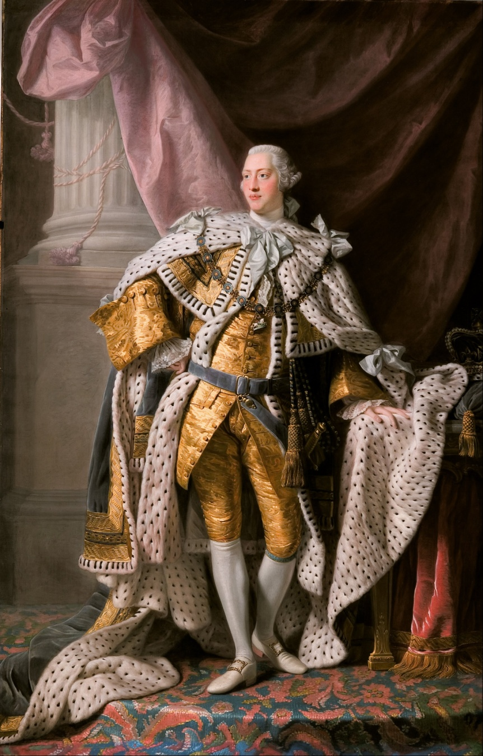
King George III
King of Great Britain during the Revolution
Policy of taxing the colonies in exchange for protection led to Revolution
Rejected American colonists’ requests for treatment as subjects equal to those in Britain

Slide 3
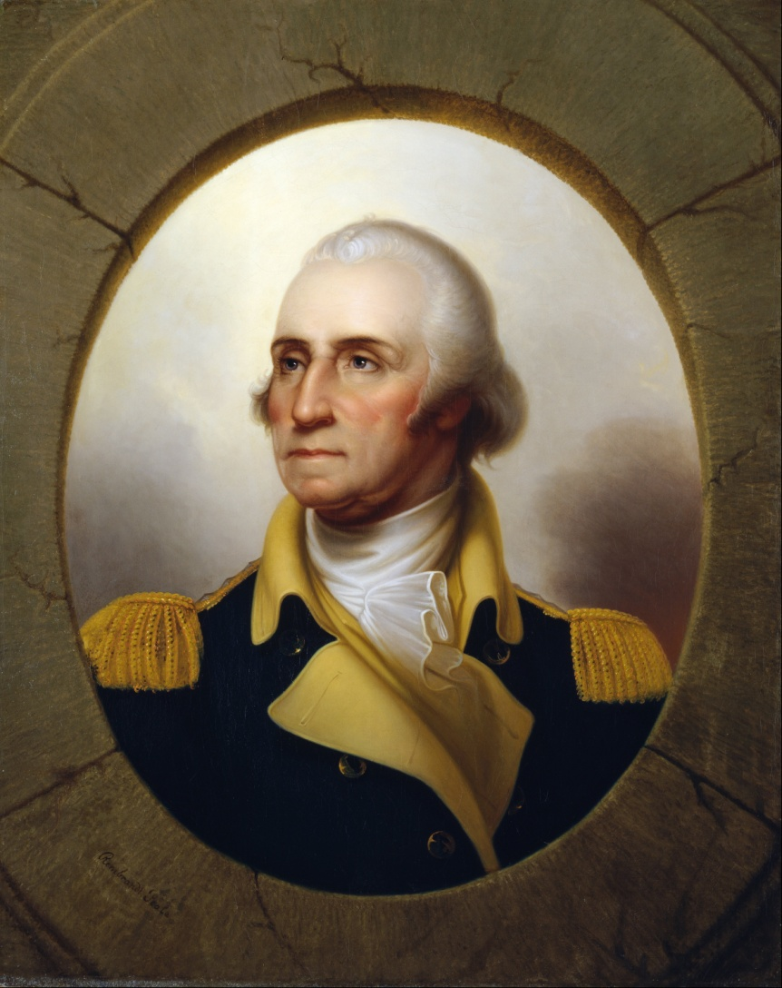
George Washington
From Virginia
Surveyor by trade
“Founding Father”
Militia officer in French and Indian War
Commander-in-chief of Continental Army during Revolution
Became first President

Slide 4
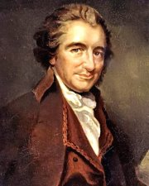
Thomas Paine
From England, moved to Philadelphia with help of Benjamin Franklin
Former tax officer, became a journalist
Published Common Sense, a pamphlet promoting American independence from Britain

Slide 5
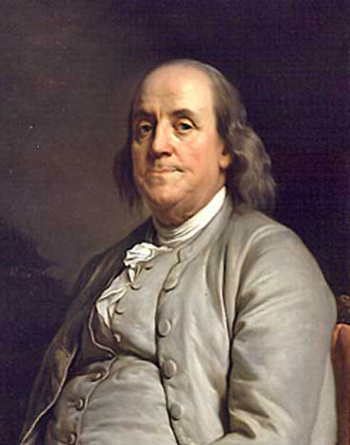
Benjamin Franklin
From Pennsylvania
Publisher by trade
“Founding Father”
Helped draft the Declaration of Independence
Served as American diplomat to France and convinced the French to join the American side
Represented America at Treaty of Paris (1783) negotiations

Slide 6
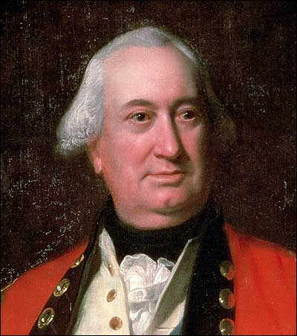
Lord/General Cornwallis
From London
Officer in British Army (served in Europe during French & Indian War)
Spoke out against oppressive taxes on American colonies as a member of Parliament
One of the highest ranking British officers throughout the Revolution, participated in many major battles including Yorktown

Slide 7
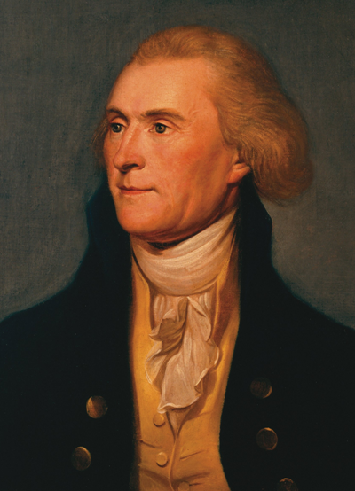
Thomas Jefferson
From Virginia
Plantation owner by trade
“Founding Father”
Served in Continental Congress
Drafted the Declaration of Independence
Served as 3rd President

Slide 8
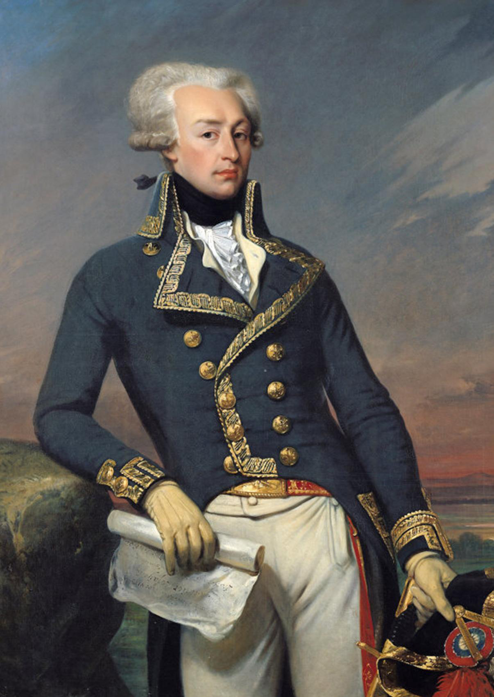
Marquis de Lafayette
From France
Entered French army at 14
Volunteered to train American troops
Major General in Continental Army, served in several battles
Convinced France to help Americans with supplies and money, purchased items himself for his troops

Slide 9
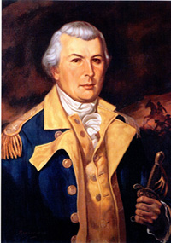
Nathanael Greene
From Rhode Island
Raised as a Quaker (pacifist)
Initially rejected as a militia officer because of a limp
Became Quartermaster General – in charge of military supplies
Became Commanding General of Continental Army in the South

Slide 10
Paul Revere
Silversmith
Created the famous “Boston Massacre” engraving that was used as a piece of Anti-British propaganda throughout the Revolution.
A member of the Sons of Liberty
Rode to Lexington on the night of April 18th, 1775 to warn Samuel Adams & John Hancock that the British were coming through on their way to Concord.

Slide 11
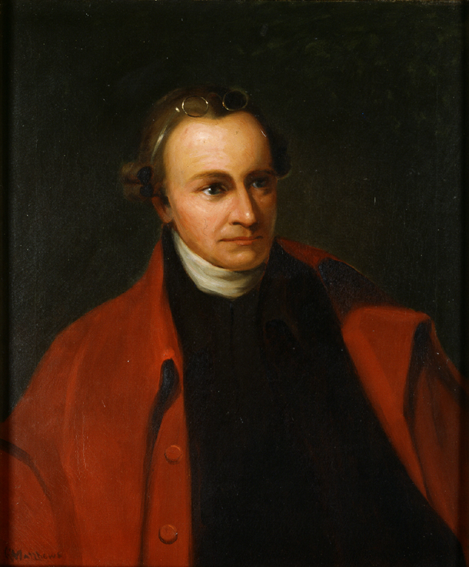
Patrick Henry
Virginia lawyer & politician
Denounced King George III after the passing of the Stamp Act.
“Give me Liberty or Give me Death” Speech
During the war and its immediate aftermath, he was governor of Virginia FIVE TIMES!

