Slide 1
World War I
On the Homefront Propaganda

Slide 2
WWI On the Homefront
World war I was at the time the most devastating war the world had ever seen. It was ‘the war to end all wars”.
The home front became a nation of working women and African Americans, who not only worked in factories to produce goods needed for the war, but cared for the sick and wounded men from the war, and also supported the war with bonds and boycotts.

Slide 3
WWI On the Homefront
Some specific ways that Americans were asked to help on the homefront to win the war:
enlist or support relatives who were fighting
buy bonds from the government to help finance the war
work in a wartime industry
volunteer with organizations like the Red Cross
eat more of some things and less or none of others
save sugar for the soldiers
grow crops (Victory Gardens)

Slide 4
WWI On the Homefront: Women and African Americans In War Time Industry
With so many men serving abroad, the brunt of the production in factories was left to the women and African-Americans left in the U.S.
Women, who had once only contemplated staying home to manage their house and families, were now working in all types of factories.
African-Americans migrated from the rural south to the urban north, and began to undertake the jobs left by men serving in the armed forces. Many more African-Americans held jobs during the war years than ever before.

Slide 5
WWI On the Homefront – The War Industries Board
To create order, President Wilson established the War Industries Board (WIB) to increase industrial output and coordinate industries.
The War Industries Board instructed the factories on what to produce, how much to produce, and the cost of the items.
Women's blouse factories made signal flags, radiator manufacturers made guns, automobile factories made airplane engines, and piano companies made airplane wings.

Slide 6
WWI On the Homefront: American Red Cross
Many upper class women who did not need to work for money to support a home, joined organizations that cared for wounded soldiers.
One of these organizations included the American Red Cross, which was instrumental during America’s time of need.
Many women worked as nurses in the Red Cross, and others performed duties such as rolling bandages, knitting socks, and working in military hospitals taking care of wounded soldiers.
Women also organized clubs and canteens for soldiers on leave, as well as drove ambulances across battlefields.

Slide 7
WWI On the Homefront – War Bonds
The war had a heavy impact on America’s economics and culture.
Liberty bonds became one of the most common ways to support the American war effort, and everyone bought liberty bonds to support the war, but also for the economic promise they offered.

Slide 8
WWI On the Homefront: Conserving Food
When the US entered the war, people in France, Britain, and Italy, along with their armies, were facing starvation, so increasing American food production became a top priority.
Americans observed days for boycotting certain foods or materials in an effort to conserve food and other items needed for soldiers and our allies in Europe.
National “wheat less” or “sweet less” days were used as a way to conserve food during the war.
The Lever Act also persuaded Americans to conserve food for soldiers abroad.
Women planted “war gardens” that produced extra fruits and vegetables for their family

Slide 9
WWI On the Homefront: Conserving Fuel
President Wilson established the Fuel Administration to control America's use of fuel. Fuel was needed by the soldiers overseas.
Americans were asked to voluntarily conserve their use of fuel. Lightless nights and gasless days were observed.
Daylight Savings Time was observed for the first time in the US's history in order to cut back on the use of fuel and electricity.

Slide 10
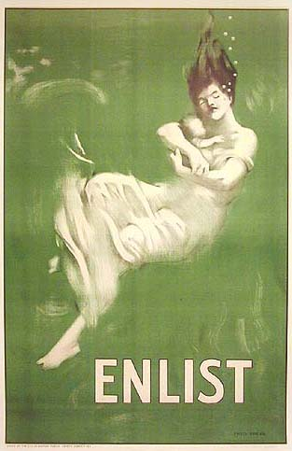
What is Propaganda?
Propaganda – ideas or beliefs that are intentionally aimed to persuade the population

Slide 11
Why is it used?
To influence an audience towards a cause, position or agenda
To create a common bond within the community
To evoke a common sentiment or feeling

Slide 12
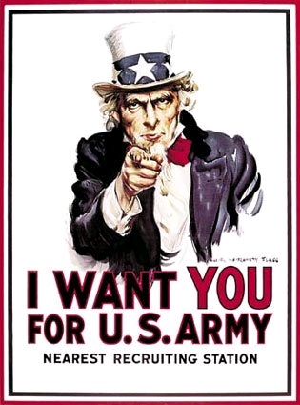
Common Characteristics
Common characteristics of good propaganda:
Suggestion and stimulation that leads to acceptance
Simple Terms & easy to understand
Colorful Pictures

Slide 13
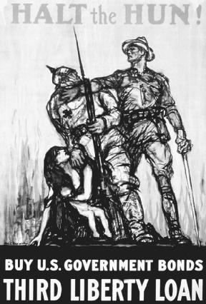
Types of Propaganda
Vilifying the Enemy – creating an enemy to unite against
War – supporting the military effort & the government
Economic
Example: Buy war bonds to support the war effort
Democracy vs. the Enemy
Good vs. Bad

Slide 14
Negative Aspects of Propaganda
Not all facts are presented
It is NOT impartial
Relies heavily on emotion
Encourages an emotional response instead of a rational response
Associated historically with negative uses
Example: Nazi Germany

Slide 15
On the Homefront
Think about some of the things Wilson asked Americans do to on the homefront in his “Do Your Bit for America” Speech.
Make sure to keep these in mind while analyzing the following WWI Propaganda Posters.

Slide 16
Propaganda Gallery Walk
Today we will be walking through a “gallery” of WWI Propaganda Posters.
You will be in groups of two or three.
You will be assigned a number (1 – 16). This is the station you will be starting at.
You need to spend approximately 3 minutes at each station analyzing these posters. Make sure to discuss this poster with your group members.
Finally, make sure to identify each poster with the appropriate number.

Slide 17
Propaganda Analysis
Use your Propaganda Poster Analysis sheet & analyze the following posters.
You may work by yourself or with your shoulder buddy.
You have three minutes per poster.

Slide 18
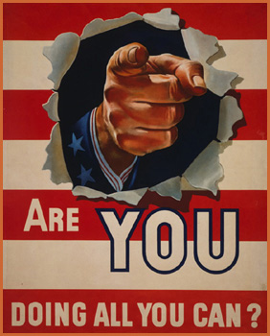

Slide 19
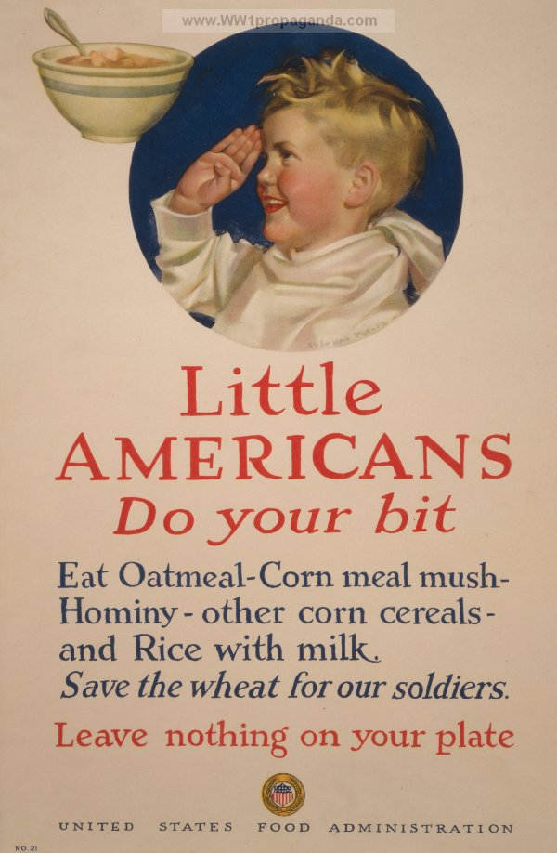

Slide 20
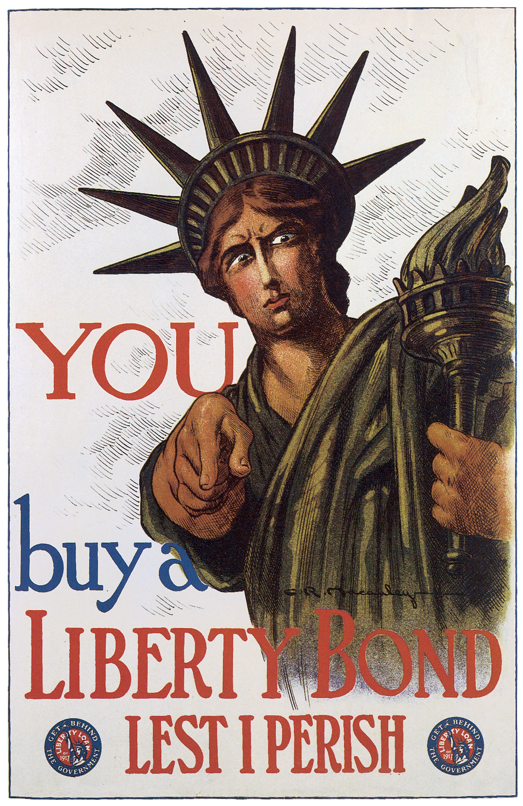

Slide 21
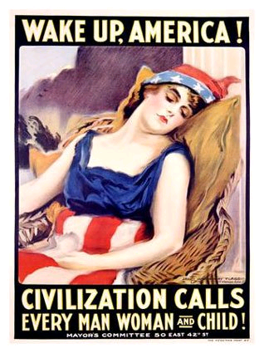

Slide 22
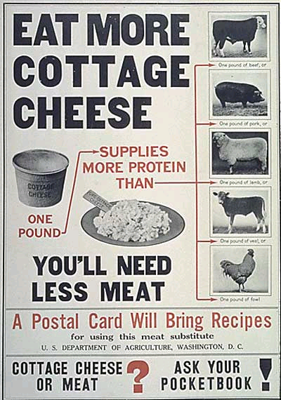

Slide 23
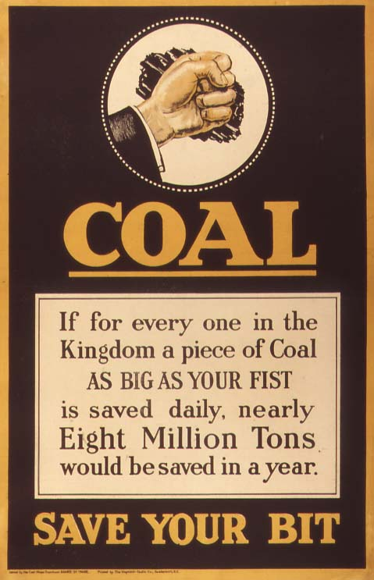

Slide 24
