Slide 1
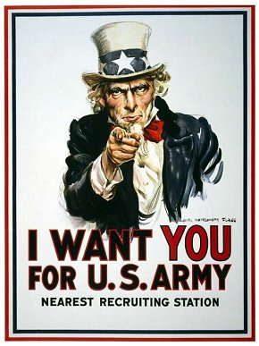
Propaganda in WWII

Slide 2
Uncle Sam Wants YOU!
Created by James Montgomery Flagg, who modeled Uncle Sam on himself to avoid having to pay a modeling fee.
Notice the use of patriotic colors, and the look of determination on his face.

Slide 3
Methods of Persuasion
According to Aristotle

Slide 4
Propaganda
information, ideas, or rumors deliberately spread widely to help or harm a person, group, movement, institution, nation

Slide 5
ETHOS
Based on credibility, legitimacy
Also considers “ethics”- what is right
Think about it this way-
If you were trying to find information for a research paper about space exploration, would you choose NASA’s website, or Yahoo Answers?

Slide 6
PATHOS
Appeals to people’s emotions
Meant to evoke certain feelings, especially pity or anger
The words empathy and pathetic are based on pathos.

Slide 7
LOGOS
Based on logic by using facts and statistics
Hint: If it’s got a bunch of numbers in it (percentages, rates, money), it’s probably logos.

Slide 8
Which is it?
Practice
Notes:
Pathos

Slide 9
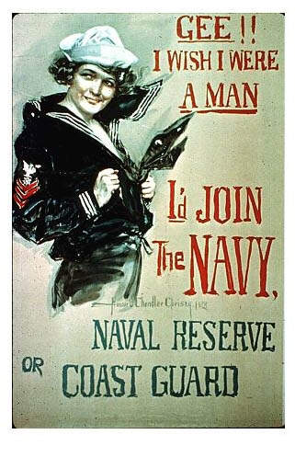
Which is it?
Practice
Notes:
Ethos

Slide 10
Which is it?
Practice
Notes:
Logos

Slide 11
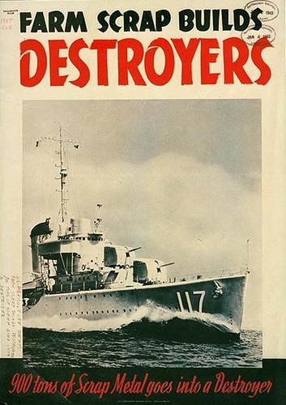
Which is it?
On Your Own
Notes:
Logos – facts

Slide 12
Which is it?
On Your Own
Notes:
pathos

Slide 13
Which is it?
On Your Own
Notes:
Ethos

Slide 14
Notes:
Ethos

Slide 15
Notes:
Pathos

Slide 16
Nazi Propaganda

Slide 17
Nazi propaganda before the start of World War II had several distinct audiences:
German audiences were continually reminded of the struggle of the Nazi Party and Germany against foreign enemies and internal enemies, especially Jews.
Ethnic Germans in countries such as Czechoslovakia, Poland, the Soviet Union, and the Baltic states were told that blood ties to Germany were stronger than their allegiance to their new countries.
Potential enemies, such as France and Great Britain, were told that Germany had no quarrel with the people of the country, but that their governments were trying to start a war with Germany.
All audiences were reminded of the greatness of German cultural, scientific, and military achievements

Slide 18
Nazi Propaganda

