Slide 1
Think about your favorite foods…
If you could eat anything for an entire day, what would it be?
Write out your ideal menu for an entire day (breakfast, lunch, and dinner). Include beverages!

Slide 2
Helping to Win the War on the Homefront

Slide 3
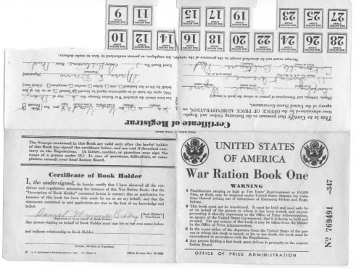

Slide 4
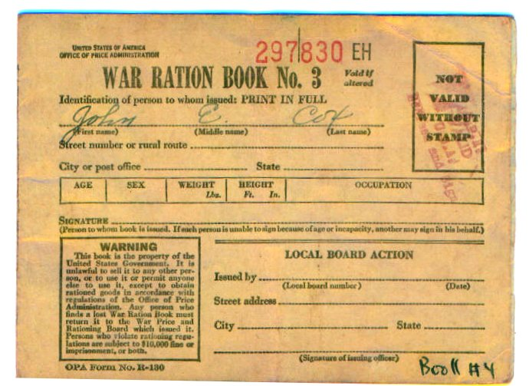
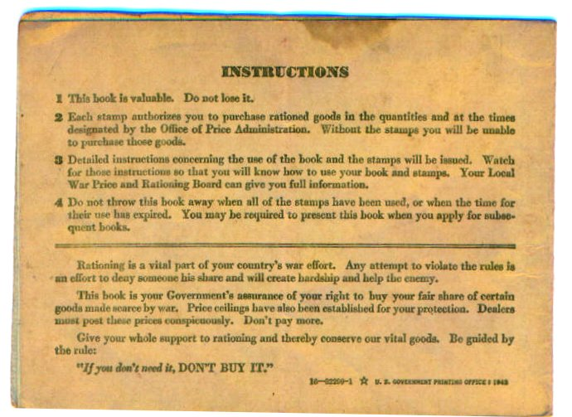

Slide 11
