Slide 1
Resistance During the Holocaust
Information from “Resistance During the Holocaust”
Produced by the United States Holocaust Memorial Museum

Slide 2
Warm Up
If you fled to escape capture, where would you go?
Who would give you food and shelter?
How would you pay for these necessities?
What would be the penalties for Christians who helped you?

Slide 3
Warm Up
Assuming you could get out of your house, how would you escape from the town or city where you lived?

Slide 4
Warm Up
How would you defend yourself?

Slide 5
Warm Up
Would you be willing to risk the lives of your family, your friends, and possibly your entire community by an act of resistance?

Slide 6
Warm Up
Once trapped in a ghetto or camp, malnourished and demoralized, would you be thinking about resistance or survival? What resources would you have to organize resistance?

Slide 7
The Real Question
The question is NOT:
“Why didn’t more Jews fight back?”
The question IS:
“How were so many people able to fight back in the face of such adversity?”

Slide 8
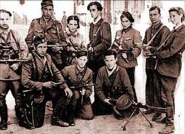
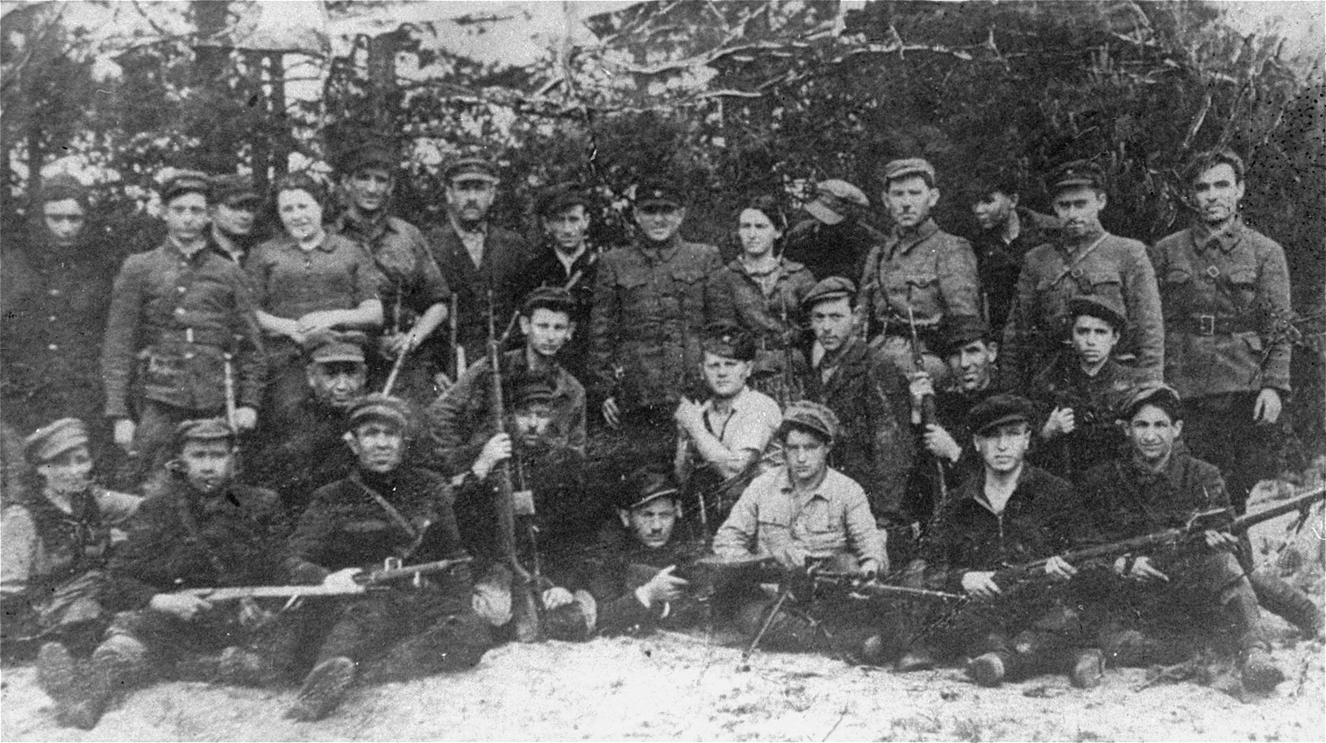
During WWII, an estimated 20,000-30,000 Jews fought bravely in resistance groups.
Defiance Trailer

Slide 9
“We had no weapons except for rocks, bottles and a few knives. We were completely outnumbered and surrounded by a trained German military force loyally supported by local population. But then again, we had no expectation that we would live beyond the next few weeks or months. Why not resist when the alternative was death at a time and place chosen by the Nazis?”

Slide 10
The Facts
Armed Jewish resistance took place in
5 major ghettos
45 small ghettos
5 major concentration camps
18 forced labor camps

Slide 11
Obstacles to Resistance
Germans had Superior Weaponry/Military
Keep in mind that Poland was overrun in a few weeks in 1939.
In 1940, France fell to the Nazis in just 6 weeks.
Other countries were soon occupied by German forces.
If these powerful nations could not hold off the Nazis, what chance did civilians have?

Slide 12
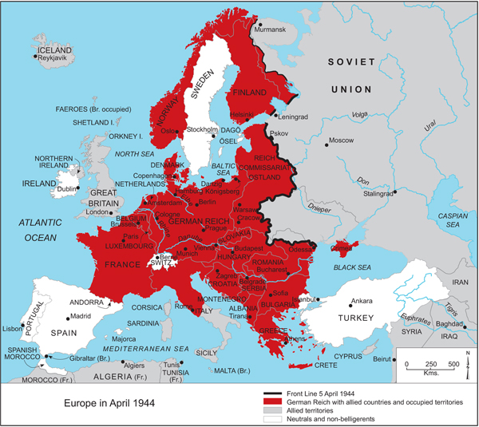

Slide 13
Obstacles to Resistance
Nazi Policy of Collective Responsibility
Entire families and even towns were held accountable for the actions of a few.
In Lithuania, an entire ghetto population was killed when 2 boys escaped and refused to return.
In Yugoslavia, the German army routinely executed 50 to 100 people for every German soldier killed by resistance fighters.
Nazis were also known to execute a person’s family in front of them before killing that person.

Slide 14
Obstacles to Resistance
Isolation of Jews and Lack of Weapons
In many occupied regions of eastern Europe, local populations, including many peasants in forest areas where Jews often had the best chances of hiding, were either hostile toward Jews or indifferent to their fate.
Civilians who did help Jews did so under penalty of death.

Slide 15
Obstacles to Resistance
Secrecy of Nazi Atrocities
Rumors of the death camps became widespread in the later years of the war, but many people (including Jews) could not believe the stories.
Many people sent to Auschwitz were required to send postcards to friends and family just before they were gassed: “Arrived safely, I am well.”

Slide 16
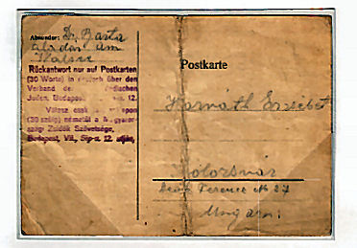

Slide 17
Resistance in the Ghettos
Nazis set up over 400 ghettos in occupied territories.
The largest was the Warsaw Ghetto, where over half a million Jews lived in late 1940.
By summer 1944, the Nazis had emptied all ghettos and killed most of the people who had lived in them.

Slide 18
Resistance in the Ghettos
Using Newspapers and Radios
Activists gathered news from BBC or Soviet Broadcasts on hidden radios to inform people of the events of the war.
Anyone found in possession of an illegal radio was executed.

Slide 19
Resistance in the Ghettos
Acts of Sabotage
These activists stole documents, tampered with vital machinery, produced faulty weaponry, slowed down production on assembly lines, stole things for the black market, and set fires in factories.

Slide 20
Resistance in the Ghettos
Couriers
These people, often women, would travel under false names and papers and carry illegal documents, newspapers, money and weapons.
In 1942, couriers began spreading news of mass murders at Chelmo, Treblinka, and other camps. Most people found the news unbelievable.

Slide 21
Resistance in the Ghettos
Armed Ghetto Resistance
From the Vilna Ghetto Manifesto:
“Jews, we have nothing to lose. Death will overtake us in any event. And who can still believe in survival when the murderer exterminates us with so much determination? The hand of the executioner will reach each man and woman. Flight and acts of cowardice will not save our lives.”

Slide 22
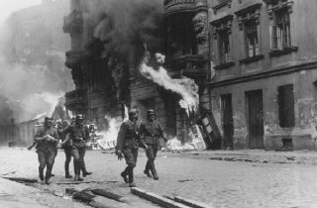
Resistance in the Ghettos
Armed Ghetto Resistance
The Warsaw Ghetto Uprising:
-April 19th, 1943-May 16th, 1943
-750 Jewish fighters used guns, grenades, and small homemade bombs to attack the 2,000 German troops
-Although they were eventually defeated, they held off the Germans for 28 days
-On May 16th, the Germans recaptured and destroyed the ghetto. Of the 56,000 captured, 7,000 were shot and the rest sent to death camps.

Slide 23
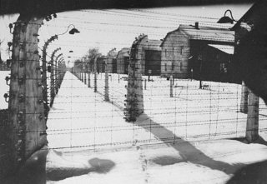
Resistance in the Camps
At least 3,000,000 people perished in the Nazi camps
Some camps were designed specifically for killing, others were forced labor camps
Jews were used for slave labor even in the death camps and forced to complete horrible tasks

Slide 24
Resistance in the Camps
Alleviate the Suffering of Others
Included smuggling/gathering food, money and medical supplies for those in need.
Attempts to Inform the Outside World
Some prisoners escaped and presented reports to local Jewish leaders.
This information was presented to the Allies, but their priority was winning the war.
The camps continued to operate, killing as many as 10,000 people per day.

Slide 25
Resistance in the Camps
Armed Camp Resistance
Uprisings in 5 major death camps.
Prisoners at Sobibor attacked SS officers and set the camp on fire during roll call. They broke the gate and 300 were able to escape. 200 were able to avoid recapture.
After the uprising, the Germans destroyed all traces of Sobibor. They plowed the camp under and planted crops over the land to hide all traces of what had taken place.

Slide 26
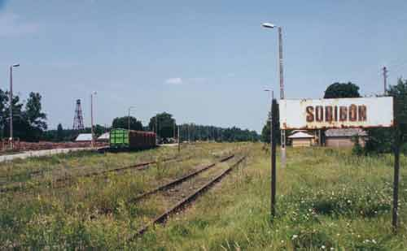

Slide 27
“Upstander” Resistance
Polish Resistance
Germans had closed many Polish schools because they were seen as “subhuman” and believed they should be reduced to minimally educated slave laborers.
Himmler:
“The objective of this elementary school must simply be to teach: simple arithmetic up to 500 at the most, how to write one’s name, and to teach that it is God’s commandment to be obedient to the Germans and honest, hard-working, and well-behaved. I consider it unnecessary to teach reading.”

Slide 28
“Upstander” Resistance
Soviet Resistance
Largest movement in Europe
First their focus was on staying alive, then they conducted acts of sabotage, such as destroying rail lines
Jewish Resistance
Faced difficulties due to Anti Semitism
Included women, children and elderly in “family camps”
Found throughout western and eastern Europe

Slide 29
Spiritual Resistance
Attempts by individuals to maintain their humanity and personal integrity in the face of Nazi attempts to dehumanize and degrade them.

Slide 30
Spiritual Resistance
Underground Schools and Libraries
Secret schools were organized in ghettos and students would travel to and from class with books hidden under their coats or in their trousers.
Documenting the Holocaust
Groups collected and stored reports, diaries and documents about life under the Nazis

Slide 31
Spiritual Resistance
Secret Religious Activities
Groups met secretly for prayer to build morale and reaffirm cultural and religious identity
Cultural Activities
Children at Theresienstadt painted pictures and wrote poems in classes organized by adults to help them deal psychologically with their circumstances.
Fewer than 100 of the 15,000 children under age 15 who passed through this camp survived.

Slide 32
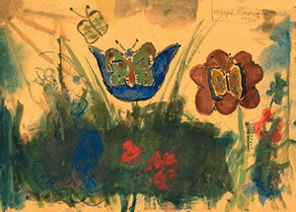
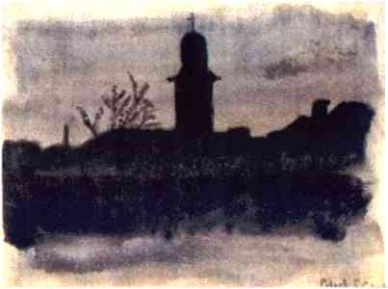
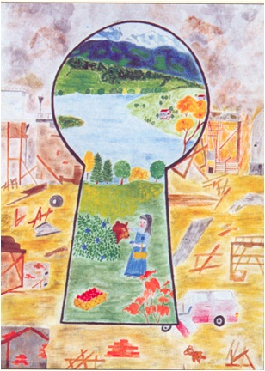

Slide 33
Resistance in Nazi Germany
Resistance in Nazi Germany was limited, lacking broad support, and largely ineffective:
Spies/surveillance by police (included Hitler Youth spies)
Most political opposition had been removed or killed in the early years
One woman was overheard saying, “Hitler hasn’t made anything better” and was sentenced to 10 months of hard labor.

Slide 34
Resistance in Nazi Germany
White Rose Movement
Only German group that spoke out against Nazi genocidal policies. Leaders were executed in 1943.
Assassination Plots
Many plots to get rid of Hitler were planned and in some cases attempted.
Distributing Anti-Nazi Literature
Groups published books about the concentration camps and atrocities of the Nazis, disguised by innocent covers.

Slide 35
Again, The Real Question
The question is NOT:
“Why didn’t more Jews fight back?”
The question IS:
“How were so many people able to fight back in the face of such adversity?”

