Slide 1
The Roaring 20s
Introduction/Overview

Slide 2
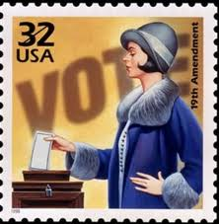
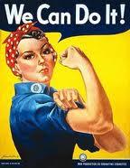
The New Woman
August 26, 1920, 19th Amendment ratified -women could vote!!!
Women who worked during WWI wanted to keep working

Slide 3
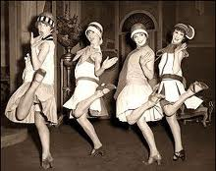
The New Woman
Idea of femininity changed
Young women were called flappers
Wore shorter skirts and dresses
Had short, bobbed hair
make-up was in
women smoked, drank, and danced all night without chaperones
http://www.youtube.com/watch?v=3svvCj4yhYc

Slide 4
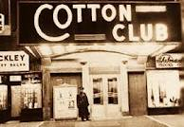
Music & Dance
The Charleston was the dance craze
https://www.youtube.com/watch?v=ZJC21zzkwoE
Jazz was popular type of music in the clubs.
One of most famous clubs was Cotton Club in Harlem.
Popular musicians included:
Duke Ellington
Louis Armstrong

Slide 5
Prohibition
Members of the temperance movement blamed alcohol for many of society’s ills.
Members wanted prohibition, stating it would stop husbands from spending all the family income on alcohol.
On January 20, 1920, the 18th Amendment was ratified.
It prohibited the sale and manufacture of alcohol – it did not, however, mention anything about the actual drinking of alcohol.
http://www.history.com/topics/prohibition

Slide 6
Prohibition & Crime
Prohibition led to organized crime
A new breed of gangster arose during this period.
Gangsters took notice of the amazingly high level of demand for alcohol within society and the extremely limited avenues of supply to the average citizen.

Slide 7
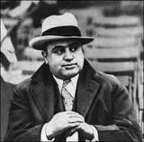
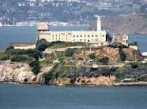
Prohibition & Crime
Popular gangsters included Scarface Al Capone, “Bugs” Moran, Baby Face Nelson, and Frank Nitty
Capone - “Public Enemy No. 1,” arrested and sent to Alcatraz

Slide 8
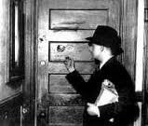
Prohibition & Crime
Gangsters hired men to smuggle in rum from the Caribbean (rumrunners) or hijack whiskey from Canada and bring it into the U.S.
Others would buy large quantities of liquor made in homemade stills.
The gangsters would then open up secret bars (speakeasies) for people to come in, drink, and socialize.

Slide 9
Life in the Roaring Twenties
Life was good after WWI
Some foods could be delivered right to front door
Clarence Birdseye perfected method for freezing and packing food
Electricity became more available
Electric appliances were more common
New convenience foods were available including rolled oats, pancake mix, canned goods and pre-sliced bread,
Gerber’s baby foods were available for the first time.
Peanut butter and jelly sandwiches became famous in 1922

Slide 10
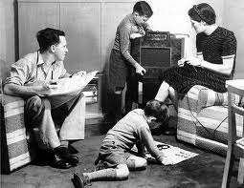
Life in the Roaring Twenties
Radios were invented – people listened to jazz, sports, news reports, and favorite programs.
https://www.youtube.com/watch?v=NFhQP3KvRCs
The first Miss America contest was Sept. 8, 1921

Slide 11
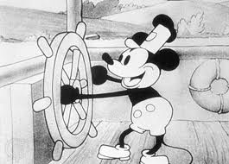
Life in the Roaring Twenties
Movies became a favorite pastime
First talking motion picture in 1927 – The Jazz Singer
First Disney cartoon in 1928 – Steamboat Willie (Mickey)
http://video.disney.com/watch/steamboat-willie-4ea9de5180b375f7476ada2c

Slide 12
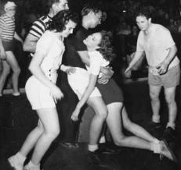
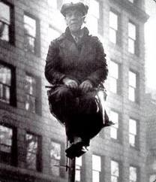
Popular Fads
Dance Marathons
Popular dances included the Charleston, the Fox-trot, and the Shimmy
Longest dance record lasted 3 weeks
Flagpole sitting
Began with a dare
Record was 51 days and 20 hours

Slide 13
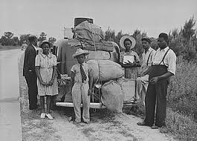
The Great Migration
Many people, especially blacks left the South looking for better life (jobs, more rights as citizens, better schools, better health care, and less segregation) in the North.

Slide 14
The Great Migration
Many Northern companies actively recruited blacks for jobs in factories and assembly plants
Life improved in general, but blacks faced overcrowded cities and different kind of prejudice

Slide 15
The Klan Strengthens
The Klan’s targets included blacks, Jews, Catholics, and immigrants
Klan wanted to “return America to traditional values and morals” – gained new members and the Klan gained political influence
Five senators were Klan members
Race riots broke out
Scandals within the Klan’s leadership led to its decline

Slide 16
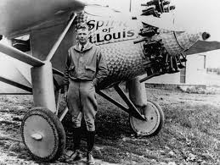
A Special Day
May 1927, Charles Lindbergh flew the “Spirit of St. Louis” from New York to France
It was the first trans-Atlantic flight!
http://www.youtube.com/watch?v=uIUL_qUJUOo

