Slide 1
Slave Resistance

Slide 2
Types of Resistance
Enslaved men & women often resisted the circumstances they faced to the best of their ability.
Resistance or the act of resisting, opposing, or withstanding, came in many forms:
Culture
Behavior
Community
Revolt
Religion
Education
Purchasing Freedom
Running Away

Slide 3
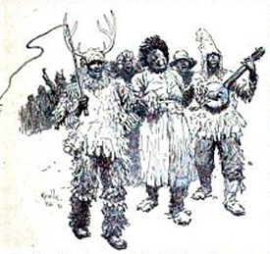
Culture
Enslaved individuals worked very hard to hold on to the their original cultures & integrate their own customs into new communities they formed.
This was evident in their language, religion, work patterns & names chosen for their children.
Refused to let their masters strip them of their identities.
Example: “John Koonering”
North Carolina slaves would have a colorful Christmas time celebration.
A slave leader would perform songs, dance, other slaves would play music instruments

Slide 4
Behavior
Behaviors such as malingering, being disrespectful & carelessness were used as forms of resistance.
Theft was also a common behavior amongst slaves. Enslaved individuals would often steal to keep themselves alive when inadequate provisions were supplied.

Slide 5
Community
Slaves made every effort to build a community wherever they were located.
This was common on plantations were multiple slaves worked.
Slaves would build communities to develop larger areas of freedom in their lives, undermine slaveholders’ discipline and to develop a community life within slave quarters.

Slide 6
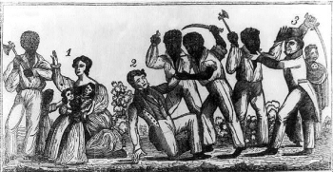
Revolt/Rebellion
Revolts & aggression were rare due to the harsh consequences slaves faced.
Despite consequences, rebellions still occurred:
Stono Rebellion (1739)
Nat Turner’s Rebellion (1831)
Notes:
http://www.pbs.org/wnet/african-americans-many-rivers-to-cross/history/did-african-american-slaves-rebel/

Slide 7
Religion
Religion was used as a form of resistance as many slaves would hold on to remnants of their own religious traditions.
Additionally, slaves would accept Christianity if they pleased, not at the request of the slaveholder.

Slide 8
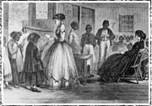
Education
Slaves went to great lengths to educate themselves.
They learned to read & write, despite this being illegal.
Many missionaries would provide religious instruction as well as teach slaves how to read & write.

Slide 9
Purchasing Freedom
Free labor opportunities such as fishing, working on a whaler or agricultural activities were available to some slaves.
Enslaved individuals would take advantage of these opportunities to earn money to buy themselves from their owners.

Slide 10
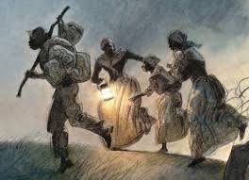
Running Away
Despite the danger in running away, many slaves believed this to be their best chance for freedom.
During the 18th century, North Carolina actually had a reputation as a haven for fugitive slaves.

