Slide 1
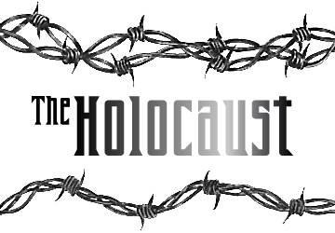
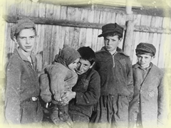
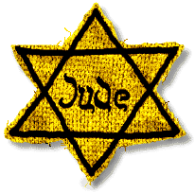
Power Point to accompany the consortium’s lesson “An Introduction to the Holocaust,” located in the Database of Civic Resources at: www.civics.org/resources/docs/Holocaust.pdf
To view this PDF as a projectable presentation, save the file, click “View” in the top menu bar of the file, and select “Full Screen Mode”
To request an editable PPT version of this presentation, send a request to hinson@sog.unc.edu

Slide 2
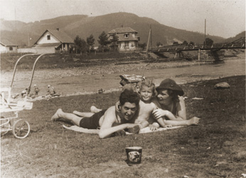
Prewar Jewish Life
Notes:
Izio and Anda Littman and their son, Otto, sunbathe on the beach in the resort town of Skole, July 4, 1939, two months before the German invasion of Poland.
Source: http://www.ushmm.org/education/foreducators/prodev/beli/2003/lesson.php?content=young

Slide 3
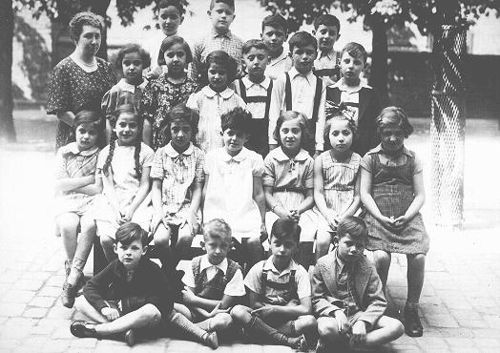
Prewar Jewish Life
Notes:
Class photo of students and a teacher at a Jewish school in prewar Karlsruhe. Germany, July 1937.
Source: http://www.ushmm.org/wlc/media_ph.php?lang=en&ModuleId=10005161&MediaId=514

Slide 4
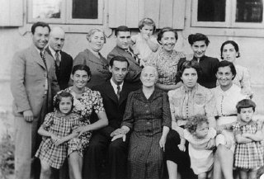
Prewar Jewish Life
Notes:
Three generations of a Jewish family pose for a group photograph. Vilna, 1938-39.
Source: http://www.ushmm.org/wlc/article.php?lang=en&ModuleId=10005161

Slide 5
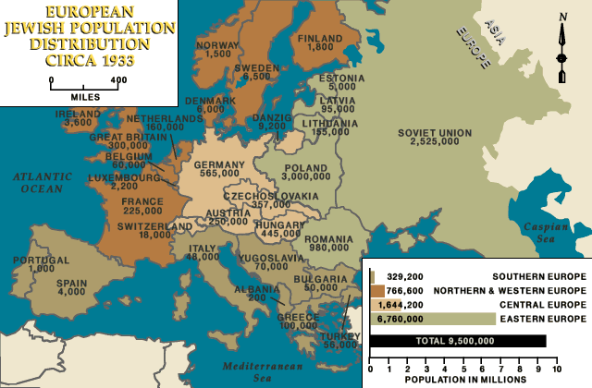
European Jewish population distribution, ca. 1933
Jews have lived in Europe for more than two thousand years. The American Jewish Yearbook placed the total Jewish population of Europe at about 9.5 million in 1933. This number represented more than 60 percent of the world's Jewish population, which was estimated at 15.3 million. Most European Jews resided in eastern Europe, with about 5 1/2 million Jews living in Poland and the Soviet Union. Before the Nazi takeover of power in 1933, Europe had a dynamic and highly developed Jewish culture. In little more than a decade, most of Europe would be conquered, occupied, or annexed by Nazi Germany and most European Jews--two out of every three--would be dead.
Notes:
Source: http://www.ushmm.org/wlc/media_nm.php?lang=en&ModuleId=10005161&MediaId=358

Slide 6
A woman reads a boycott sign posted in the
window of a Jewish-owned department store.
The sign reads:
“Germans defend yourselves against Jewish atrocity propaganda, buy only at German shops!”

Slide 7
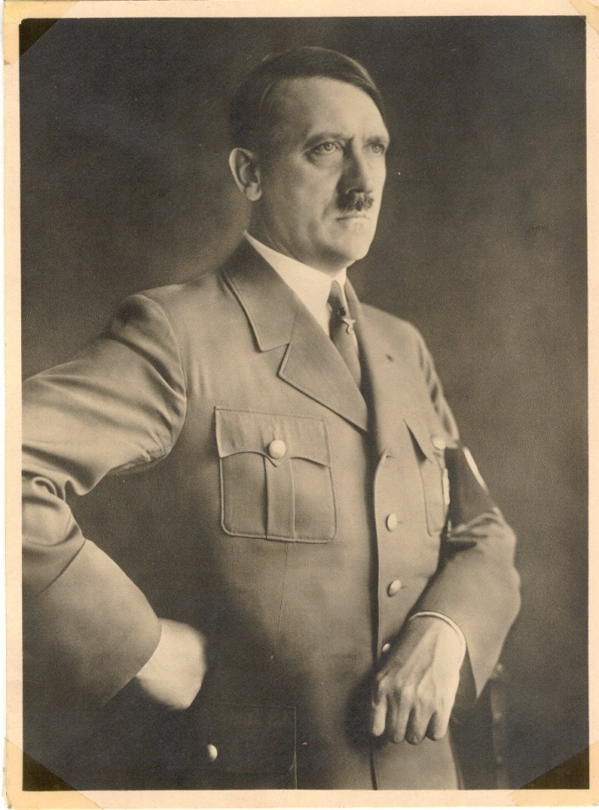
Hitler and the Nazis
Adolf Hitler and the Nazis wanted to
create a master race. They called the
master race the Aryans.
To the Nazis, the “perfect Aryan” had
blonde hair, blue eyes, and light skin.
They were supposed to be tall and
strong.
Look at a photograph of Adolf Hitler. Does he look like a perfect
Aryan to you?

Slide 8
Hitler and the Nazis
The Nazis thought some people were inferior, including:
  Jews
  Gypsies
  Poles
  African-Germans
  Jehovah’s Witnesses
  Communists
  Homosexuals
  People who were mentally or physically handicapped
Non-Aryans could not get married or have children.
Many people tried to leave Germany, but could find no refuge (other countries were having hard times, too. Most countries, including the United States, were having trouble feeding their own people.)

Slide 9
What do you think this chart was used for?

Slide 10
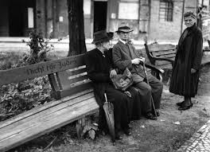
Jewish people had their rights taken away
Citizenship was revoked
Kicked out of schools
Doctors, lawyers, or people who owned businesses were forbidden to do their work.
Park benches and the beaches had signs saying, “No Jews Allowed.”
Jews even had to give away their pets!

Slide 11
Why would anyone join the Nazi party?
For Nazis or people who helped them, life began to improve.
Many new jobs were created such as more police, and filling jobs from which non-Aryans were removed
People who helped the Nazis were allowed more food than people who disagreed with them.
In a country that had been so poor after the first World War, many people were happy and excited to be Nazis.

Slide 12

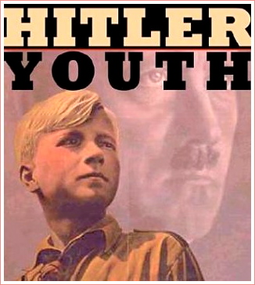
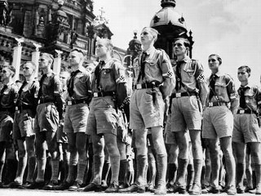
Why would anyone join the Nazi party?
Even the children were supposed to join the “Hitler Youth,” a club that taught them how to be Nazis.
The Nazis used the mass media to spread propaganda to gain support from the German people.

Slide 13
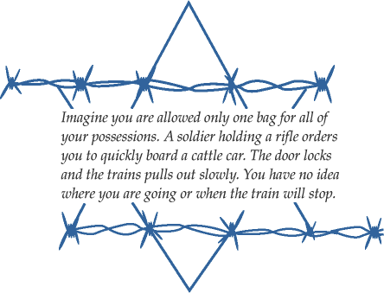

Slide 14
From 1939 to 1942:
World War II and the “Final Solution”
Hitler and the Nazis wanted to control all of Europe, so in 1939, Germany invaded Poland, and World War II began. Germany took over Poland in just a few days.
Soon Germany invaded many other countries. By 1941, they had over taken Poland, France, Belgium, Luxembourg, Netherlands, Denmark, and Norway.
As the Nazis took over more countries, they had even more Jewish people under their control. The Nazis made all Jews wear a Star of David on the outside of their clothing, so they were easy to find.
They were forced to move out of their homes and into ghettos. The ghettos in Europe were dirty and crowded. Food was scarce, and many people were sick and dying.
Often, when the ghettos were too full, the Nazis would send people to concentration camps or labor camps.

Slide 15
Jews from the Lodz ghetto board deportation trains for the Chelmno death camp.

Slide 16
Dutch prisoners wearing prison uniforms marked with a yellow star and the letter ‘N’, for Netherlands, stand attention during a roll call at the
Buchenwald concentration camp.

Slide 17
From 1942 to 1944:
The Death Camps
In January 1942, fifteen Nazi officials met to close the ghettos and get rid of the Jewish people. Their plan was called the “Final Solution.”
For 9 years, the Nazis had killed many Jews, but the new plan was even more serious. They decided to kill all of the Jewish people in Europe—about 11 million people!

Slide 18
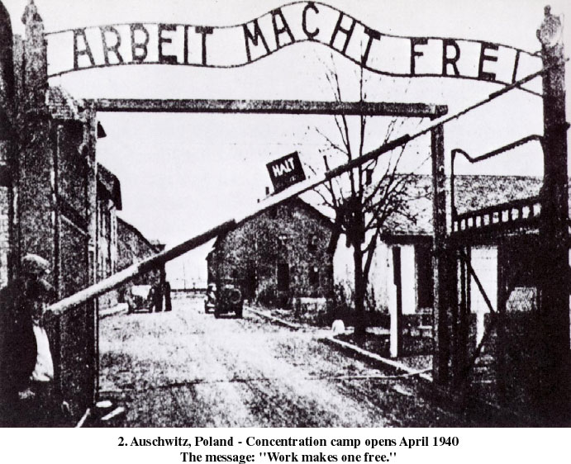
Death Camps / Concentration Camps
The Nazis built killing centers called death camps. They wanted to keep their homeland “pure,” so most of the death camps were in Poland.
The largest death camp was called Auschwitz.
There were only six death camps but hundreds of concentration, labor and transit camps.

Slide 19


Deportation
The death camps were like factories to kill people.
First, people were sent to the camp in crowded, locked boxcars on very long trains with boxcars like the kind used for cows.
They were hungry, dirty, and scared. They thought they were going to a labor camp to work.

Slide 20
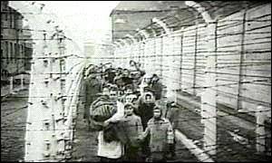
Arriving at the Camps
When the doors were opened, they were told to leave their suitcases behind. Men had to line up in one area, women in different area. Old people, sick people, and mothers with young children and babies were sent to another area. Why do you think this was done?
People who objected were shot in front of everyone. The people felt confused and afraid.
The Nazis told them that they would get food after they took a shower.

Slide 21
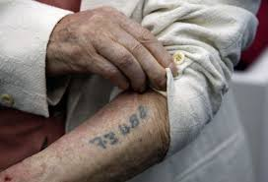
The Showers
The showers at the death camps had two uses.
One use was to bathe a lot of people at once.
  People who could work as slaves for the Nazis were showered with ice cold water.
  Then all of the hair on their bodies was shaved off. They were shaved for two reasons: to make them look different so it would be hard to escape, and to reduce problems with lice.
  The new prisoners were given a number to use instead of their name. At some camps, the number was tattooed on their arm to mark them as prisoners forever.

Slide 22


The second use for the showers was to kill people.
  Poison gas came out of the shower heads and killed people who could not work as slaves
  (especially the old people, sick people, and young children).
  Millions of people died on the day they arrived at the death camp. Their families found out later that they were killed immediately.

Slide 23
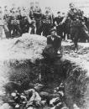
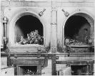
From 1944 to 1945: The Last Days
In late 1944, the Allies were winning the war in Europe.
The Nazis wanted to win their “war against the Jews,” even if they lost World War II. They tried to kill people faster.

Slide 24
Death Marches
As the Allies came close to the concentration camps and death camps, the Nazis forced their prisoners to walk to camps in Germany. These are called the death marches.
The winter was cold and snowy. Many people were too weak to walk and died on the side of the roads.

Slide 25
The War ends
Finally, in the spring of 1945, the Allies won the war in Europe.
It is difficult to estimate the number of people who died during the Holocaust. Think about a few of the ways people died:
— in the ghettos they starved or were shot,
— on the trains going to concentration camps,
— in the gas chambers at the killing centers,
— from too much work and too little food in the concentration and labor camps,
— and on the death marches.

Slide 26
The War Ends
One common estimate of the Jewish population who died is six million people.
But saying “six million Jews” leaves out the other people who died, like Poles, gypsies, homosexuals, prisoners of war, and Jehovah’s Witnesses.
We know the Nazis killed millions of people, but the exact number will never be known.
Band of Brothers - Why We Fight

Slide 27
Sources for Power Point
http://www.cls.utk.edu/pdf/holocaust/sectionb.pdf
http://en.wikipedia.org/wiki/Holocaust
http://www.ushmm.org/

