Slide 1
Unit 1: Geography of the United States and North Carolina
Key Terms

Slide 2
climate
A characteristic of a region used to describe its long-term atmospheric conditions

Slide 3
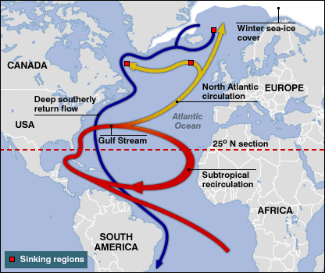
Gulf Stream
The ocean current that runs northward along the North Carolina coast; it carries warm water from the Gulf of Mexico across the Atlantic Ocean

Slide 4
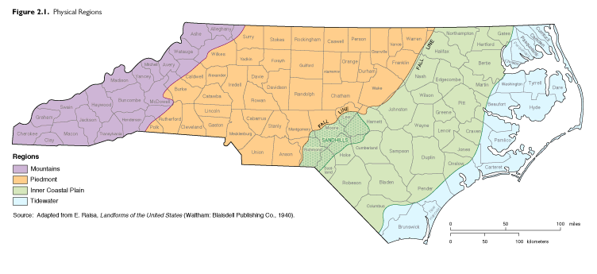
region
A specific area where the lay of the land and the habits of the people are much the same

Slide 5
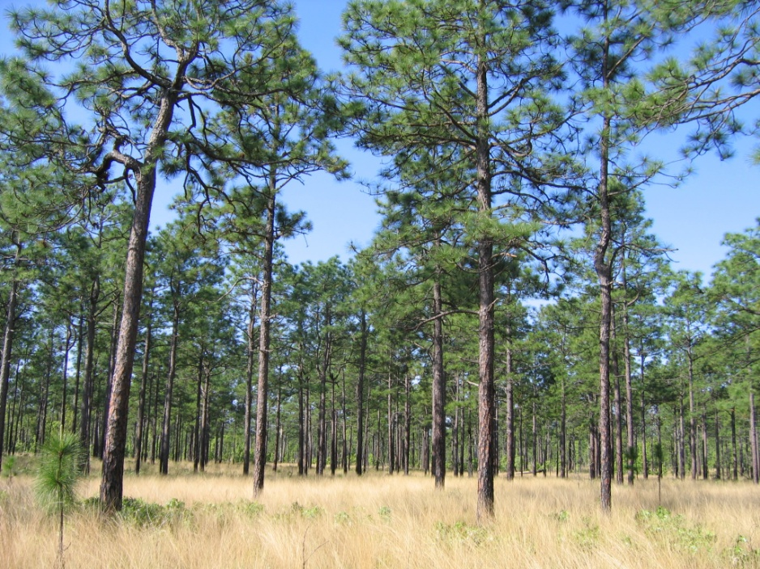
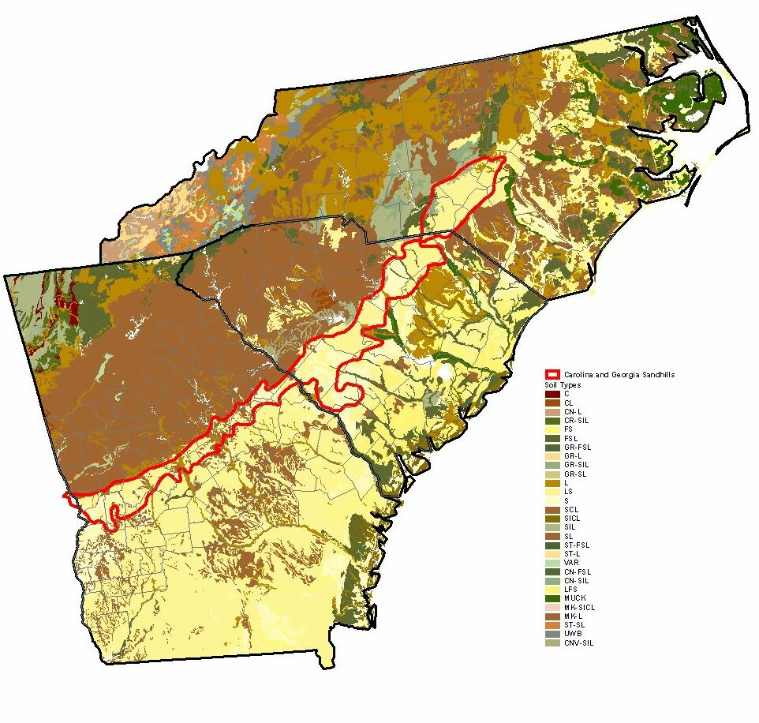
sandhills
An area in south-central NC that has sandy soil

Slide 6
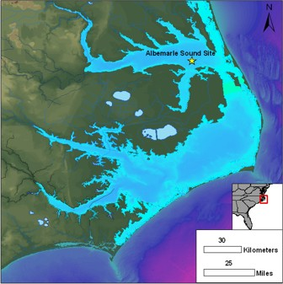
sound
An inland body of mixed (salt and fresh) water

Slide 7
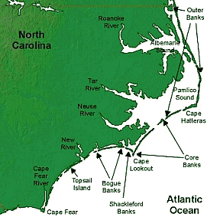
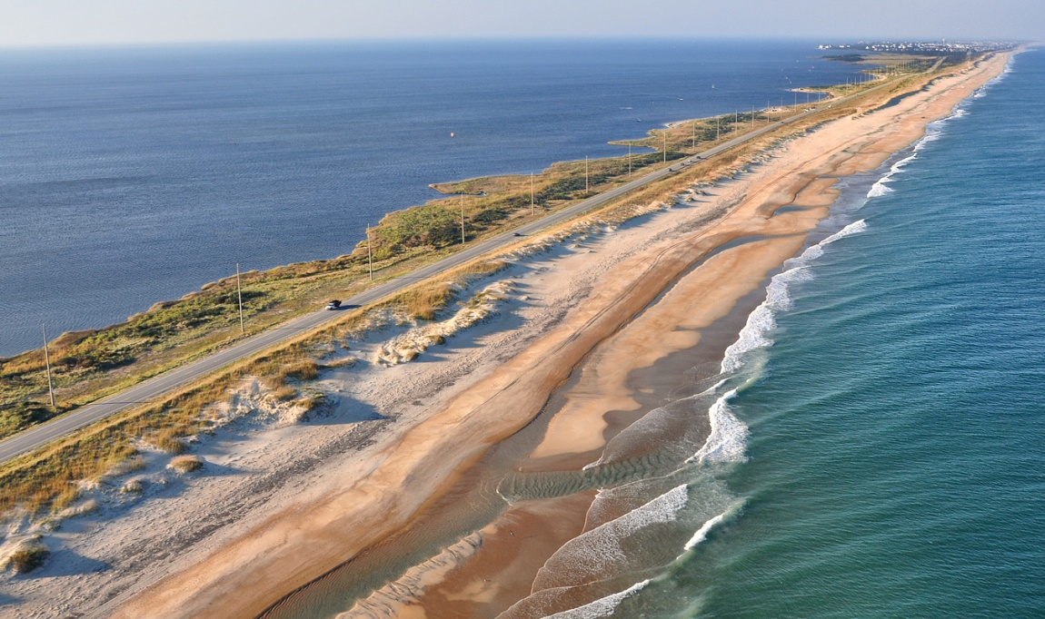
barrier islands
A long chain of islands or sand spits along the state coastline

Slide 8
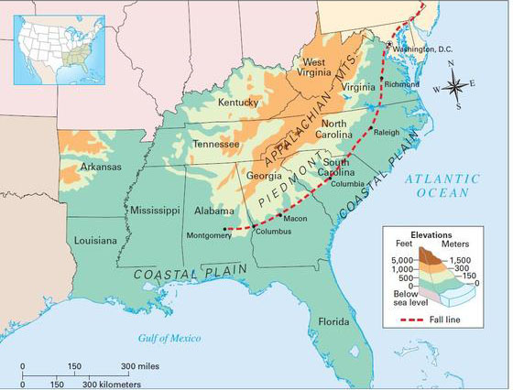
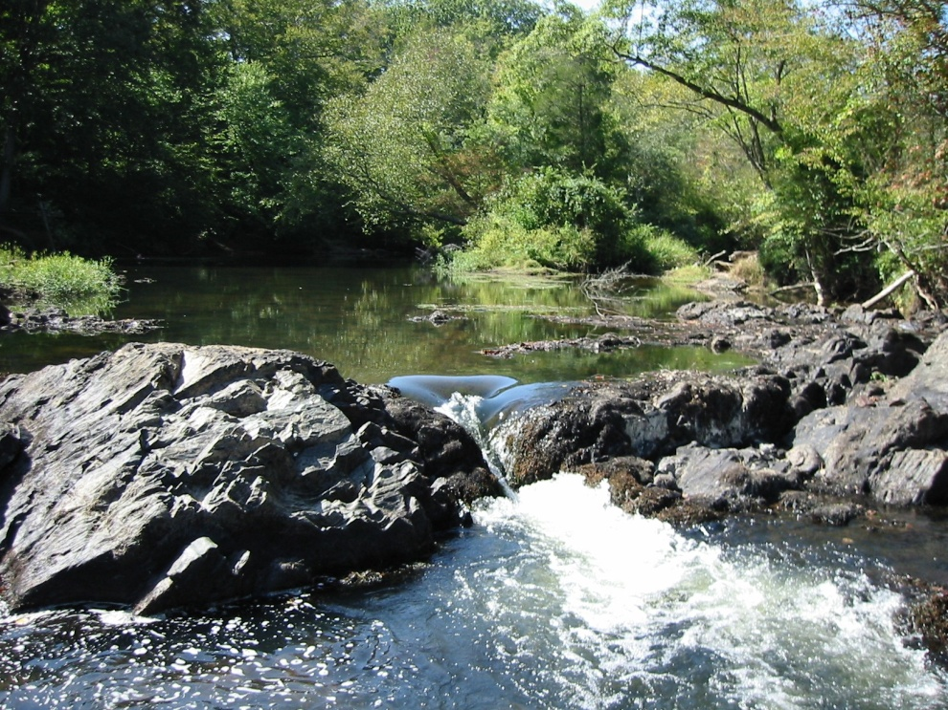
fall line
A natural vertical elevation that separates the piedmont and coastal plains

Slide 9
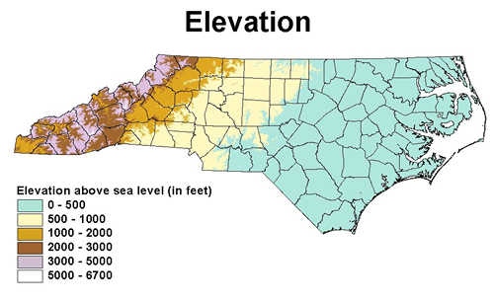
elevation
The height of something as measured how high it is above sea level

Slide 10
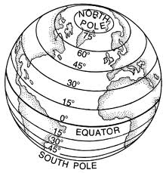
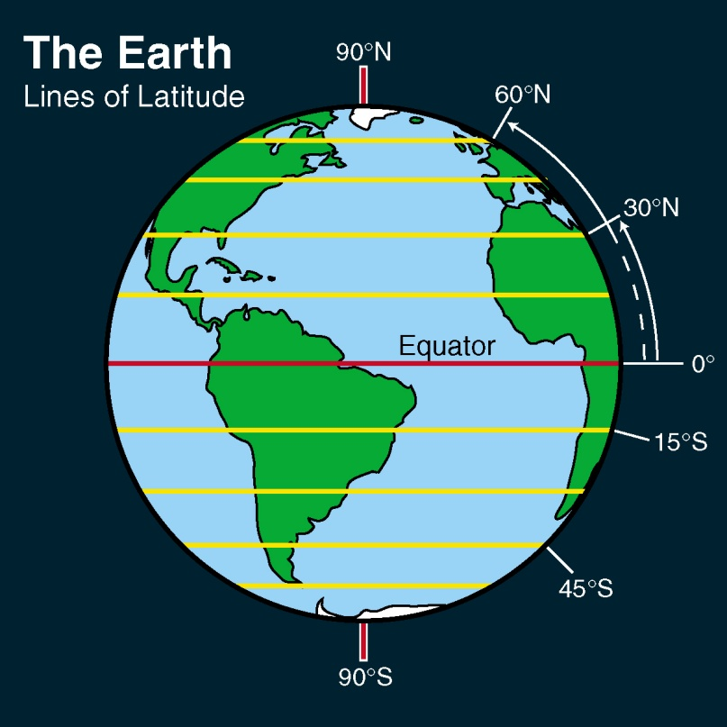
latitude
A measurement in degrees of a place’s distance north or south of the Equator

Slide 11
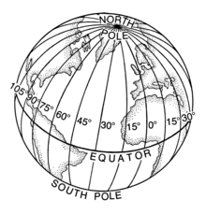
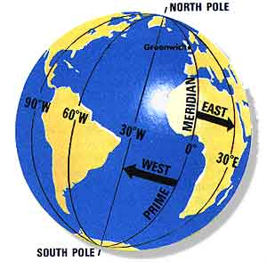
longitude
A measurement in degrees of a place’s distance east or west of the Prime Meridian

Slide 12
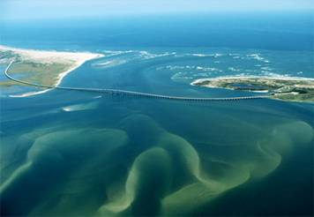
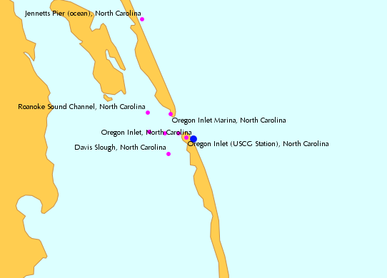
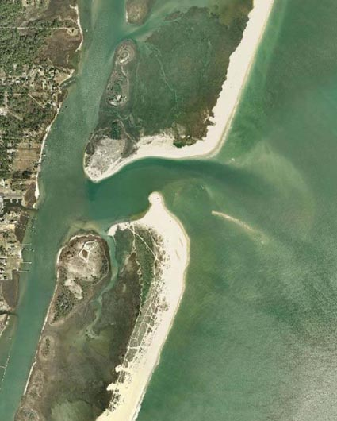
inlet
A break in the barrier islands that allows sea water to come in and out with the tides

Slide 13
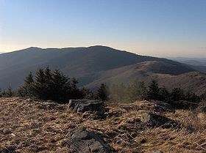
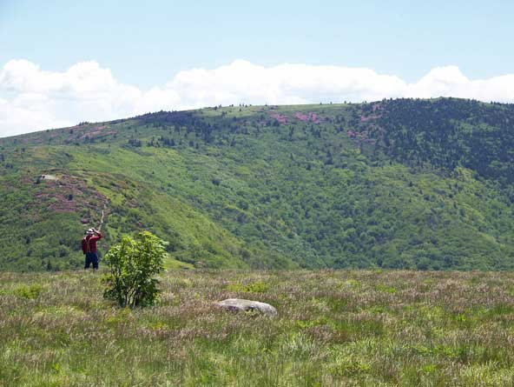
bald
A mountain area usually above 6,000 feet in elevation where few trees grow

