Slide 1
Unit 3 American Revolution Key Terms

Slide 2
Treaty of Paris 1763
a treaty signed in 1763 by France, Spain, and Great Britain that ended the French and Indian War.

Slide 3
boycott
To voluntarily choose not to purchase or use certain goods in hope for a change

Slide 4
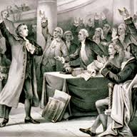
delegate
A representative to a conference who is authorized to act on behalf of others

Slide 5
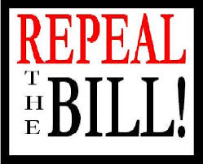
repeal
To cancel or take away

Slide 6
tyranny
A government in which a single ruler has absolute power

Slide 7
compromise
An agreement in which each side give up part of what it wants to end a disagreement

Slide 8
treason
Betraying one’s country

Slide 9
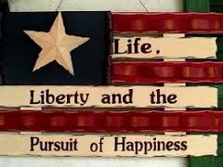
unalienable
Cannot be taken away or given up

Slide 10
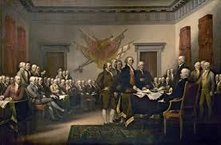
Continental Congress
Colonial delegates that first met in Philadelphia at Independence Hall in 1774 that acted as the governing body during the Revolutionary War

Slide 11
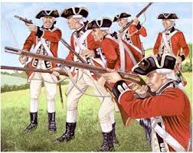
Loyalist
an American colonist who supported Britain during the War of American Independence

Slide 12
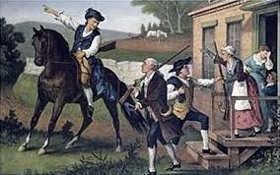
Minutemen
Name for the Patriot militia that formed before the Revolution began. They were a mobile group of soldiers that could act as scouts and fighters at a minute's notice

Slide 13
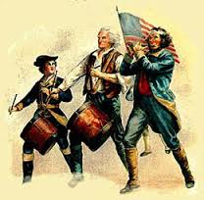
Patriots
those who supported the cause of North American independence in the American Revolution

Slide 14
Treaty of Paris 1783
the agreement signed on September 3rd, 1783 that formally ended the United States War for Independence (American Revolution)

