Slide 1
Unit 4 United States Government Key Terms
Part One

Slide 2
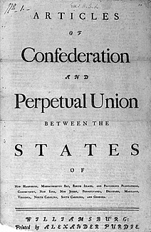
confederation
A joining together, such as the joining together of states; the United States was a confederation from 1776 to 1789

Slide 3
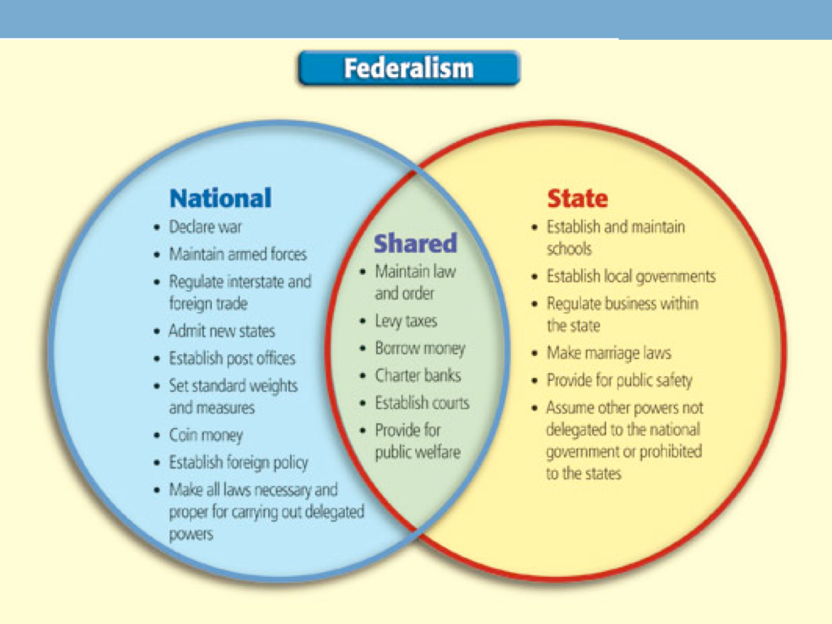
federal system/federalism
a form of government in which power is divided and shared between a central government and state and local governments

Slide 4
republic
a nation that has a government in which power is held by the people who elect representatives

Slide 5
unicameral
a one-house legislature

Slide 6
ratify
to approve of something in order to make it official

Slide 7
compromise
a way to settle differences by each side giving up some of its claims or demands and agreeing to a common solution

Slide 8
Unit 4 United States Government Key Terms
Part Two

Slide 9
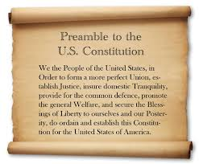
Preamble
the introduction to the US Constitution that outlines the goals of the document

Slide 10
impeach
to accuse the President of wrong doing and to put him on trial for that wrong doing

Slide 11
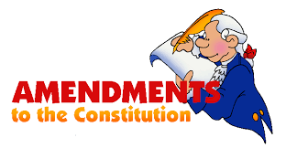
amendment
a change to something (i.e. the Constitution) that overrides (when needed) the previously stated rules

Slide 12
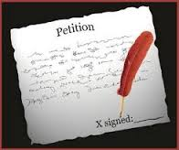
petition
a process by which citizens can request something of the government, typically in writing and with signatures of people who support it

Slide 13
Double Jeopardy
being tried for the same crime twice

Slide 14
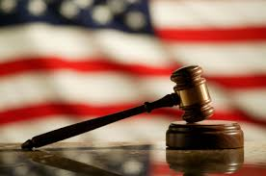
due process of law
according to this every citizen must be allowed to go before a court when they are accused of a crime

Slide 15
impartial
unbiased

Slide 16
Eminent Domain
the right and process by which the government is allowed to take property away from citizens in order to help the nation improve

Slide 17
precedent
any act, decision, or case that serves as a guide or justification for subsequent situations

Slide 18
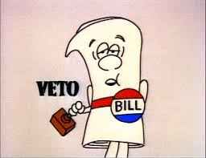
veto
the right of a branch of government to reject a bill that has been passed in an effort to delay or prevent its enactment

Slide 19
Anti-Federalist
people who were against ratification of the Constitution because they thought it gave too much power to the federal government

Slide 20
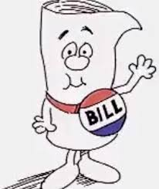
bill
a proposed law given to the legislature for approval

Slide 21
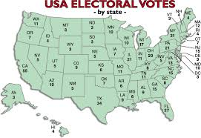
Electoral College
the system by which the Constitution details the election of the President - citizens of states vote to choose electors to represent their state and those electors vote for the President

Slide 22
Federalist
those in favor of the government established by the US Constitution

Slide 23
bicameral
a two-house legislature

