Slide 1
Quick Review
What has happened since we first started this class WAYYYY back when in August…

Slide 2
Pre-Colonial Days

Slide 3
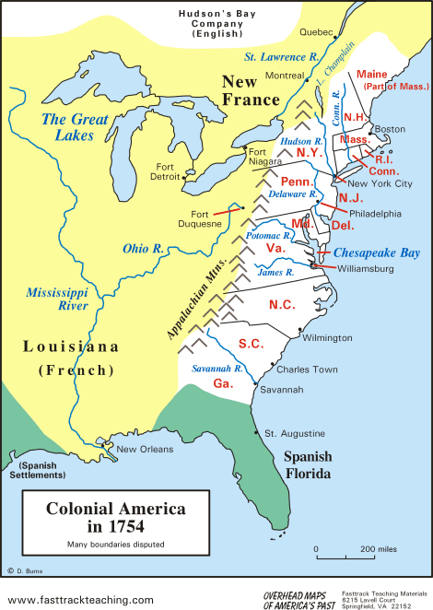
Colonial Period

Slide 4
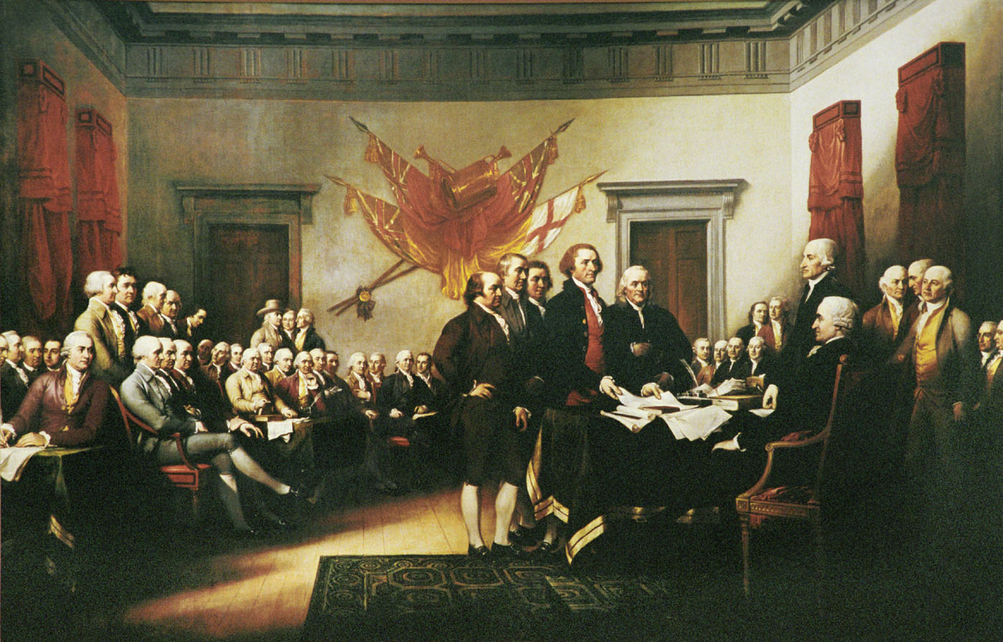
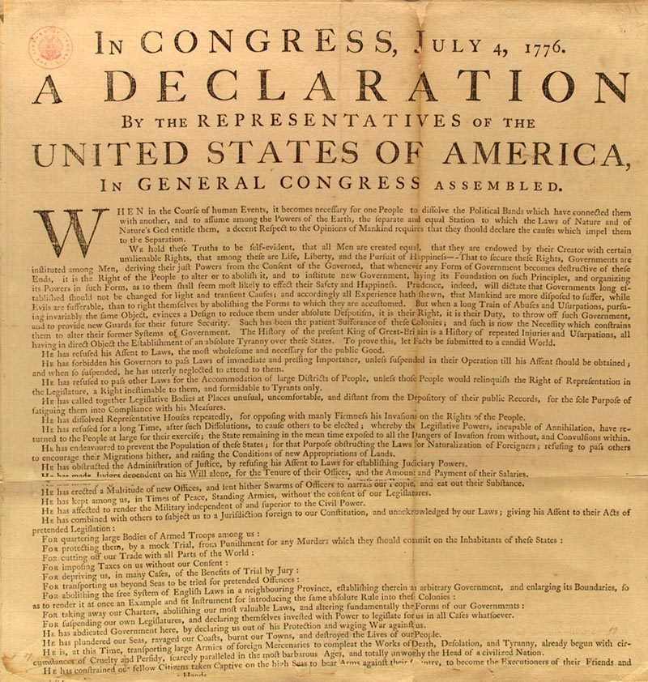
REVOLUTION!

Slide 5
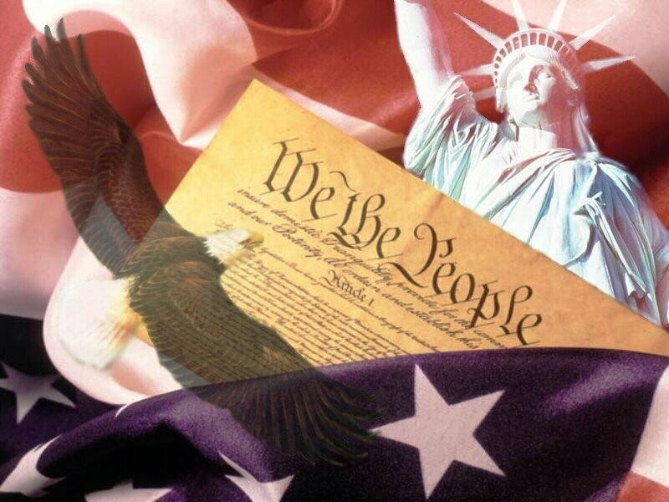
The Birth of a Nation

Slide 6
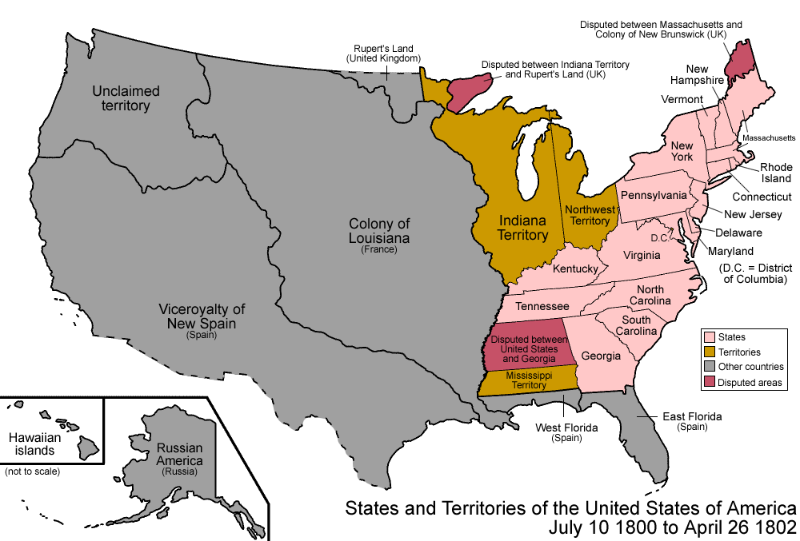
Westward Expansion…

Slide 7
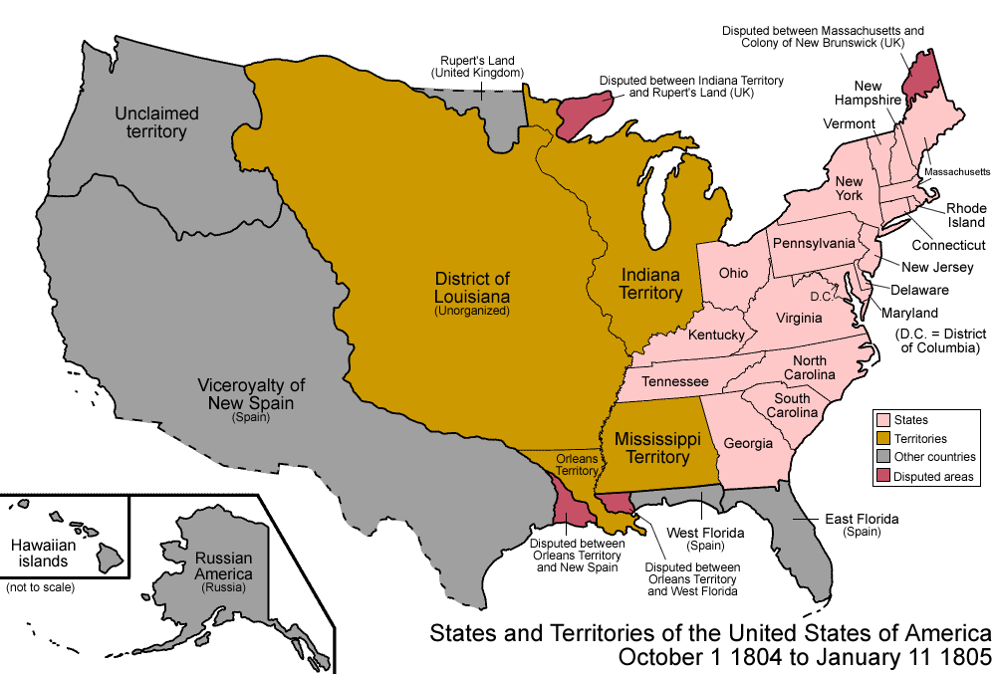

Slide 8
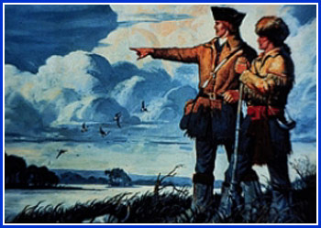
Lewis & Clark

Slide 9
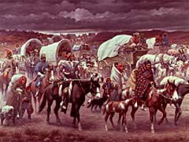
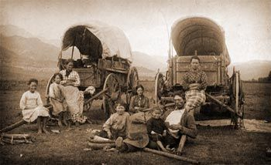
Go West Young Man
Trail of Tears
California Gold Rush
The Oregon Trail

Slide 10
Mexican – American War

Slide 11
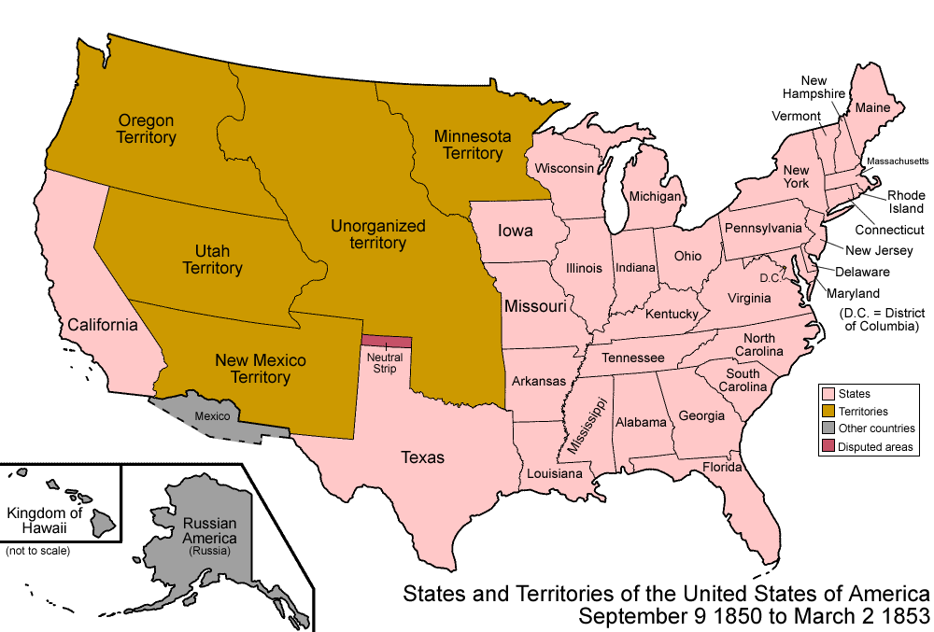
More Westward Expansion…

Slide 12
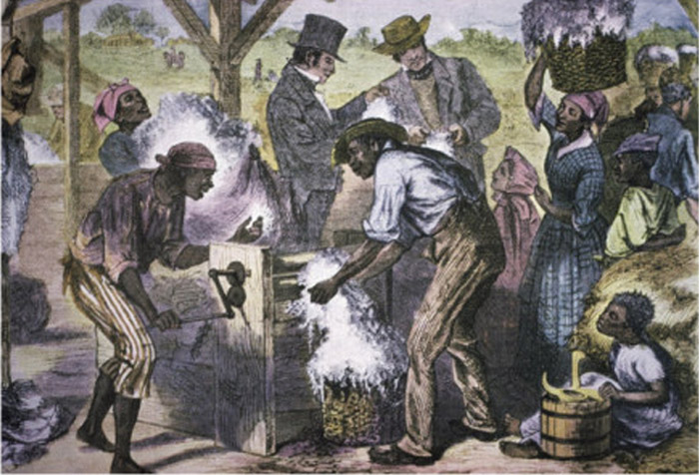
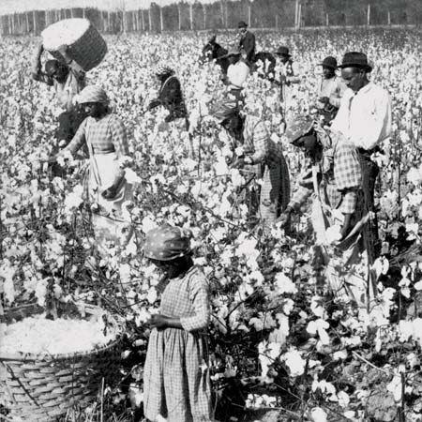
Slavery in the South

Slide 13
Unit 6 Key Terms
A Nation Divided

Slide 14
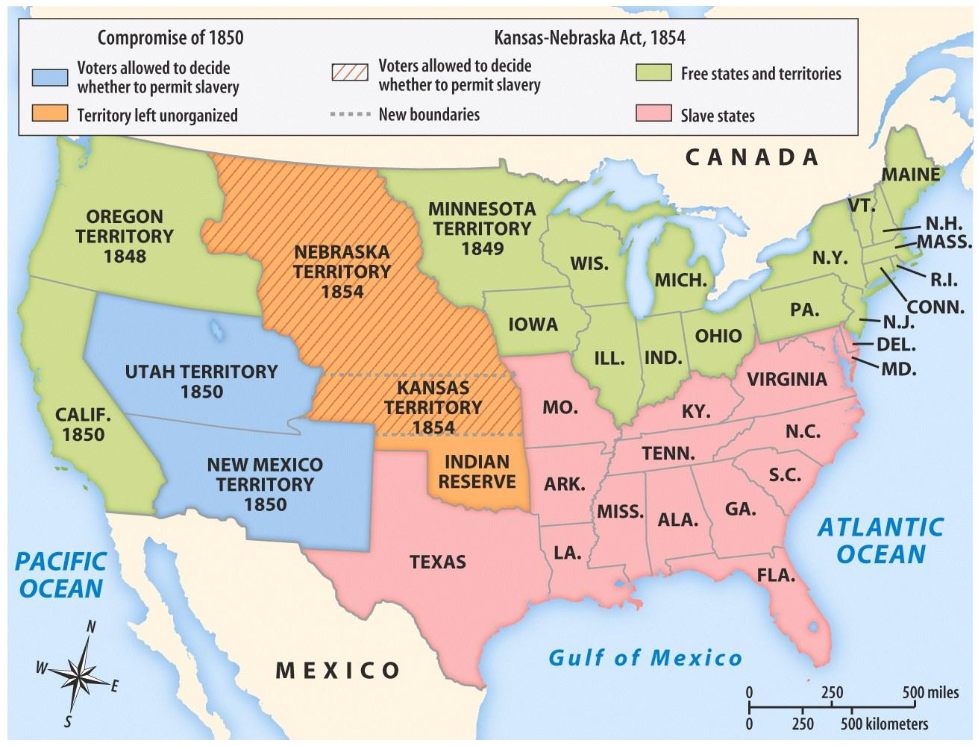
Sectionalism
excessive concern for local interests and customs

Slide 15
emancipate
legally freeing a slave by a master

Slide 16
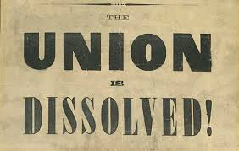
secede
To break away from a nation and become independent

Slide 17
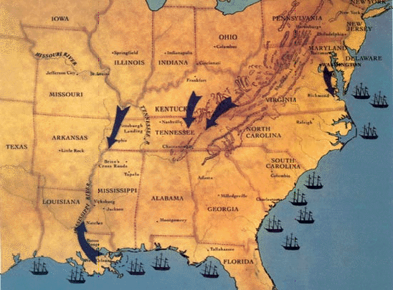
naval blockade
the use of a fleet of ships to prevent ships carrying supplies from reaching ports

Slide 18
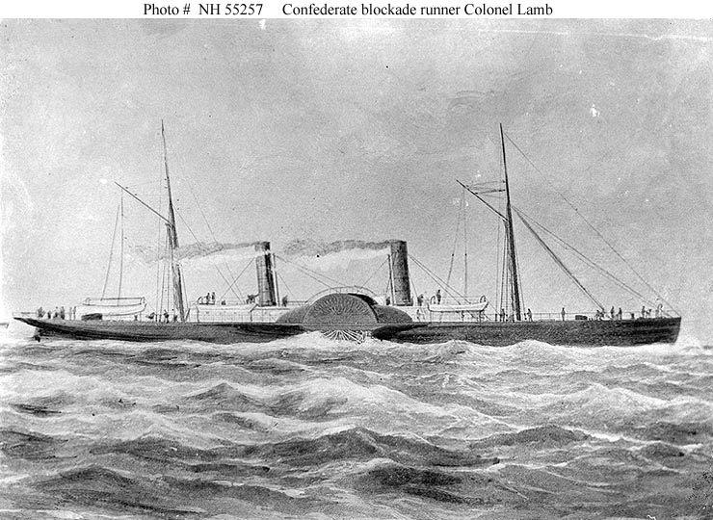
blockade runner
a low-lying steamship painted gray to match the ocean and fool pursuers that was able to slip through the naval blockade

Slide 19
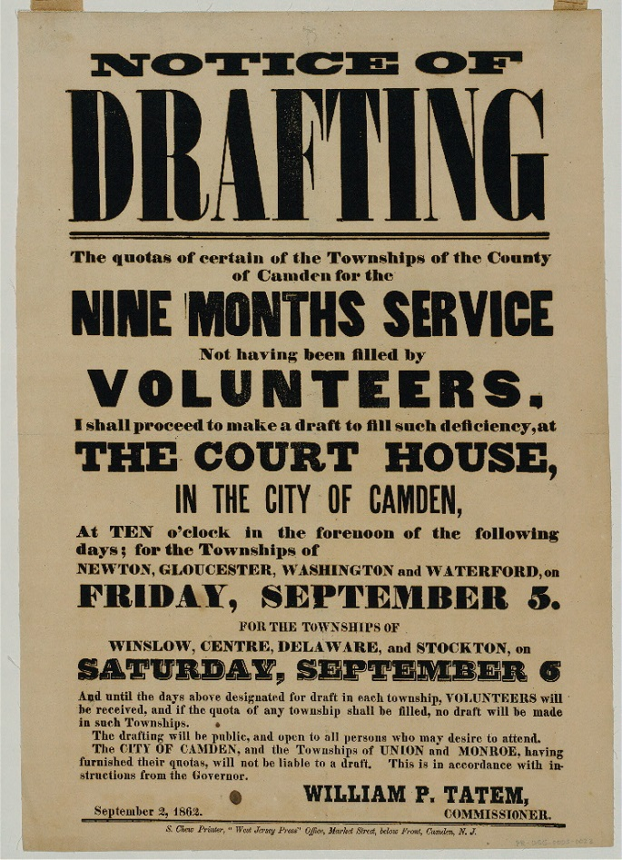
conscription
to force to join the military; a military draft

Slide 20
Confederate States of America
the government formed by the southern states that seceded from the Union in the early 1860s

Slide 21
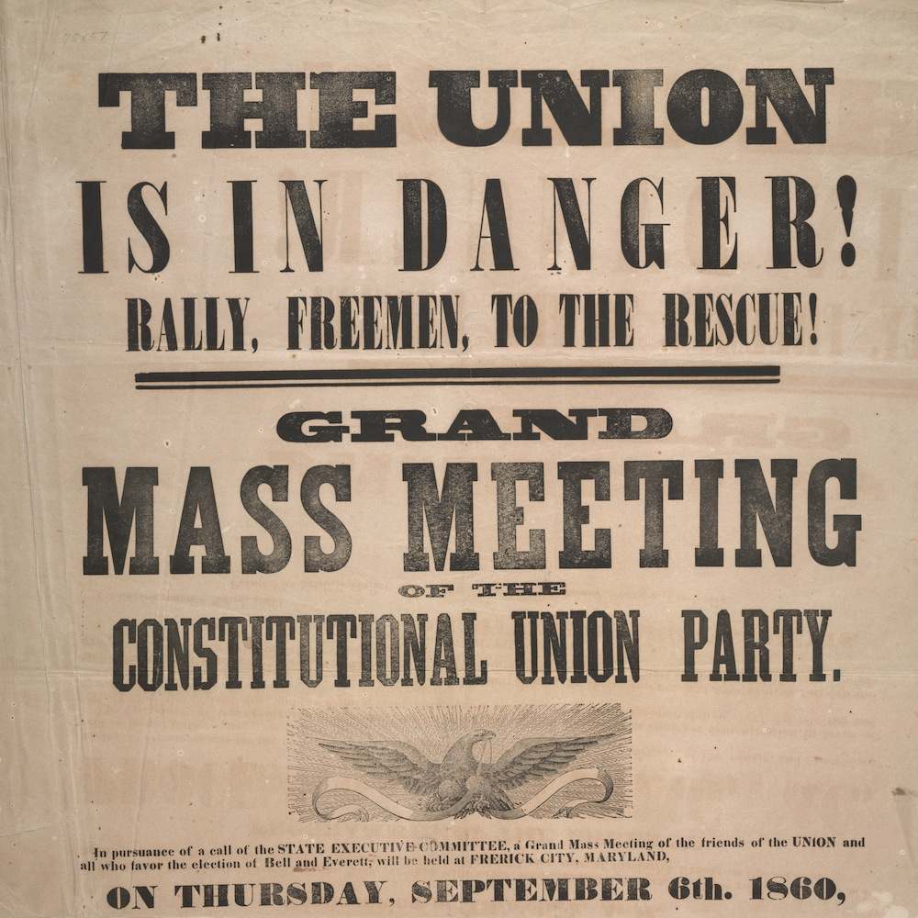
Unionist
one who wanted to stay in the Union

Slide 22
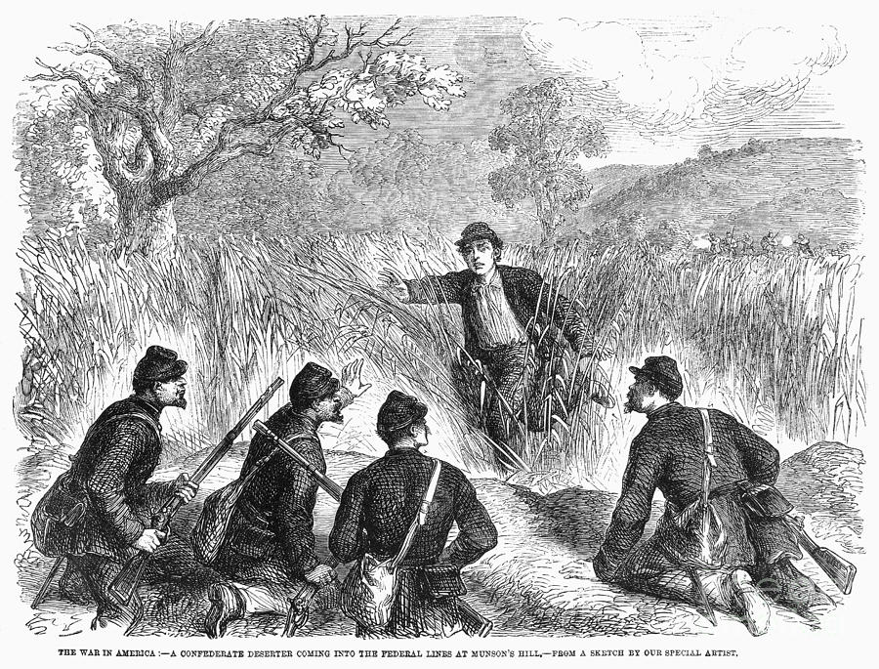
deserters
one who leaves or runs away from duty with no intention of returning

Slide 23
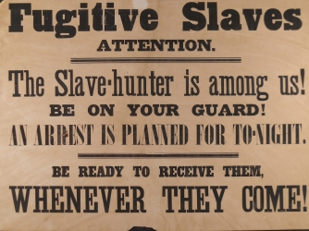
fugitives
a person who is fleeing from prosecution, intolerable circumstances, etc.

Slide 24
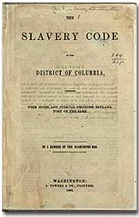
slave codes
laws in the South that kept enslaved persons from voting, moving freely, or meeting in large groups

Slide 25
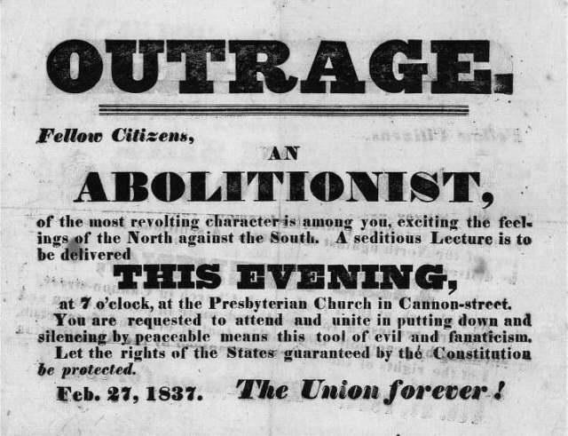
abolitionists
people who work toward abolishing (getting rid of) slavery

Slide 26
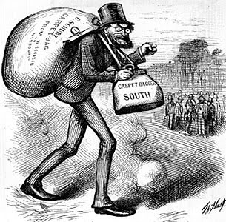
Reconstruction
the period after the Civil War when the South was reorganized and reintegrated into the Union (1865-1877)

Slide 27
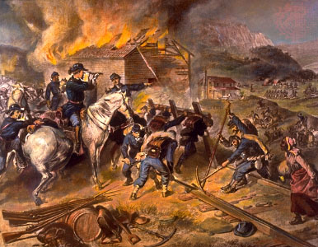
Total War
A style of warfare where the violence is not only against the enemy army but against civilians and the resources of your enemy

