Slide 2
Background Information
The first three presidents of the United States worked very hard to avoid war with Britain & France.
Despite these efforts and as a result of tensions with both nations, the United States went to war in June of 1812.

Slide 3
Nearpod Question
Who were the first three presidents of the United State?

Slide 4
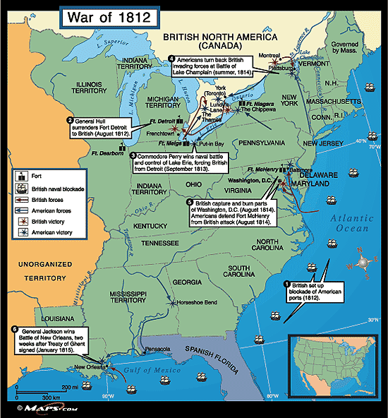
War of 1812

Slide 5
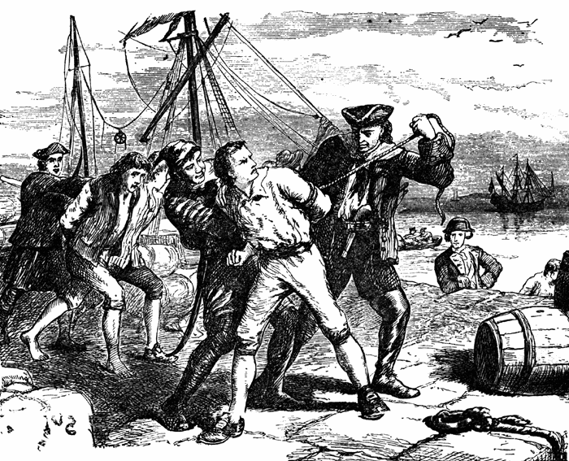
Ships Seized!
1803 Britain and France go to war again – US remains neutral
Both nations violate the United States’ neutrality
1805 – 1807 hundreds of US ships captured
Impressment – when the British
Navy captured and forced
thousands of US sailors to
serve on British ships

Slide 6
Jefferson Tries to Remain Neutral
Embargo Act (1807) – banned Americans from exporting or importing goods
hoped this would stop neutrality violations by cutting off supplies
Oops! This hurt Americans, especially in New England, more than it hurt Great Britain and France
Nonintercourse Act (1809) – allowed Americans to trade with any country EXCEPT Great Britain and France

Slide 7
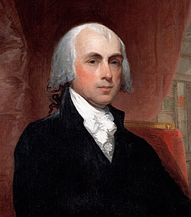
A New President
James Madison
becomes President
in 1809
Great Britain and France
continuing to violate
US neutrality

Slide 8
War of 1812 Video
James Madison & the War of 1812
http://www.history.com/topics/war-of-1812

Slide 9
To War or Not to War?
War Hawks – people in Congress who wanted war with Great Britain (mostly from the South and the West)
Reasons to go to war:
revenge for seizing sailors and ships
excuse to conquer Canada
believe Great Britain is arming Native Americans to attack settlers

Slide 10
To War or Not to War?
Others didn’t want war (mostly from the Northeast)
Reasons to avoid war:
They remembered the long and bloody Revolution and didn’t want “Round 2” with Britain
Believed war would harm American trade
NC was sharply divided on the question

Slide 11
Nearpod Question
If you were living in 1812 America, would you be for the war (War Hawk) or against the war?
For the war (War Hawk)
Against the war

Slide 12
Nearpod Question
Using your notes, tell me the reasons why you were either for or against the war??

Slide 13
War Begins
In June of 1812, Madison asks Congress to declare war on Great Britain
US navy has 16 ships and a small, inexperienced army
Great Britain was still fighting with France but sends some ships to blockade US ports
Blockade – prevent entry or exit

Slide 14
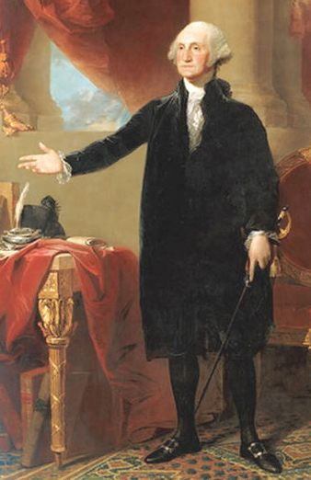
Washington is Burned
In 1814, the British had finally defeated Napoleon and were able to send more troops to the US.
The new British strategy was to seize the nation’s capital.
In August 1814, the British conquer Washington DC, and burn the Capitol and the White House, among other buildings. Government members are scattered.
Dolley Madison saves a treasured painting of George Washington from the White House before it was burned.
Notes:
August 1814

Slide 15
Nearpod Question
Draw what you think the burning of Washington looked like.

Slide 16
Burning of Washington
Burning of Washington (5:10 to end) 4 min http://www.youtube.com/watch?v=_LgV6KIDtoE

Slide 17
Battle of Baltimore
Battle of Baltimore (15 min) http://www.youtube.com/watch?v=CnRQ8-MMX28

Slide 18
Treaty of Ghent
War “ends” with treaty signed on Christmas Eve of 1814
STALEMATE!! No one gained or lost territory
The issue of impressment wasn’t even addressed! (But eventually faded on its own)

Slide 19
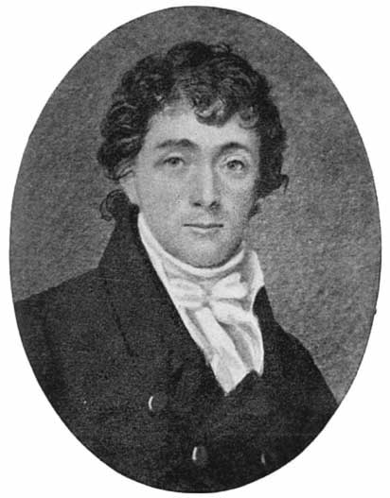
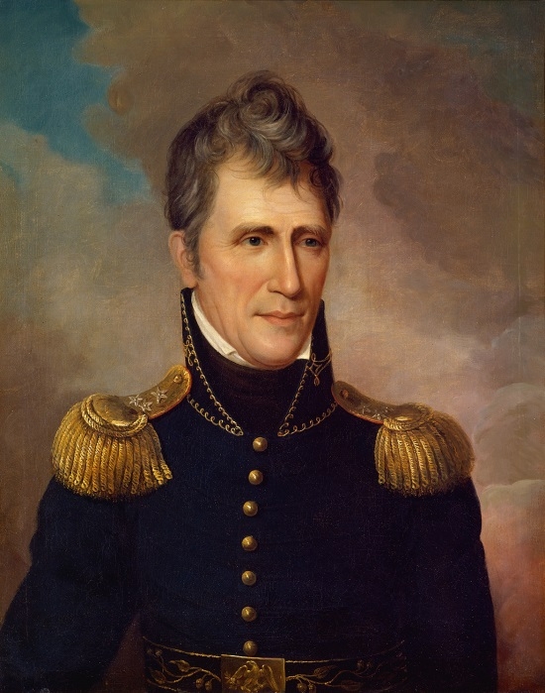
Other Key People and Events
Francis Scott Key wrote a poem “The Star Spangled Banner” while watching the attack on Fort McHenry in Baltimore Harbor
Andrew Jackson becomes a war hero at the Battle of New Orleans in January of 1815 (after the treaty to end the war had been signed)

Slide 20
Nearpod Question
Visit this site: http://www.history.com/topics/war-of-1812
Based on your reading & notes, summarize the War of 1812 with three facts.

