Slide 1
Unit 8 The Turn of the Century
Part 2: World War I

Slide 2
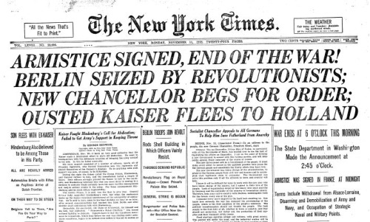
armistice
an agreement to stop fighting; the end of World War I

Slide 3
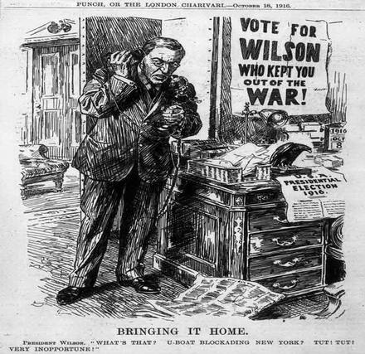
neutral
not taking sides during a conflict

Slide 4
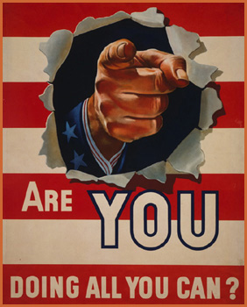
homefront
The civilian activities of a country at war
Examples: rationing, buying war bonds, victory gardens

Slide 5
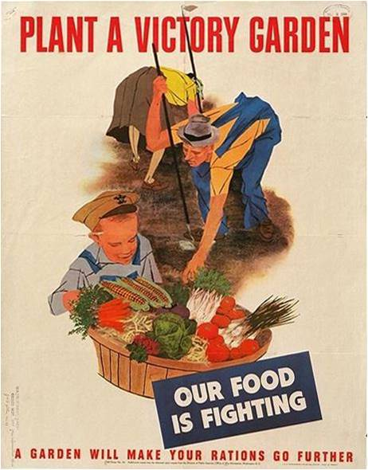
victory gardens
a vegetable garden, esp. a home garden, cultivated to increase food production during a war or period of shortage

Slide 6
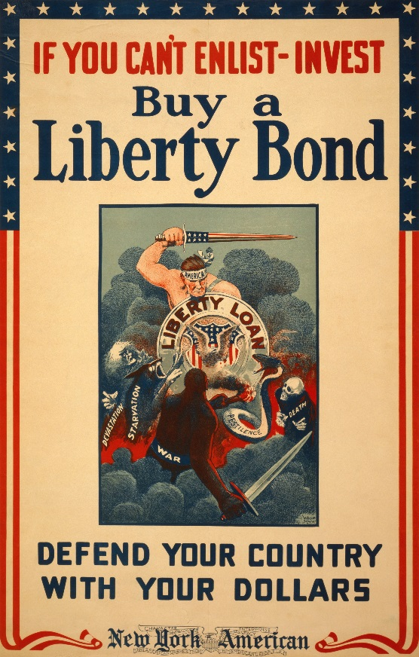
war bonds
a type of government bond used to raise funding for a war effort

Slide 7
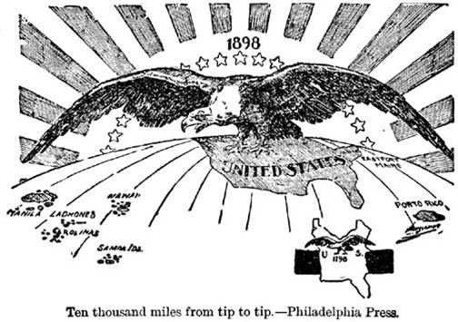
imperialism
the establishment of political or economic control over other countries; empire building

Slide 8
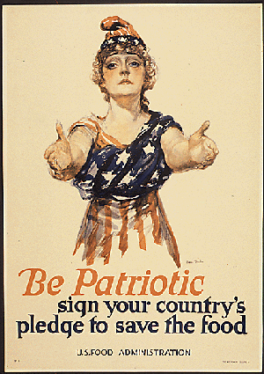
nationalism
excessive devotion and loyalty to one’s own nation/country

Slide 9
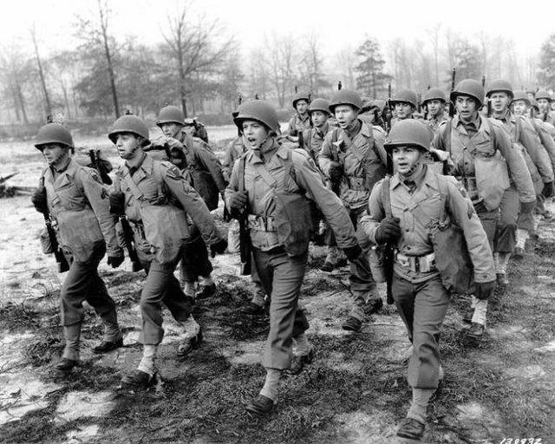
militarism
the principle or policy of maintaining a large military force

Slide 10
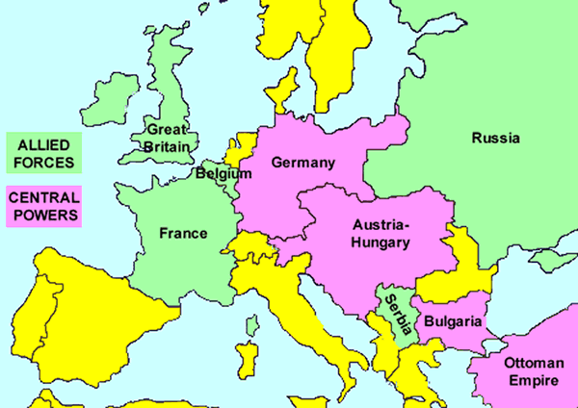
Central Powers
the World War I alliance that included Germany, Austria-Hungary, and the Ottoman Empire

Slide 11
Allied Powers
the World War I alliance that included Serbia, France, Great Britain, Russia, Japan, and later, Italy. The United States joined the Allies in 1917

Slide 12
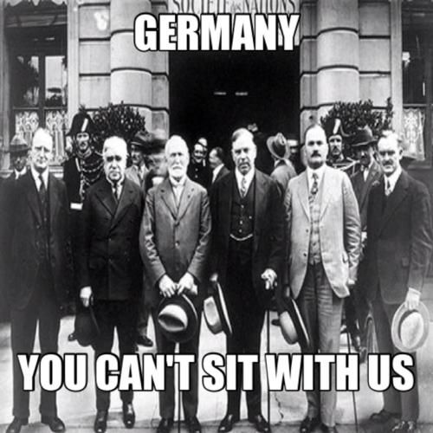
League of Nations
an organization of nations established at the end of World War I whose purpose was to maintain world stability

Slide 13
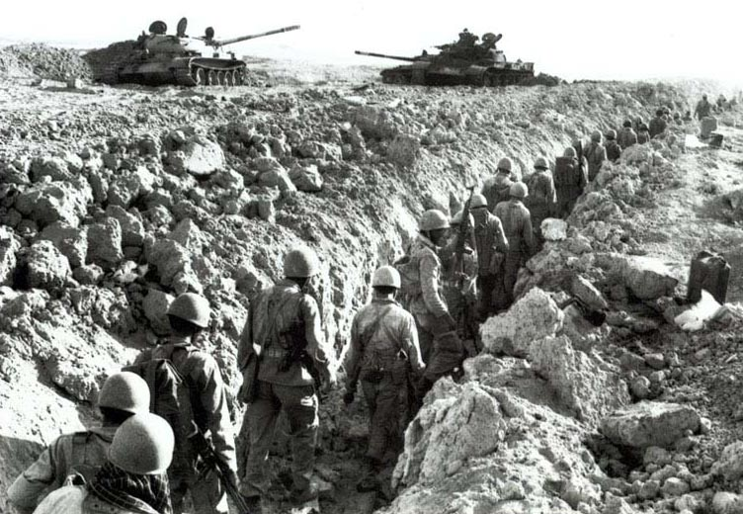
trench warfare
combat in which each side occupies a system of protective trenches

