Slide 1
Unit 11 – World War II
Vocabulary

Slide 2
Axis Powers
Germany, Italy, and Japan; these countries signed a pact in Berlin in 1940

Slide 3
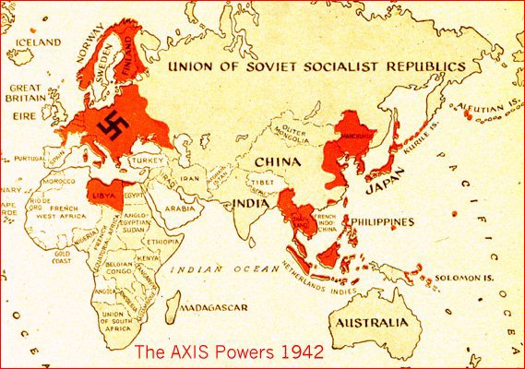

Slide 4
Allied Powers
The nations fighting against Nazi Germany during WWII; primarily the US, Great Britain, and Soviet Union

Slide 5
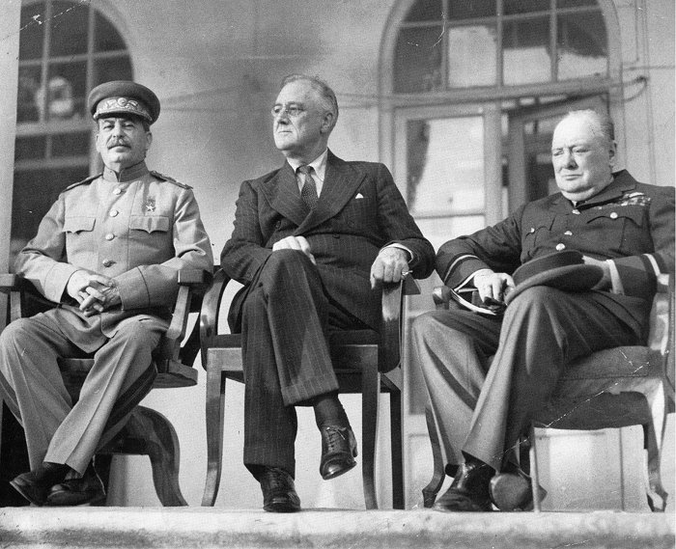

Slide 6
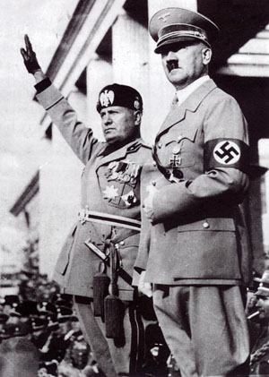
Dictator
An individual who rules a country through military might
http://www.history.com/shows/the-world-wars/videos/adolf-hitler

Slide 7
Fascism
Political system based on militarism, extreme nationalism, and blind loyalty to the state and its leader

Slide 8
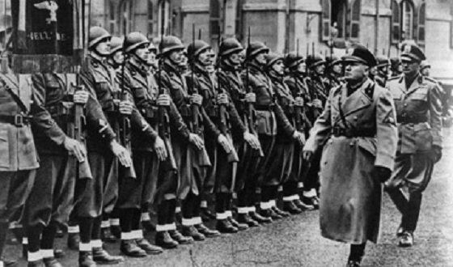
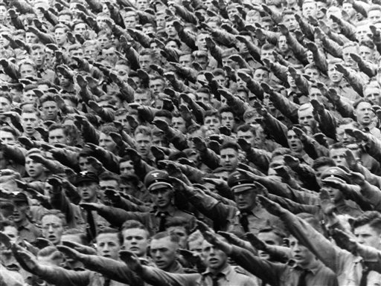

Slide 9
Nazi Party
The political party founded in Germany in 1919 and brought to power by Hitler in 1933 (National Socialist German Workers’ Party)

Slide 10
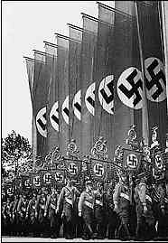
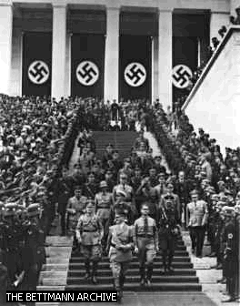
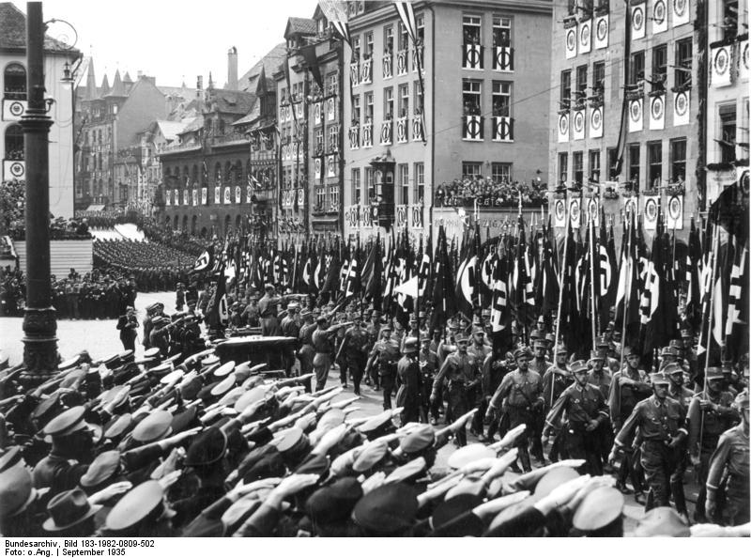

Slide 11
Blitzkrieg
A form of warfare (lightning) used by German forces in WWII. In a blitzkrieg, troops in vehicles, such as tanks, made quick surprise strikes with support from airplanes. These tactics were used by Germany in their attacks on Britain and France

Slide 12
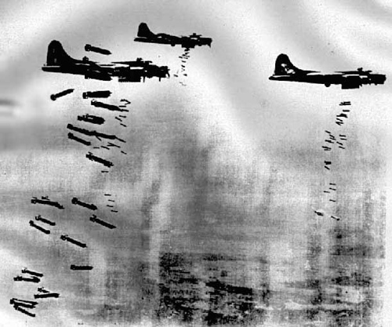

Slide 13
Anti-Semitism
Prejudice against Jews

Slide 14
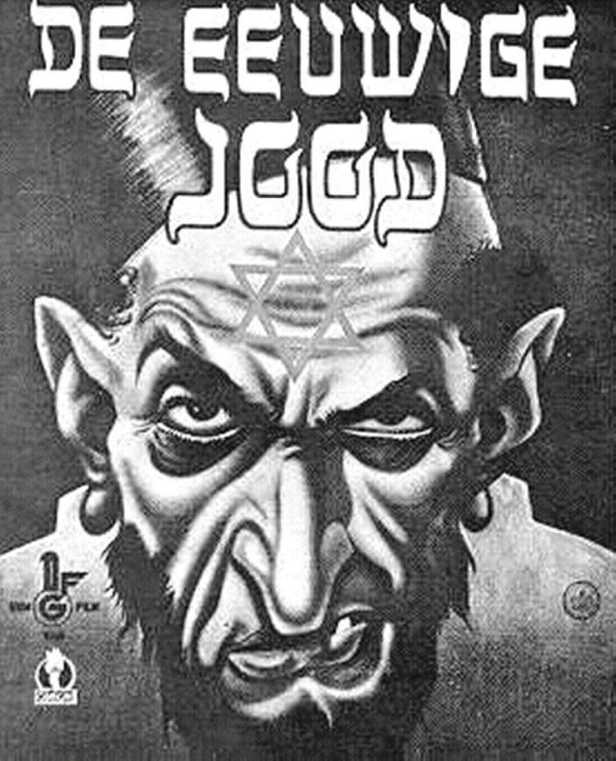
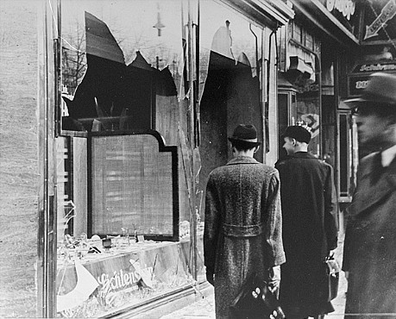
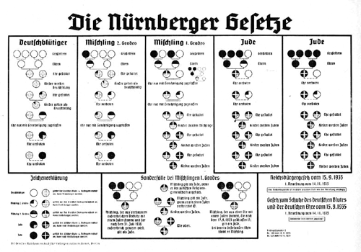

Slide 15
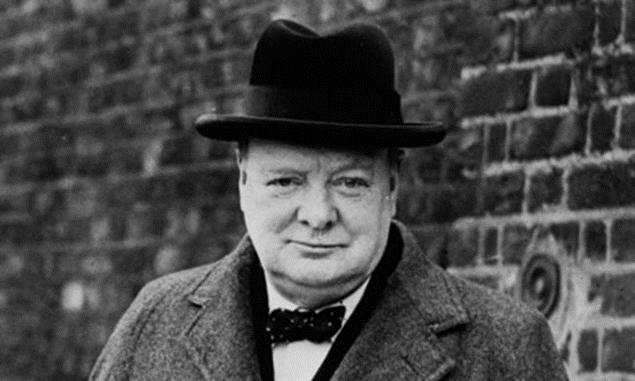
Appeasement
Policy of giving into aggression in order to avoid war

Slide 16
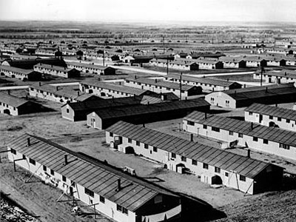
Internment camps
a prison camp for the
confinement of prisoners of
war, political prisoners, etc.
http://www.history.com/topics/world-war-ii/japanese-american-relocation

Slide 17
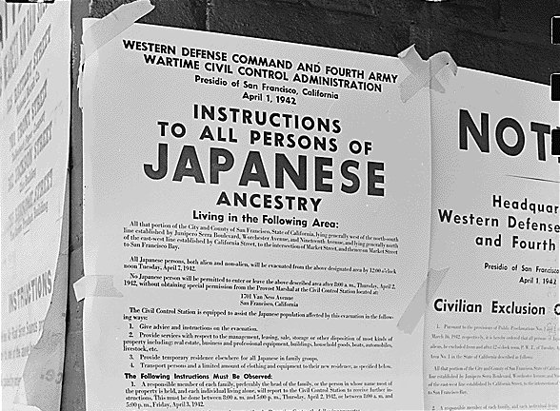

Slide 18
The Holocaust
Term that refers to the systematic, planned extermination of Jewish people during WWII

Slide 19
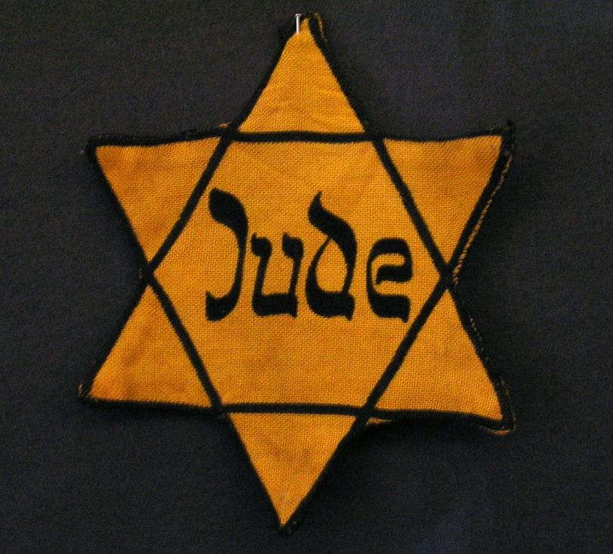
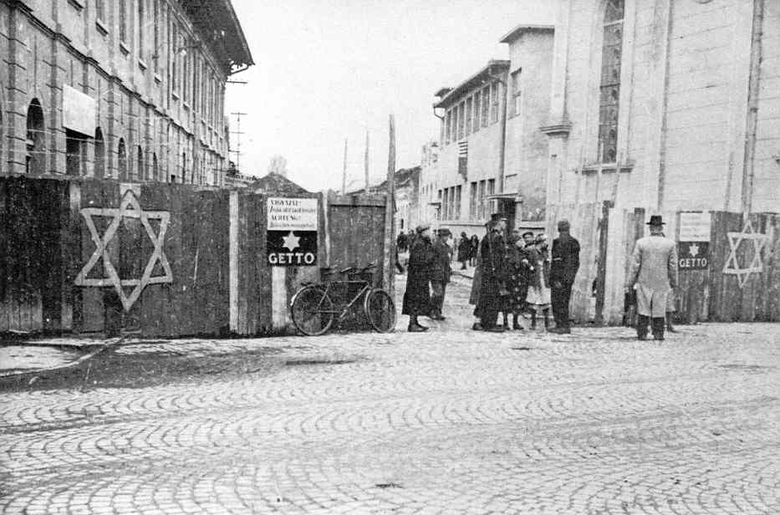
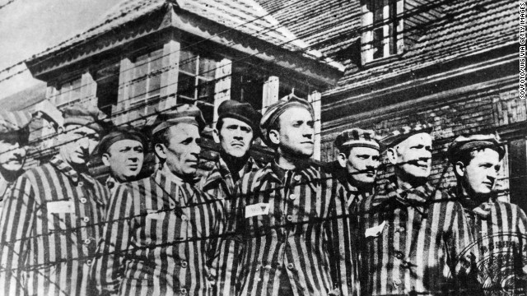
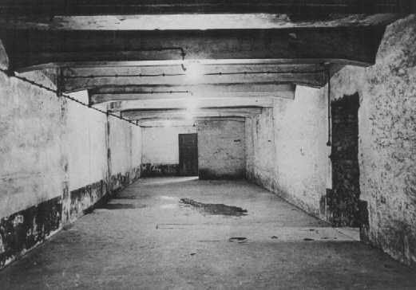

Slide 20
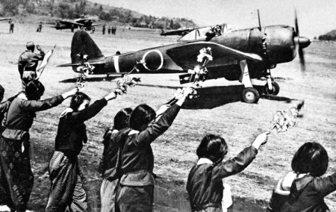
Kamikaze pilots
WWII Japanese pilots trained to make a suicidal crash attack, usually upon a ship

Slide 21
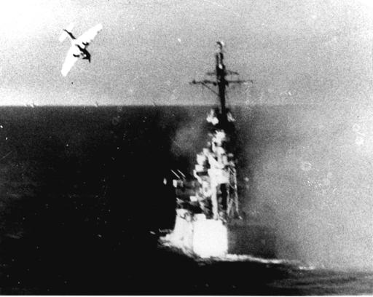

Slide 22
D Day
June 6, 1944, the day of the invasion of western Europe by Allied forces in WWII
Eisenhower's D-Day Message
Allied Invasion of Normandy

Slide 23
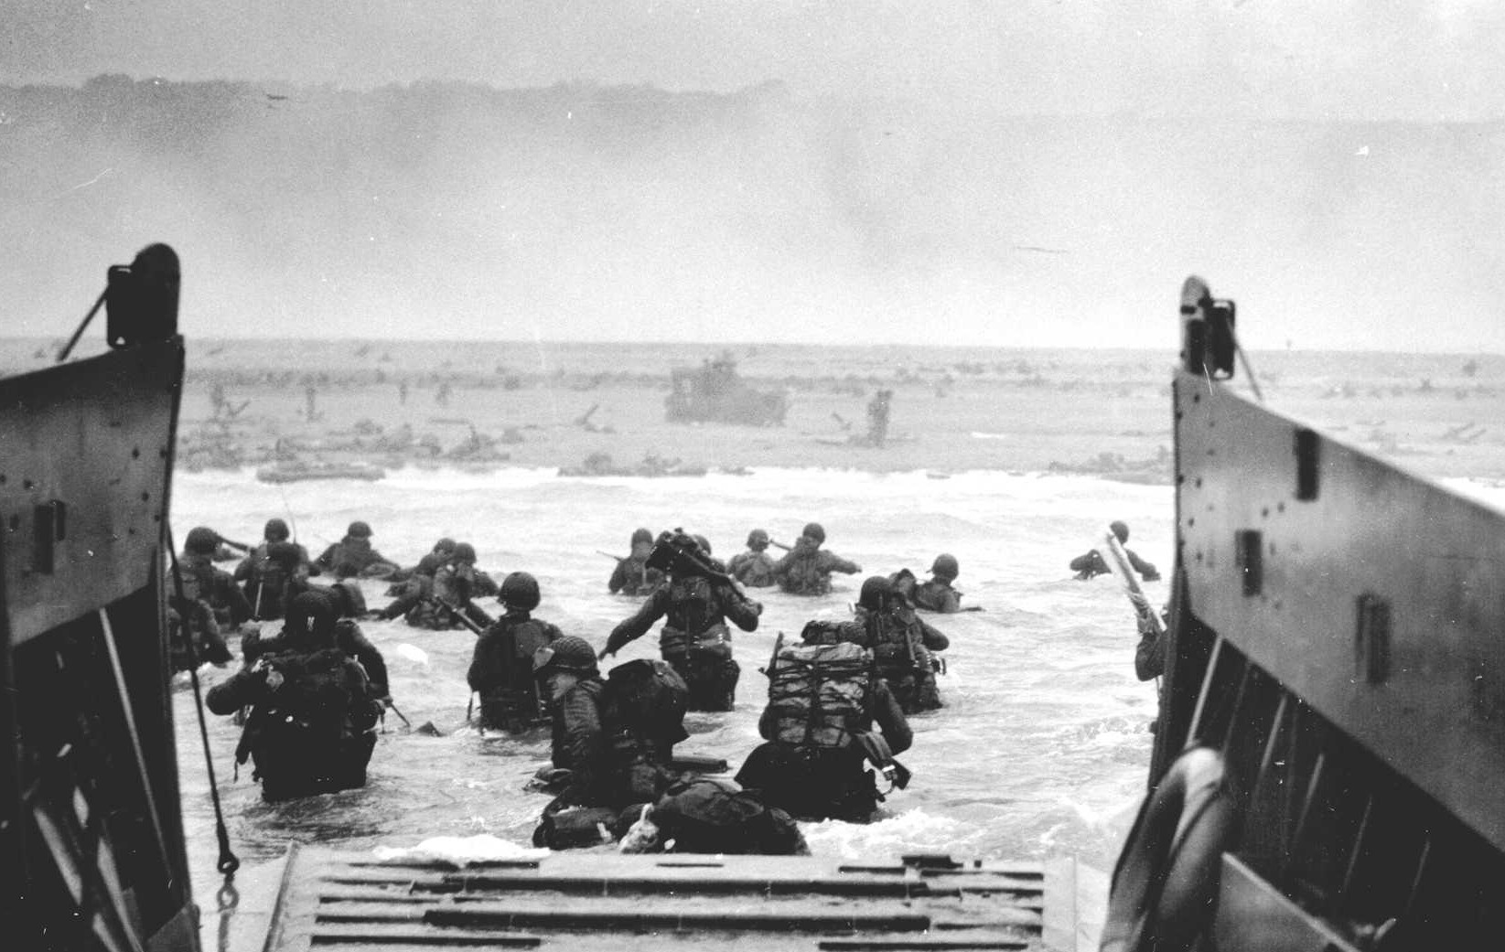

Slide 24
United Nations
The United Nations was formed after WWII as a successor to the League of Nations and has served as a forum for many international disputes

Slide 25
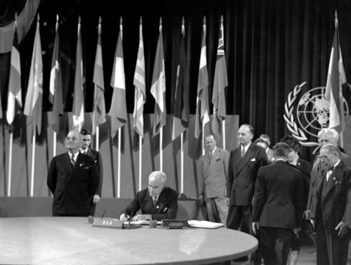

Slide 26
Torpedo Junction
The area off the coast of Cape Hatteras that was the sight of American and U-boat bombings during the early years of WWII.

Slide 27
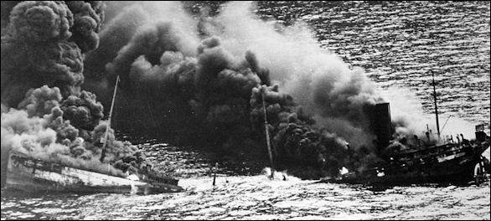

Slide 28
Manhattan Project
The unofficial designation for the US War Department’s secret program, organized in 1942, to explore the production of an atomic bomb

Slide 29
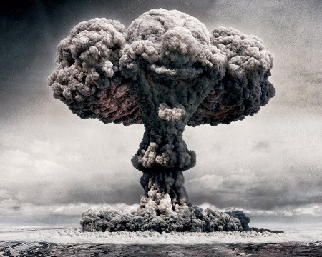

Slide 30
V-E Day
May 8, 1945, the day of victory in Europe for the Allies in WWII
https://youtu.be/GuhnGbkvu8o

Slide 31
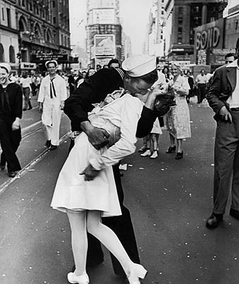

Slide 32
V-J Day
August 15, 1945, the day Japan accepted the Allied surrender terms in WWII

Slide 33
